Slide 1
Progressives- Review

Slide 2
Important Terms
Progressives- Political group that promised and fought for change in industrial America
Trust- Name given to monopolies during the Progressive Era

Slide 3
Main Issues Of The Progressive Movement
Health issues
Poverty
Corporate corruption
Women’s vote

Slide 4
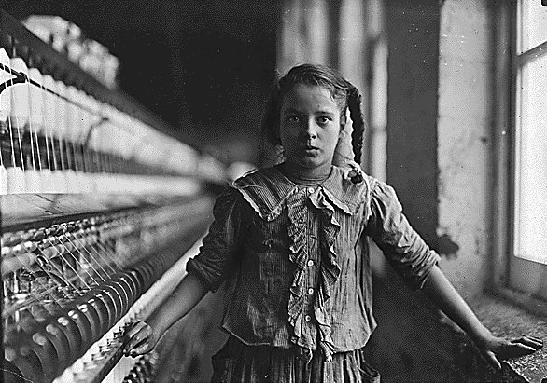
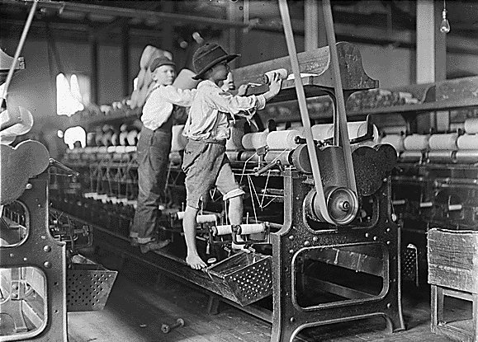
Child Labor
There were 2 million child laborers in the US
Most of the unskilled workers in factories (cotton mills) were children
No enforced age limit or working hours

Slide 5

Muckrakers
They demand social improvement through political action
The main tactic of the movement was to get the public involved and government intervention to stop the worst offenders
There had always been muckrakers but the photograph changed the impact b/c there was evidence, not opinion
Muckrakers= Writers who exposed social and political corruption

Slide 6
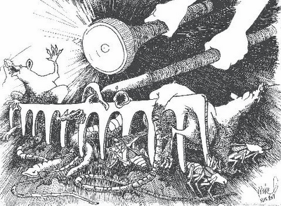
Write down at least 2 objects on the cartoon.
Write down the possible meaning.

Slide 7

The Jungle by Upton Sinclair
Upton Sinclair’s “The Jungle”
Wrote about meat packing plants
This book describes the filthy conditions of stored meat and danger to the workers
The conditions horrified the public into demanding changes in the industry

Slide 8
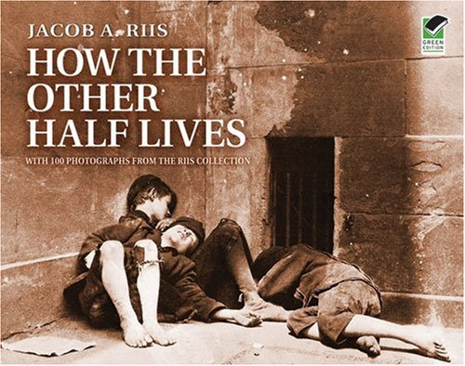
Riis was a homeless, poor immigrate when he first made it to the US
The book describes the poverty, disease and crime of NY
Rich citizens donated $ and put public pressure on politicians to make changes

Slide 9
Political Changes From The Progressives
Referendum- referring measures proposed or passed by a legislative body to the vote of the electorate for approval or rejection.
#57, 2008 | Yes | For- 1,058,995 | Against- 665, 942 | Increased sen. for drug offenses
# 80, 2012 | No | For- 810, 538 | Against- 923,071 | Allows personal marijuana/ sale

Slide 10
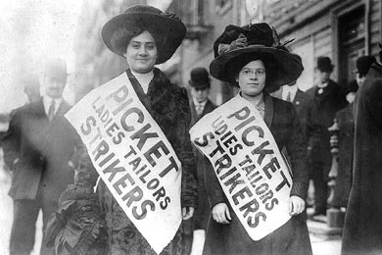
Garment Strikes
Nov. 23, 1909, more than 20,000 Slavic/ Jewish immigrants (mostly women, teens/ 20s) launched an 11 week strike against the NY garment industry
Bail averaged $2,500 a day, court fines of $5,000
10 year old girl was sent to a workhouse for 5 days w/out a trial
The strike cost the factory over $100,000 in profits
The women won only a few demands but started a 5 year campaign for better working conditions

Slide 11
Results
52 hour work week
4 holiday paid day per year
Provision of tools and material w/out fees
Better wages

Slide 12
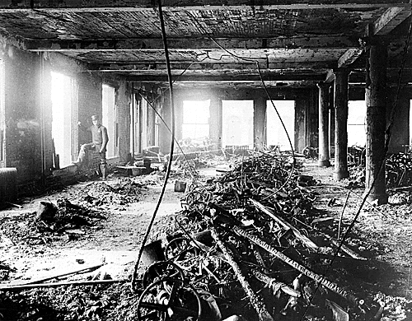
Triangle Shirtwaist Fire
Fire engulfed top 3 floors—200 workers trapped on 8th floor
146 people died, mostly teenage girls—smoke inhalation, burned, jumped
3 days to identify bodies
Owners tried for manslaughter—not guilty; no laws to break
Factory opened within weeks

Slide 13
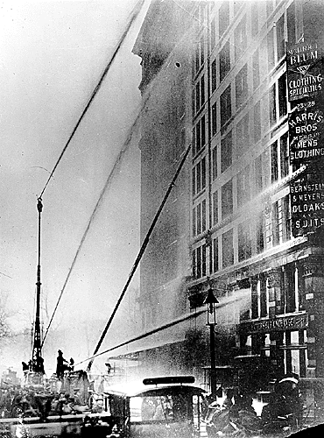
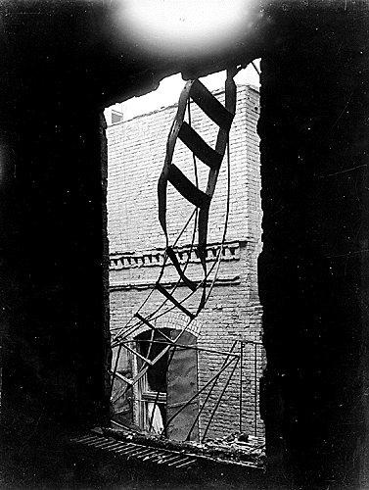
Triangle Shirtwaist Fire

Slide 14
Changes From the Fire
Unions forced owners to take responsibility for workers
Doors opened out, indoor sprinklers and multiple exit became the law
Laws established for safety, working conditions, hours, age
People use power of the state to change peoples’ lives

Slide 15
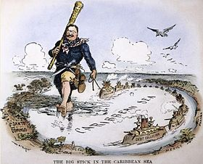
Big Stick Policy
Teddy would threaten US attacks if nations did not do what he wanted
The US would do more, if Europe tried to do more
He said that the Monroe Doctrine gave the US only the right to intervene in Latin America
This was known as the Roosevelt Corollary (addition to an established idea)
Like in the Dominican Rep. was going bankrupt, he stated that only the US could stabilize the Latin American nations

Slide 16
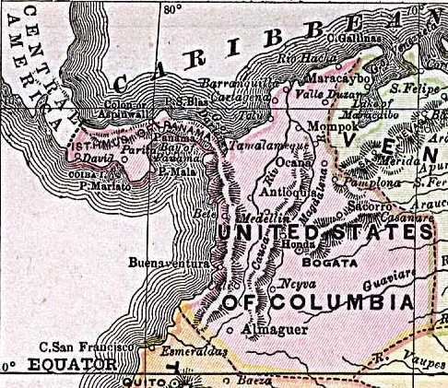
Panama
Panama was under the control of Columbia
The people of Panama had fought several times for independence
The French were the first to try and build a canal but failed
Disease and difficult terrain, or land, made the French quit; over 20,000 dead

Slide 17
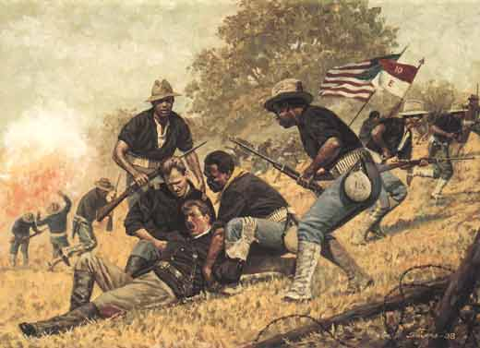
Reasons For Canal
During Spanish American War, the US tried to send ships to Cuba
It took the USS Oregon 74 days to get to Cuba
The US wanted a shorter/less dangerous route through Latin America

Slide 18
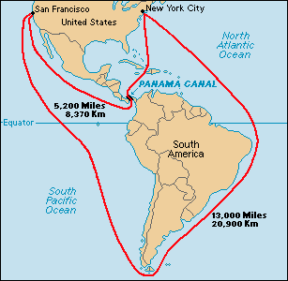

Slide 19
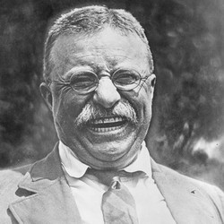
Teddy Roosevelt, the President
After he became President he sent US ships to coast of Panama (Columbia)
This blocked Columbia from trying to stop the Panamian rebellion, 1903
He used the Monroe Doctrine for the justification of this
Columbia did not want to fight the US, so Panama became independent
Hay-Bunau-Varilla Treaty was signed Nov. 8, 1903- which gave exclusive rights to the US, owning 10 mile strip on the canal zone
Panama received $10 million and an annuity of $250,000 beginning nine years later

Slide 20
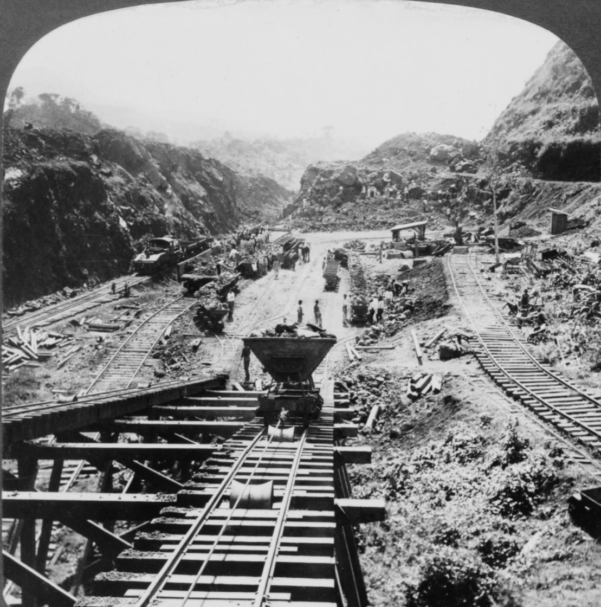
Building The Canal
Swamps were drained to lessen disease, estimated $10 a bug, sprayed oil over
Conditions were very difficult and many workers died
Landslides, malaria were the top killers of the workers; killed of mosquito in 10 mile area
The Canal cost $380 million dollars and thousands of people died
The US owned the land of the canal (99 year lease), 10 miles wide, 50 miles long
Built 1904- 1914, open to the public 1918
However, the US and Panama have made millions by charging ships to use the canal

Slide 21
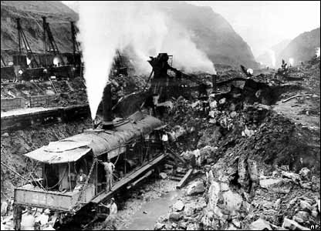
Building The Canal, cont…
The Canal cost $380 million dollars and thousands of people died
The US owned the land of the canal
However, the US and Panama have made millions by charging ships to use the canal

Slide 22
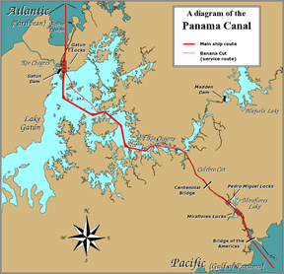
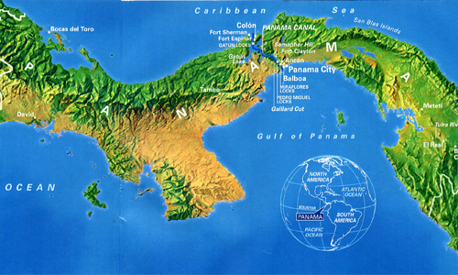
Panama Canal

Slide 23
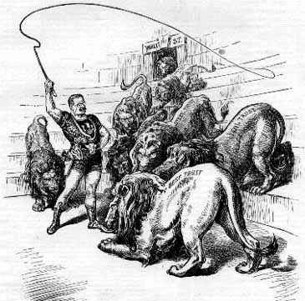
Trust Busting
He was not bought like 99% of the Congressmen, he was independent
TR believed in a “square deal”= Fair chance at achieving success
Sherman Antitrust Act- Declared monopolies illegal, no teeth
The US had repeatedly sided w/ big business before his presidency, American Refining Company owned 98% of the sugar industry but the Supreme Court ruled not a monopoly
He brought a lawsuit against JP Morgan 5 months into office to stop him from buying more RR companies
The case went all the way to the Supreme Court, won barely decided in favor of the gov.
TR became known as a “trustbuster

Slide 24
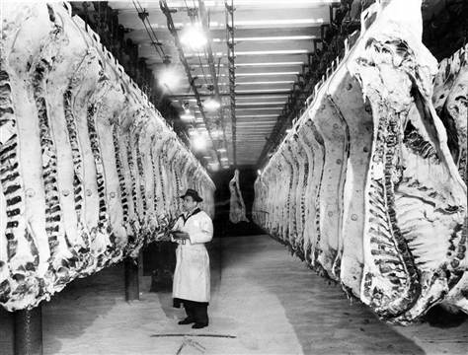
Reforms in Food
TR read the Jungle and was friends with Sinclair
The Pure Food and Drug Act passed in congress in 1906, w/ TR’s support
This prohibited the manufacture, sale or shipping w/out government inspection
Coca-Cola replaced cocaine with caffeine but violated the Pure Food Act with too much
The company had to settle out of court and reduce the amount of caffeine

Slide 25
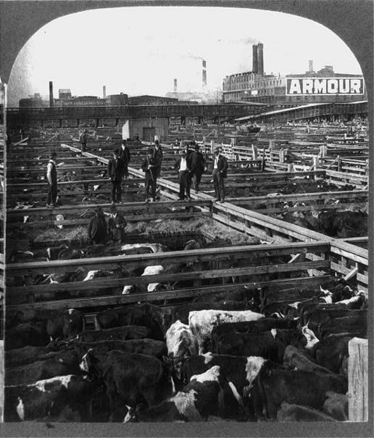

Slide 26
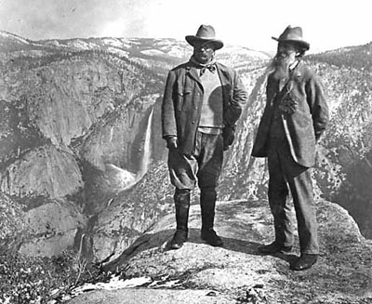
National Parks
He loved to be outdoors; hunting, sightseeing…
He created five national parks (2x existing number); 18 national monuments and more than 140 million acres' worth of national forests
Including the Grand Canyon, which there were talks of filling with garbage before this

Slide 27
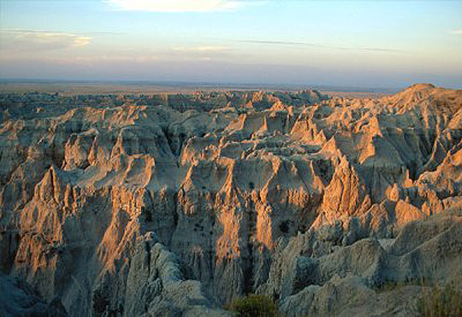
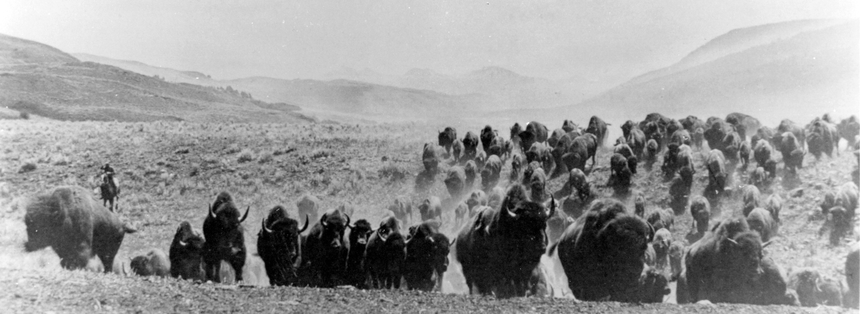

Slide 28
Women’s Right To Vote
Known as the suffrage movement
Although this movement began in 1848, the greatest gains were made during the Progressive era

Slide 29
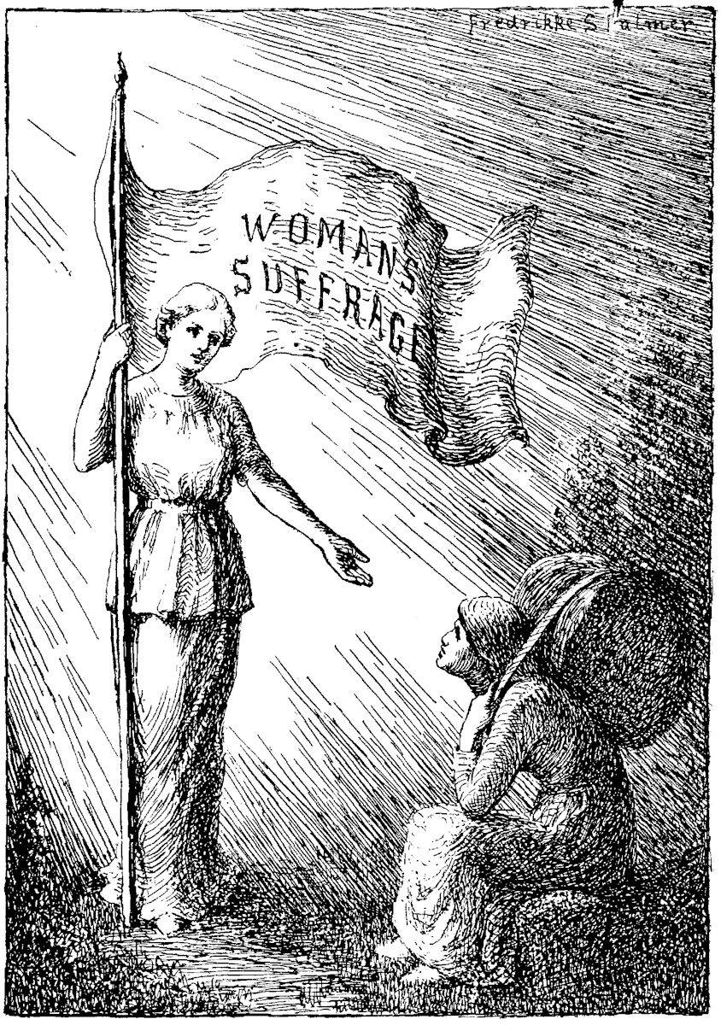
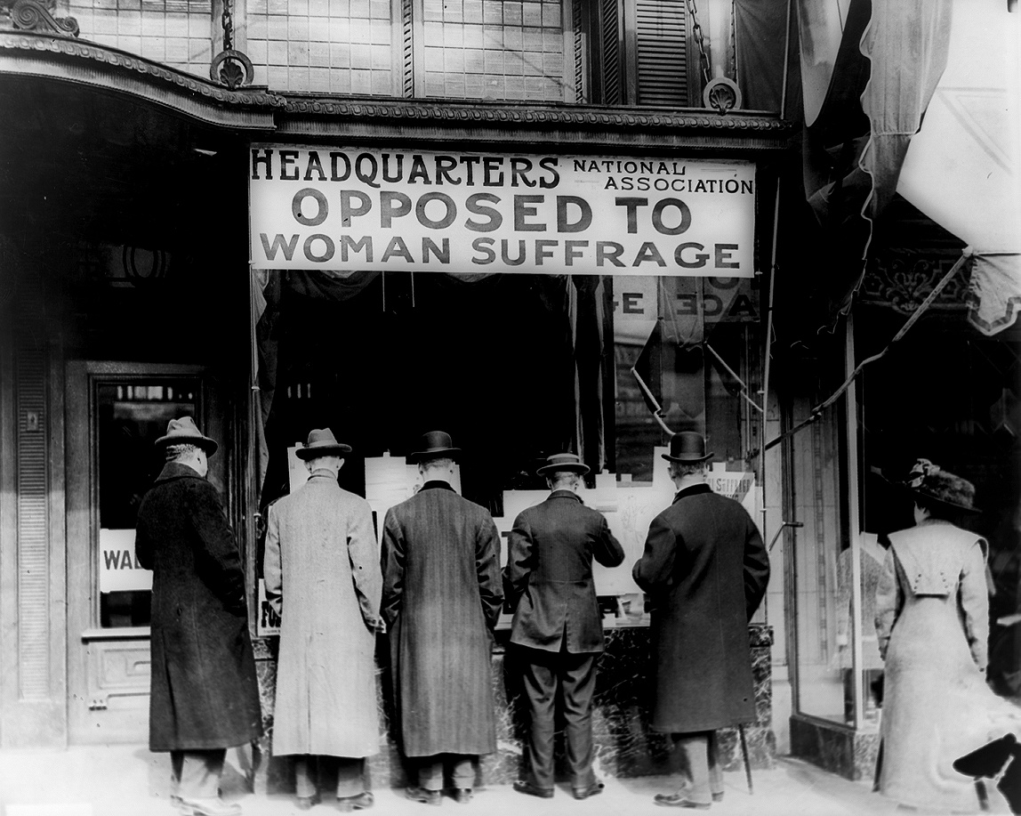

Slide 30
The slow start to suffrage was because abolition of slavery was a priority during the 1850- 60s
Black male suffrage was seen as a higher priority and the movement was afraid of asking for too much at one time
National Woman Suffrage Association was split into 2 groups:
  1. Constitutional amendment
  2. Gain state support first, and then go to the national government

Slide 31
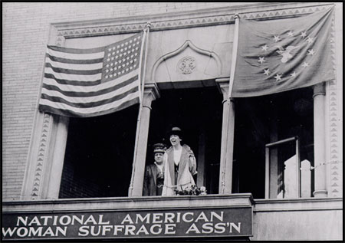
1. Constitutional amendment | 2. Gain state support first, and then go to the national government

Slide 32
The 2 groups joined together later as the National American Woman Suffrage Association
Political gains were not made until 1910 because of the internal fighting
One reason for the gain was that working women wanted voting rights to protect for better labor laws
Big businesses opposed the movement b/c they more power in the hands of the workers
More safety codes= less profits and more unions

Slide 33
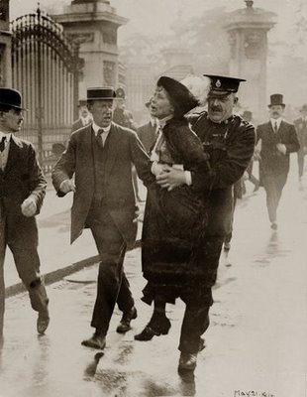
  Quaker social worker
  She the NAWSA congressional committee and organized the Washington March
  After she felt the NAWSA was moving to slow, she made her own radical group
  Her supporter picketed the White House, chained themselves to lampposts and went on hunger strikes if arrested
Alice Paul

Slide 34
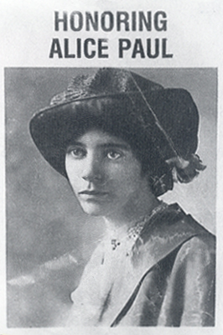
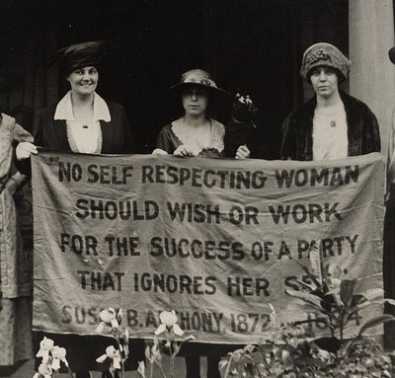

Slide 35
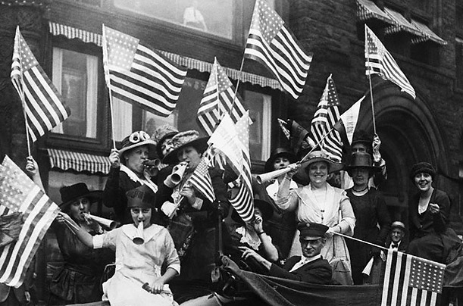
1869 Wyoming became the first state to give voting rights to women
During the Progressive era, more states did the same
Carrie Catt; member of the state first branch, used Suffrage money to defeat 2 anti-suffrage Senators
On Aug. 26, 1920 3/4 of the states in the US voted to pass the 19th amendment granting women the right to vote

