Slide 1
WWI- Review

Slide 2
Nationalism
Nationalism- Strong connection with one’s nation
Borders meant that we are all the same and we have to protect ourselves

Slide 3
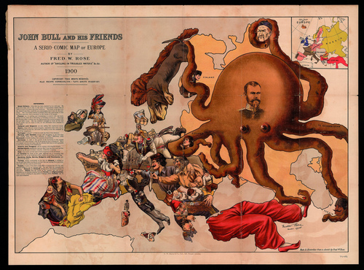

Slide 4
Storm Clouds Over Europe
Europe has nearly always been at war with itself.... too many cultures & not enough space to co-exist peacefully.
National borders constantly changing after each new war in Europe.
The memories of the defeated don’t fade easily or quickly.

Slide 5
Entangling Alliances
(a recipe for war)
Treaty of the Triple Alliance between…
  Germany
  Austria-Hungary
  Turkey (The Ottoman Empire)

Slide 6
Entangling Alliances
(a recipe for war)
Treaty of the Triple Entente between…
  Russia
  France
  UK

Slide 7
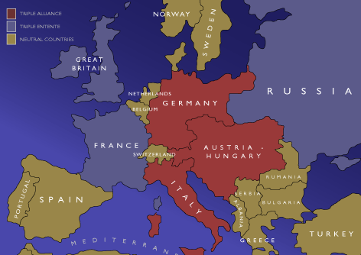
The Alliance System

Slide 8



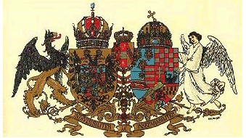
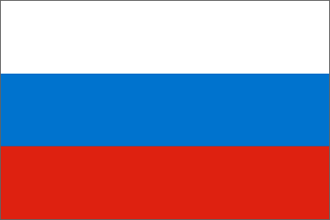

1. The Alliance System
Triple Entente:
Triple Alliance:
UK
Germany
France
Austria- Hungary
Russia
Italy

Slide 9
Germany’s Desires For War
Germany wanted to be recognized as a world power
Germany wanted a greater empire= more colonies

Slide 10
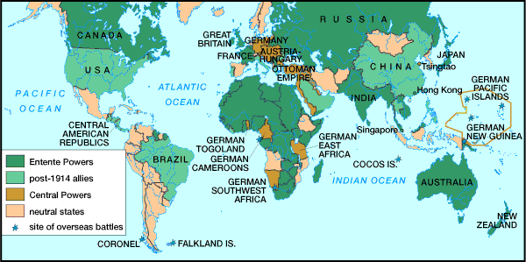
Economic & Imperial Rivalries
At the end of the 19th century, all of the major European powers fought for and gained empires throughout the world, the largest in Africa
Germany felt overshadowed and wanted a “place in the sun”
The Industrial Revolution demanded a steady stream of resources to continue its growth, which cause fighting over areas with resource potential

Slide 11
Militarism
As Germany increased military spending, so did the rest of Europe
By 1914, almost all of the European nations had a large surplus of weapons

Slide 12
Militarism & Arms Race
Total Defense Spending for the Great Powers [Ger., A-H, It., Fr., Br., Rus.]
in millions of £s.
1870 | 1880 | 1890 | 1900 | 1910 | 1914
94 | 130 | 154 | 268 | 289 | 398
TQ: Why would the European nations build up their military during this time?
 | 1910-1914 Increase in Defense Expenditures
France | 10%
Britain | 13%
Russia | 39%
Germany | 73%

Slide 13
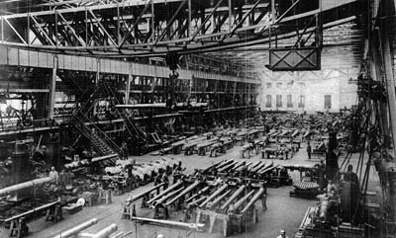
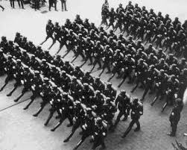
Germany before WWI

Slide 14

The “Powder Keg”
The Alliance System
European Rivals
The Balkans

Slide 15
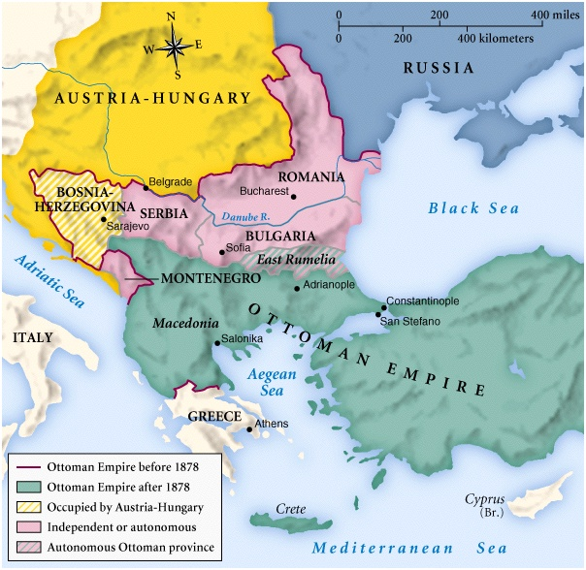
The Balkans in 1878
Tensions began when Austria- Hungary annex (took over) part of the Ottoman Empire; Bosnia, on October 6, 1908
Turkey (Ottomans) fought 3 wars in 1912 and 1913 over the Balkans
Many of the smaller Balkan nations began to desire independence b/c of the frequent wars in the region, with many of the ethnic group identifying themselves as Slavic
Austria-Hungary maintaining control over the region and discontent was at a high

Slide 16
The Spark that Ignites Europe
June 28, 1914 Sarajevo
  Archduke Francis Ferdinand assassinated by a Serbian terrorist, who wanted Bosnia to be its own nation.

Slide 17
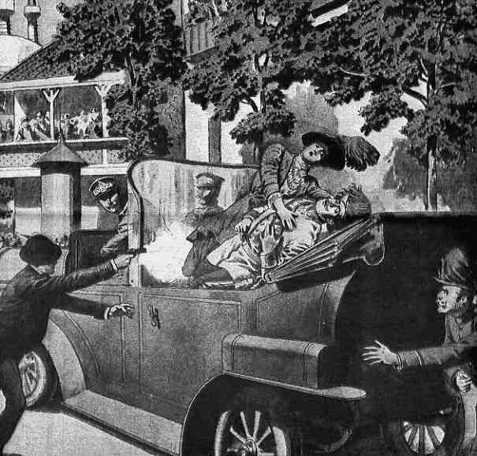
The Assassination: Sarajevo
Austria-Hungary used the assassination to assert more power over Serbia
After three weeks, Austria-Hungary replied with an ultimatum to Serbia. It wanted:
  Serbia to take full responsibility for the murder, though Princip was not Serbian but Bosnian. Austria claimed that the conspirators confessed to the murders being planned with Serbian approval and weapons.
  The right to police 'anti-Austrian' groups within Serbia.
The right to prosecute these and other conspirators in Austrian courts.

Slide 18
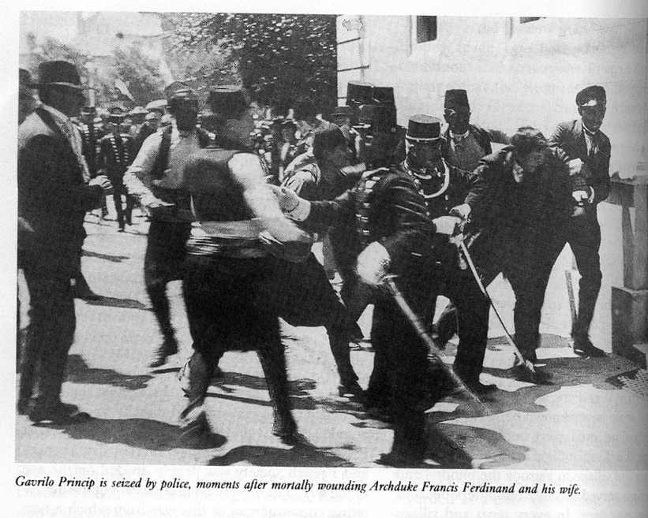
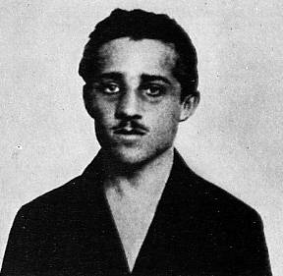
The Assassin:
Gavrilo
Princip
The Black Hand= Serbian Terrorist Group

Slide 19
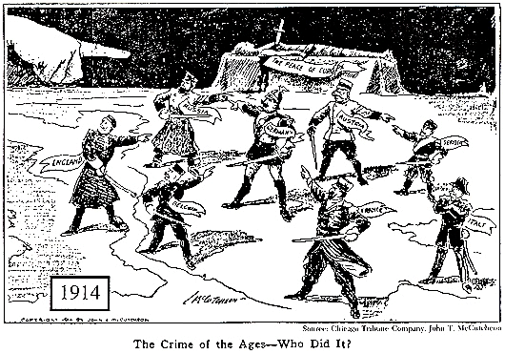
Explain the content and possible meaning of the cartoon.
Who’s To Blame?

Slide 20
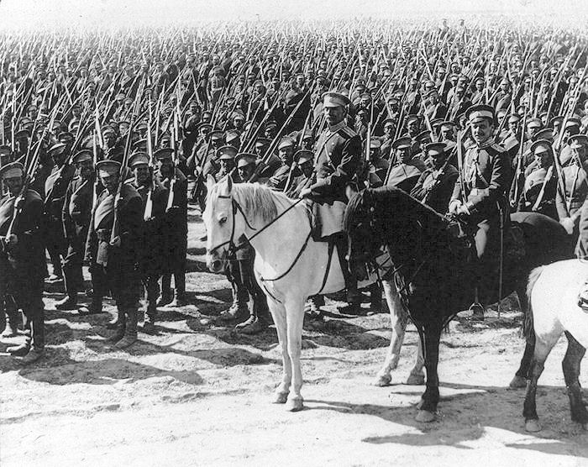
Mobilization
Process of assembling troops and supplies; making a nation ready for war
In 1914, mobilization was considered an act of war
For Russia to mobilize its army would take 6 weeks, at least
To support the Russian ally (Serbia), Russia mobilized against Austria- Hungary and Germany
Germany warned Russia to withdrawal its troops from the borders
When Russia refused, Germany declared war on Russia

Slide 21
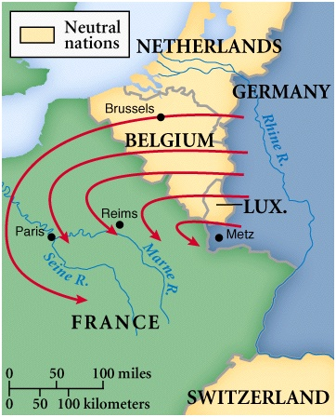
The Schlieffen Plan
The Germans wanted to knock out France in under 5 weeks and attack Russia before they could mobilize

Slide 22
The Spark that Ignites Europe
KABOOM!
Germany tells A-H to do what they wish (gives them a “blank check for war”).
A-H declares war on Serbia.
Russia declares war on A-H.
Germany declares war on Russia/ France.
The United Kingdom declares war on Germany.

Slide 23
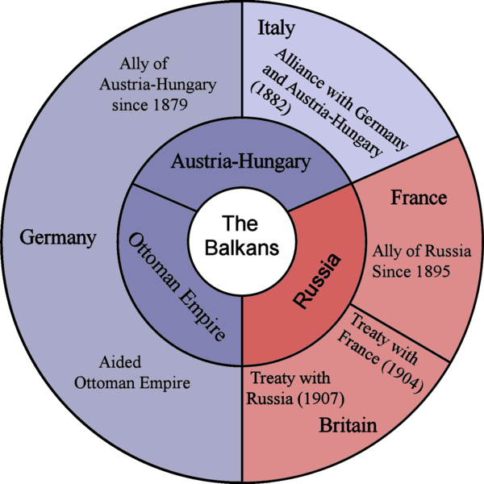
Objective: To examine the causes of America’s involvement in World War I.

Slide 24
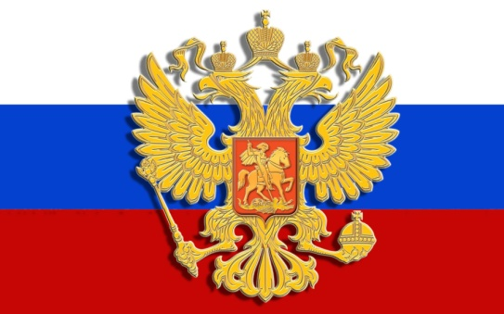

Two Armed Camps!
Allied Powers:
Central Powers:
Germany
UK
France
Austria- Hungary
Russia
Ottoman Empire
Italy

Slide 25
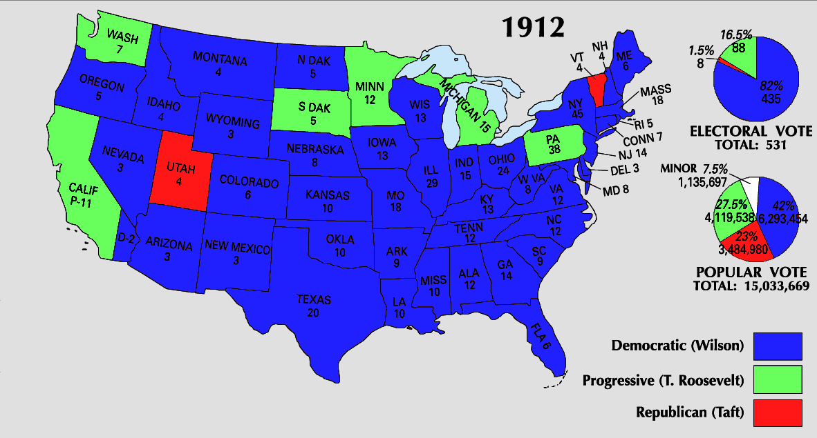
Election of 1912
He ran on his “New Freedoms”, progressive campaign
He created the Federal Reserve, which helps inflation of US $ by limiting the amount of money that is in circulation
Most Americans wanted to stay out of WWI, so Wilson ran the 2nd term on the slogan “He kept US out of war”
Wilson barely won the 2nd term, the 1st Dem. Since Jackson to do so

Slide 26
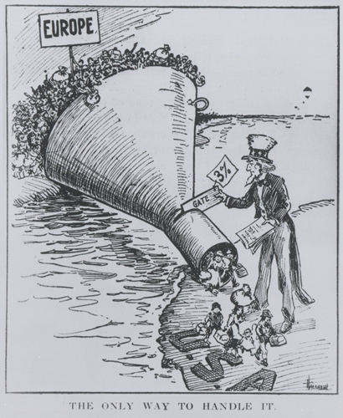
US Isolationism
The US is physically apart from Europe, so it’s easy to avoid involvement
Many Americans were from various land that were involved in WWI
G. Washington stressed that the US stay away from the conflicts of Europe
The US added a quota system to its immigration policy b/c of the isolationism ideals

Slide 27
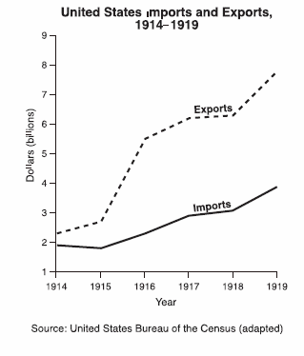
American Neutrality
Officially, the U.S. was a neutral country.
However, we traded food, weapons, oil, steel, and other goods far more with the Allied Powers than with the Central Powers.

Slide 28

The Arch Duke’s Assassination Lights The Dynamite!!
European Rivals
The Alliance System
WWI
The Balkans

Slide 29
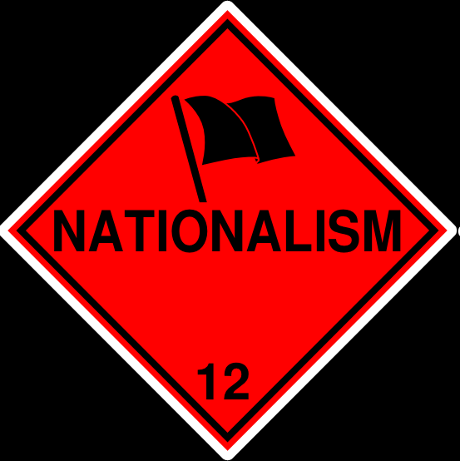
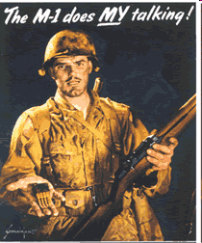
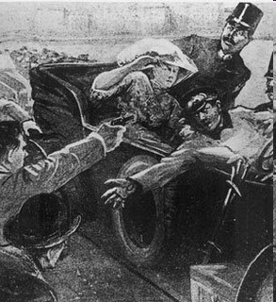
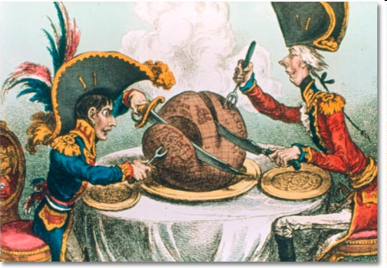
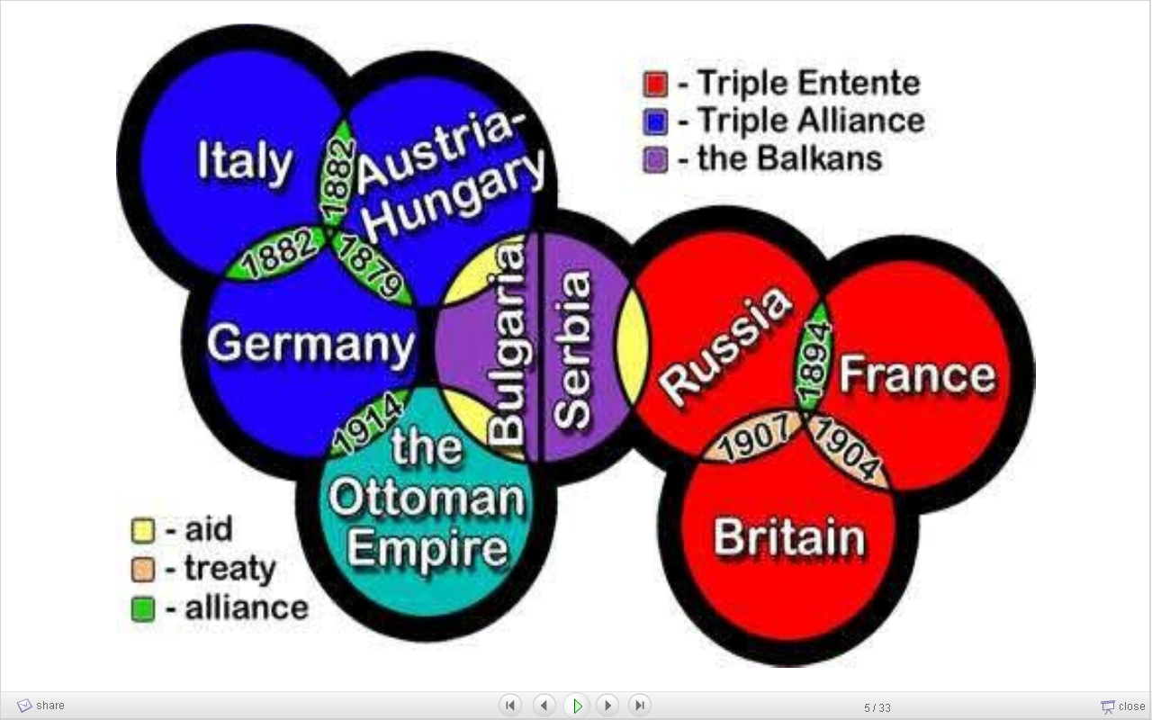
M
A
N
I
A
ilitarism
lliances
ationalism
mperialism
ssassination

Slide 30
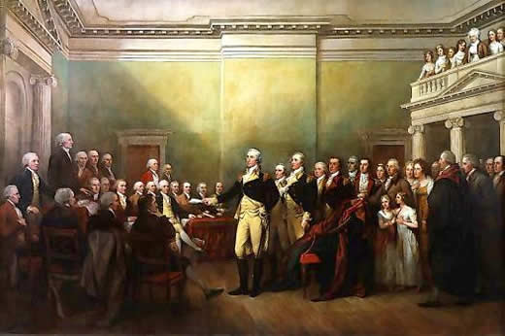
Washington’s Farewell Address
Washington warned about “entangling alliances”

Slide 31
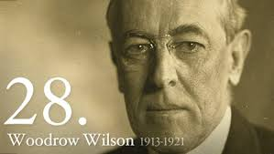
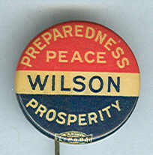
Woodrow Wilson
“It would be a great tragedy of fate, if my administration was consumed by war”

Slide 32
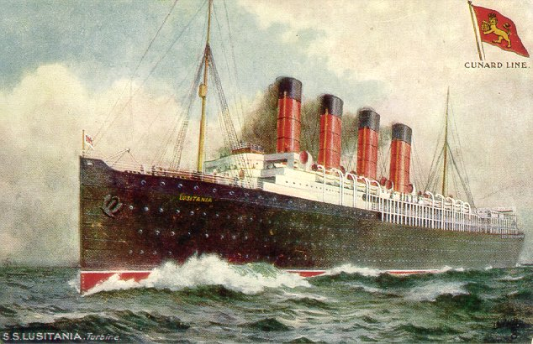
Lusitania
The Germans accused the ship of illegally carrying weapons, which she was
May 7, 1915, a German U-boat shot the boat sinking it in 18 minutes
It sunk so fast b/c the torpedo hit the explosive in the below deck
Around 1,200 died in the attack, all civilians (138 US)
This began a push by the public to get involved
Sussex Pledge- Germany would stop sinking merchant ships and allow military vessels to surrender before attack

Slide 33
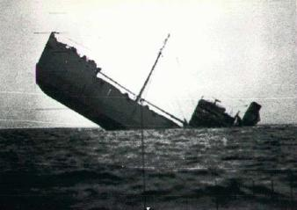
Unrestricted Submarine Warfare
Military advisors told Kaiser Wilhelm that Unrestricted Submarine Warfare could defeat Great Britain within 5 months
They argued that the US violated the Sussex Pledge by continuing to send ships
German believed that they could finish the war before the US joined
Wilson used an old anti-piracy law to order the arming of US ships

Slide 34
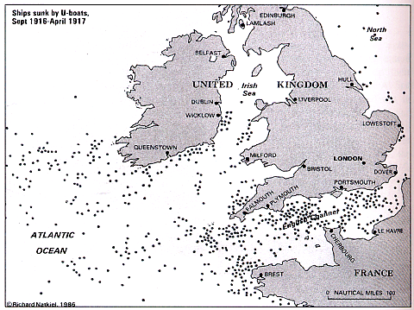
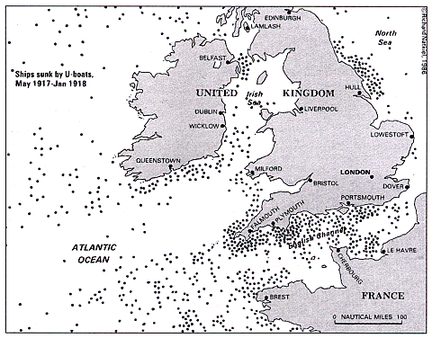
Allied Ships Sunk by U-Boats

Slide 35
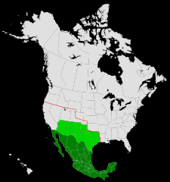
Zimmerman Telegraph
The German message to Mexico asking them to attack the US
Mexico would get back Texas, New Mexico, and Arizona
Mexico decided not to take up on Germany’s offer

Slide 36
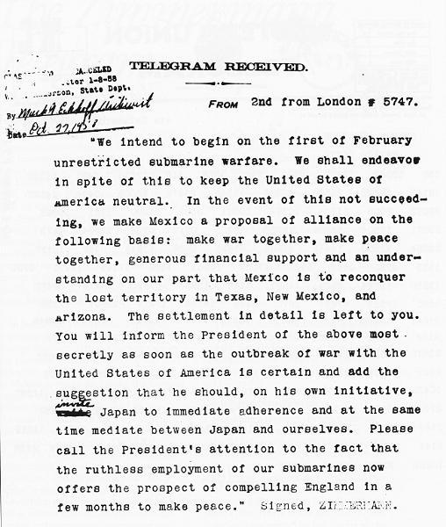
The Zimmerman Telegram

Slide 37
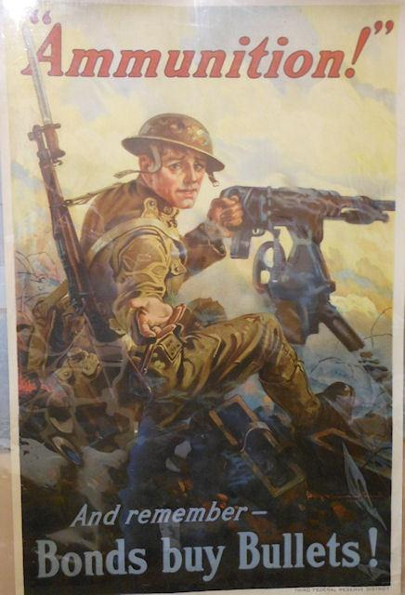
WWI Propaganda
Committee for Public Information- organization that was in charge of US propaganda
Increased nationalism- 4th of July is recognized as a nat. holiday
Liberty sandwiches= Hamburger, Hot dog= Bratwurst
Selective Service Act- US draft to produce troops for the war effort

Slide 38
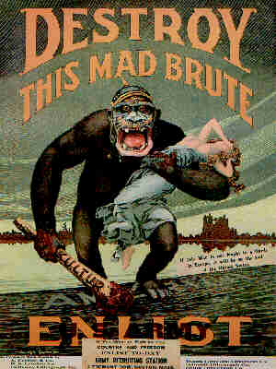
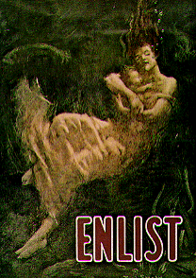

Slide 39
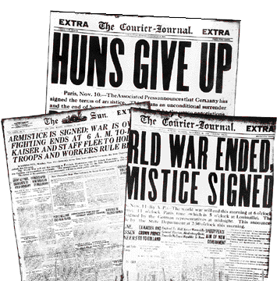
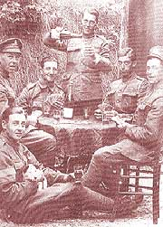
11 a.m., November 11, 1918
The Armistice is Signed!

Slide 40
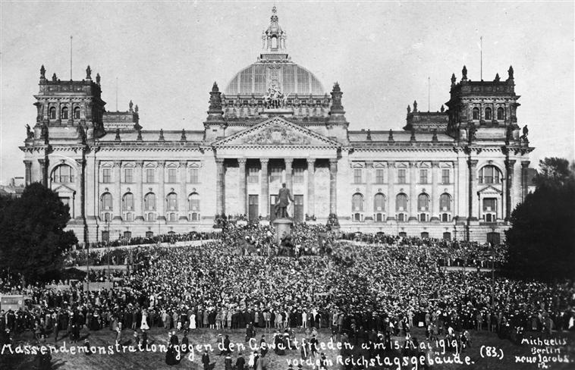
Treaty of Versailles

Slide 41
Treaty of Versailles
International Relations | League of Nations is formed
Responsibility | Germany accepts responsibility for starting the war and agrees to pay $ to the Allies
Territory | New Nations are formed Germany returns land to France France and GB acquire land in the Middle East
Military Strength | Germany will reduce its army and navy and eliminate its air force Germany land along the Rhine River is demilitarized

Slide 42
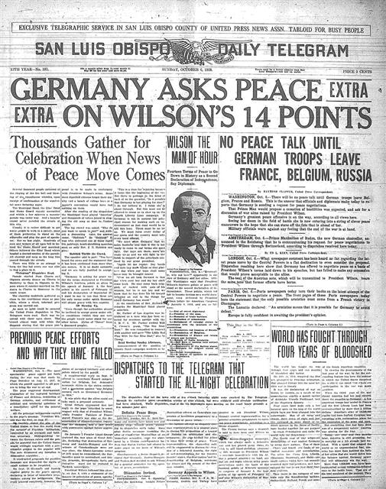
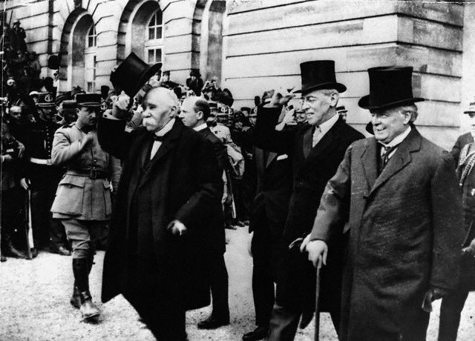
Wilson’s 14 Points
George Clemenceau of France, Woodrow Wilson and David Lloyd-George of Great Britain

Slide 43
14 Points
Wilson believed in a League of Nations dedicated to peace
He believed that it would bond all people together
Wealthy nations would protect the poor, strong the weak…
US Senate refuses the League of Nations, Henry Lodge (R) blocked it mostly because the US would no longer have the ability to declare war
Wilson went on a national tour attempting to get the public to demand that Congress passes the bill
Oct. 2, 19191,Wilson had a stroke b/c of the stress of the tour, his 2nd wife protected him from the public and the Congress, she would rely messages back and forth
From 1920-21, 18 months he could barely walk or speak, paralyzed of the left side of his body, he couldn’t write his name
She was basically the Executive branch for the remainder of his term
It has no real power because the US is not involved
Wilson “They have shamed us in the eyes of the world”

Slide 44
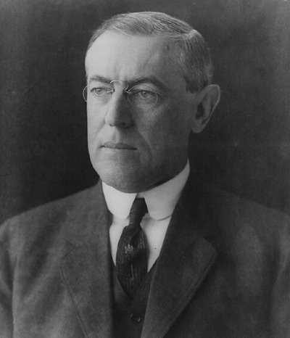
Woodrow Wilson
Absolute freedom of navigation upon the seas, outside territorial waters, alike in peace and in war, except as the seas may be closed in whole or in part by international action for the enforcement of international covenants.
What is Wilson referring to?

Slide 45
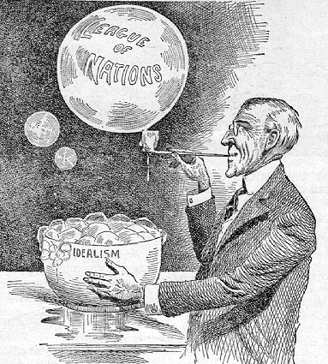

Slide 46

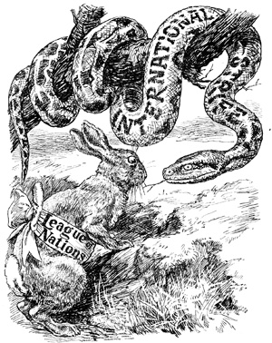
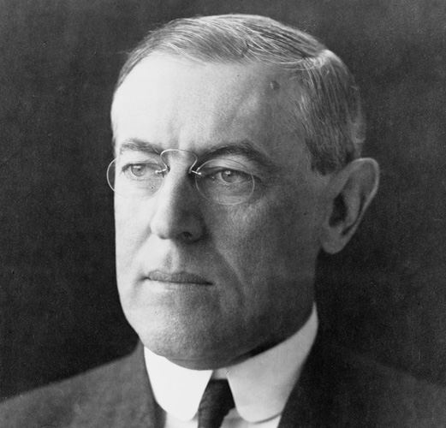
Woodrow Wilson- US President

Slide 47
A New Map of Europe
One result of the Treaty of Versailles was the loss of territory of the Central Powers
Germany and Russia lost much of their lands in Eastern Europe
Poland, Czechoslovakia and other nations were created from this
The Ottoman Empire was broken up after the war
French controlled: Lebanon and Syria
UK controlled: Iraq and Palestine

Slide 48
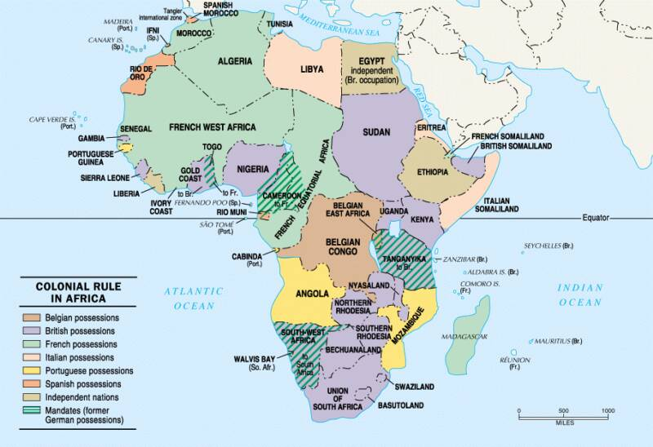
League of Nations Mandates in Africa

Slide 49
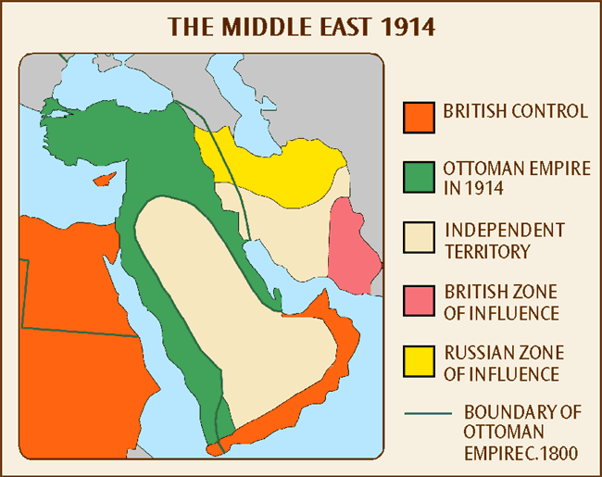
The Middle East in 1914

Slide 50
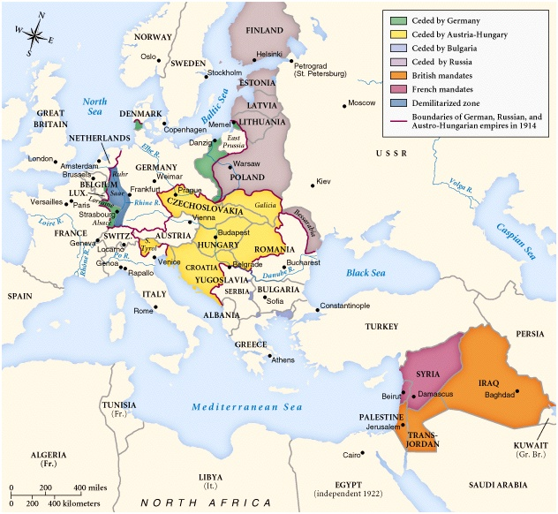
New Nations: 1923

Slide 51
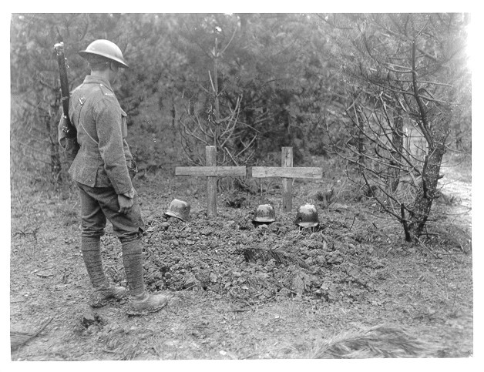
9,000,000 Dead in Combat

Slide 52
World War I Casualties

