Slide 1
Manifest Destiny

Slide 2
Manifest Destiny
Manifest Destiny- Belief that it was America’s destiny to expand throughout the North American continent.
This is because we are stronger and better prepared to succeed as an empire than the European nations.

Slide 3
“Manifest Destiny”
First coined by newspaper editor, John O’Sullivan in 1845.
".... the right of our manifest destiny to over spread and to possess the whole of the continent which Providence has given us for the development of the great experiment of liberty and federaltive development of self-government entrusted to us. It is right such as that of the tree to the space of air and the earth suitable for the full expansion of its principle and destiny of growth."
A myth of the West as a land of romance and adventure emerged.

Slide 4
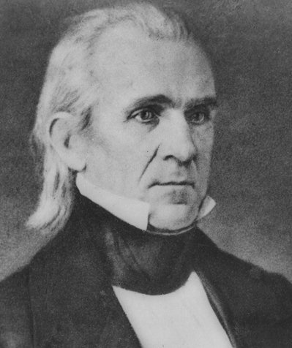
President Polk
(1845- 1849)
4 Goals of Polk as the president
  1. Settle the OR debate
  2. Bring California into the US
  3. Independent treasury to fix the credit mess
  4. Lower the tariff on imports

Slide 5
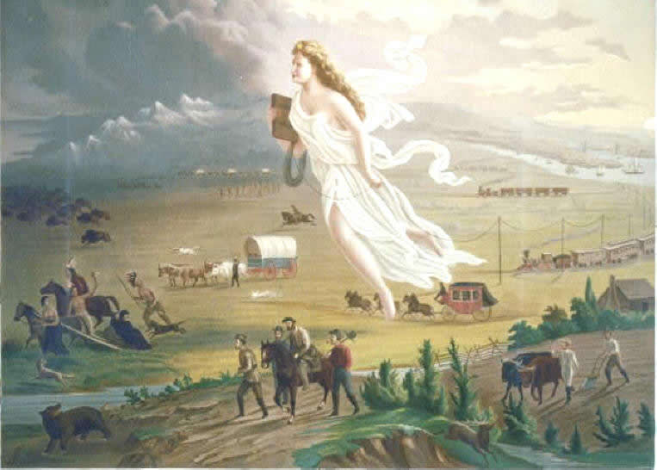
1. Write down 2 items that you see in the painting.
2. Write down 1 possible meaning of the painting.

Slide 6
Texas
Independence
(1836-1845)

Slide 7
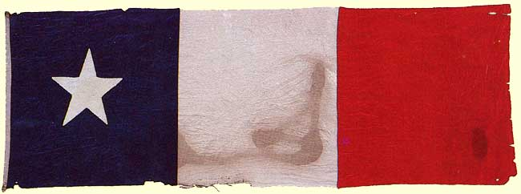
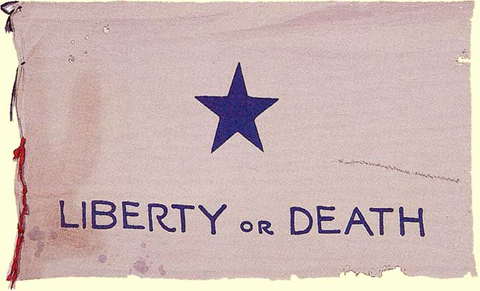
The Republic of Texas

Slide 8

Spanish ownership
Spain owned the area of Texas
Promotion of growth
Texas was widely unpopulated
Spain granted land to families who would settle
Mexico won its independence over Spain
New deal
  Learn Spanish
  Convert to Catholic
  Obey Mexican law
US citizens flood into the area of Texas
Americans outnumber Mexicans 10- 1 in Texas
Did not follow new rules
Desire for independence

Slide 9
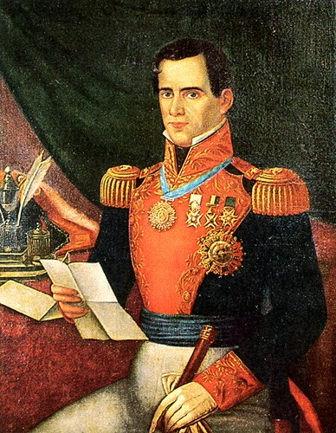
Tensions rise
Mexican leader Santa Anna becomes Pres.
Declares himself dictator
Texans felt betrayed
S. Anna tries to put the Texans in their place
Steven Austin called for independence and was put in jail

Slide 10
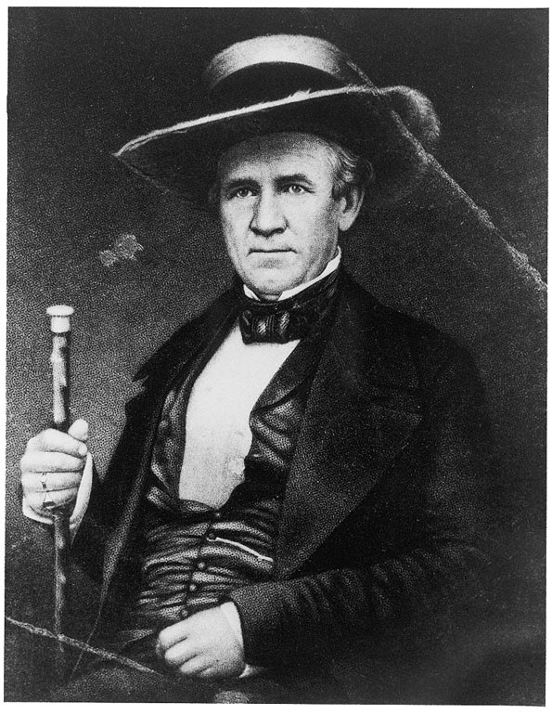
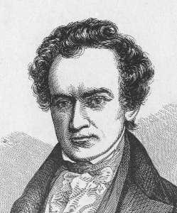
Key Figures in Texas Independence, 1836
Sam Houston
(1793-1863)
Steven Austin
(1793-1836)

Slide 11
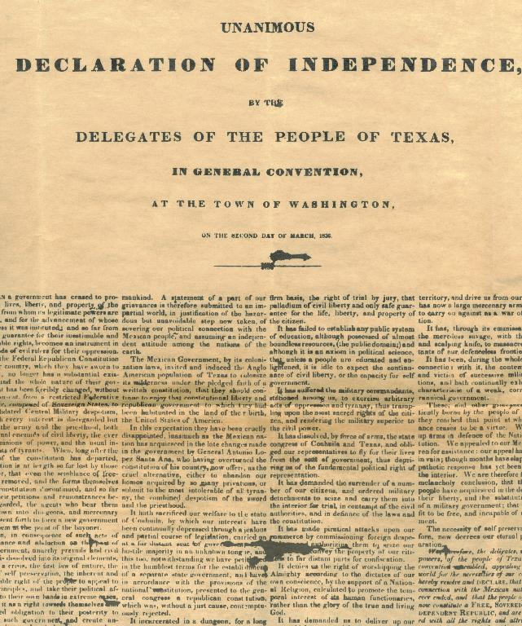
Texas Declaration of Independence
Texas declares itself independent March 2, 1836
Mexico claimed that the annexation was illegal
US offer to buy was denied

Slide 12
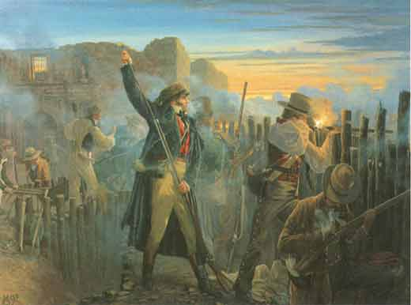
Davey Crockett’s Last Stand
The Alamo, Feb. 23- March 6, 1836
S. Anna loses a few minor battles
Frustrated he finds Texans in the Alamo (San Antonio chapel), with 4- 6,000 troops
185 men, including
Davy Crockett
Jim Bowie
The defender fought off S. Anna’s forces for 12 days
On the 13th day of assault cannons broke the wall
All men were killed, 185, and the burned
Women, children and servants were spared and sent to spread the message

Slide 13
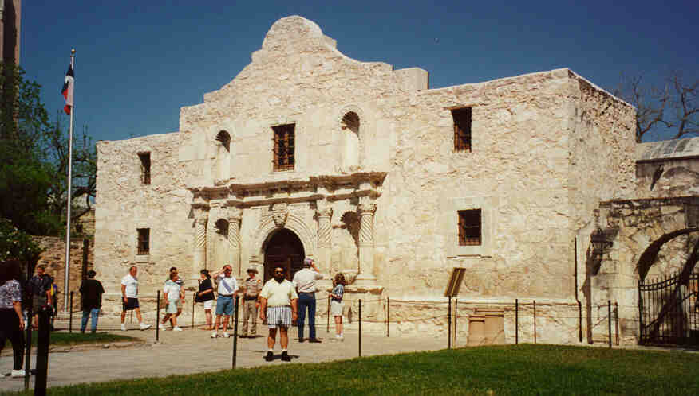
“Remember the Alamo!”

Slide 14
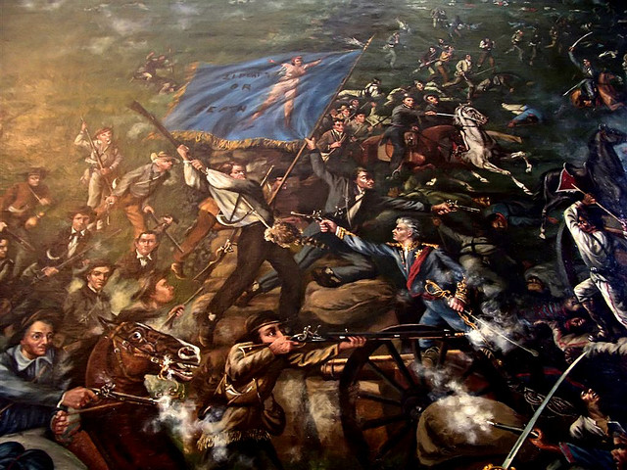
Battle of San Jacinto, April 21, 1836
Sam Houston led a group that took out Santa Anna in 18 minutes, 6 months after the Alamo
Anna was captured and signed the Treaties of Velasco

Slide 15
Treaties of Velasco
The public treaty provided that hostilities would cease and that Santa Anna would withdraw his forces below the Rio Grande and not take up arms again against Texas.
He also pledged to restore property that had been confiscated by the Mexicans.
Both sides promised to exchange prisoners on an equal basis. The Texans would send Santa Anna back to Mexico and would not pursue the retreating Mexican troops.
The 2 sides didn’t follow the treaty and Mexico refused to recognize Texas as independent until the Mexican-American War

Slide 16
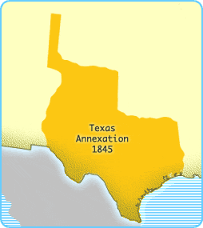
Debate Over the Annexation of Texas
The Whig party did not want the annexation b/c they we opposed to new slave states
Sectionalism
Democrats argued that these are people who want freedom,
A plot is exposed that Britain wanted to buy the land to
  Curb US power
  Discredit the Monroe Doctrine
  New land for cotton so UK could skip the US tariff
President Tyler annex Texas on Dec. 1845, after hearing about the British plan

