Slide 1
Marbury v. Madison/ Andrew Jackson

Slide 2
Marbury v. Madison, 1803
Marbury v. Madison, arguably the most important case in Supreme Court history, was the first U.S. Supreme Court case to apply the principle of "judicial review" -- the power of federal courts to void acts of Congress in conflict with the Constitution.

Slide 3
Background
In the final days of his presidency, Adams appointed a large number of justices of peace for the District of Columbia whose commissions were approved by the Senate, signed by the president, and affixed with the official seal of the government.
The commissions were not delivered and when President Jefferson assumed office March 5, 1801, he ordered James Madison, his Secretary of State, not to deliver them. William Marbury, one of the appointees, then petitioned the Supreme Court for a legal order, compelling Madison to show cause why he should not receive his commission.

Slide 4
Result
It was decided that Marbury shall not get the seat because the Congress went beyond its powers written in the Constitution
By Marshall’s timely assertion of judicial review, the Court began its ascent as an equal branch of government -- an equal in power to the Congress and the president.

Slide 5
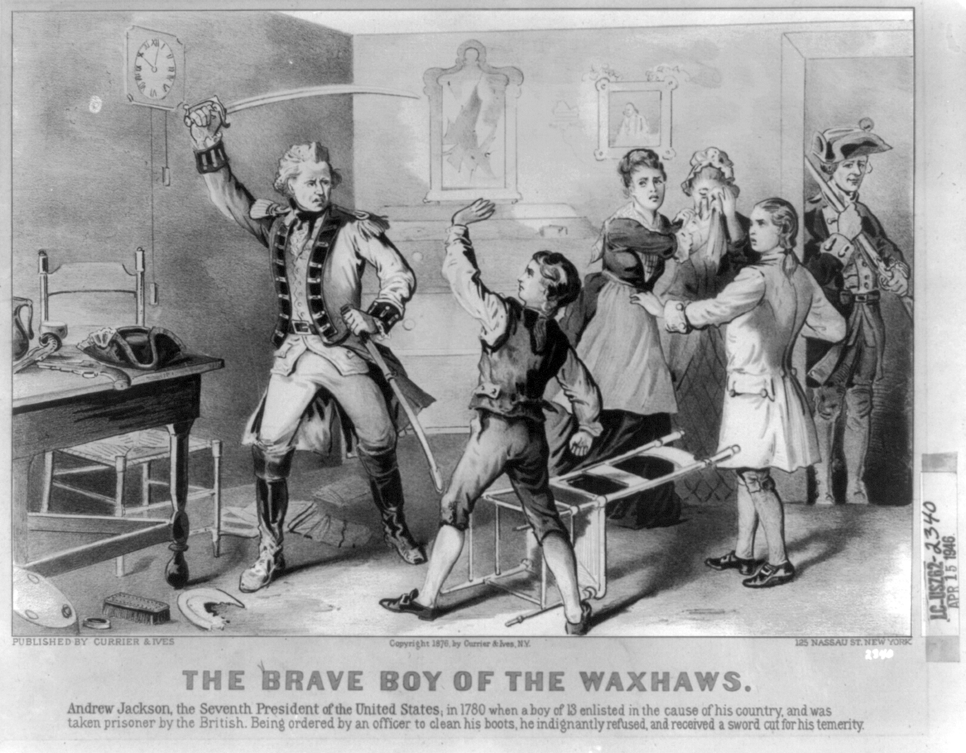
Background
He grew up in the back-county of South or North Carolina
His father died while Andrew’s mom was pregnant
During the Rev. war (age 13), he served as a carrier for the Patriots; very brutal in the Carolinas, execution of POWs on both sides
His neighbors (loyalists) told the Brits about Andrew, a UK officer showed up at his house
The officer demanded that Jackson clean off his boots, refused, and the Brit sliced his arm, scared for life
He was jailed, becoming the only US president to be a POW
2 brothers (heat stroke, disease), one brother died w/ Andrew on a POW ship, and mother died during the war

Slide 6
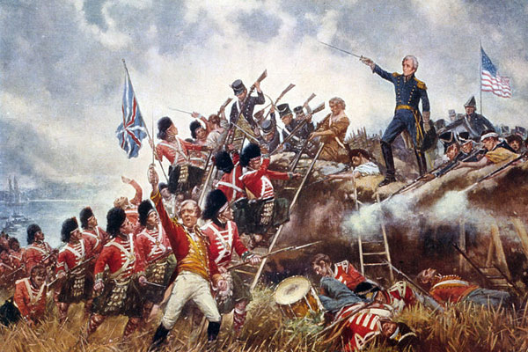
Battle of New Orleans

Slide 7
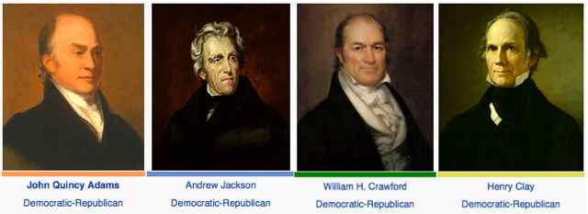
Election of 1824
During this time Congress would vote on their Electoral College vote for the state, not popular vote
Many writers argued for Jackson’s strong personality as the president, also he was not a part of the “corrupt Washington elite” Common Man
Jackson wanted to represent the rights of the majority but unrepresented west/ south
Jackson won the popular vote and the Electoral College but not enough to win the Presidency; too many candidates, so it spread out the votes
The House of Representatives would choose the winner of the election
Henry Clay had no chance of winning, so he threw his support to Q. Adams
“Jackson could be an American Napoleon”
Q. Adams was elected and gave Secretary of State to Clay
Jackson supporters called the election of 1824 the “Corrupt Bargain”

Slide 8
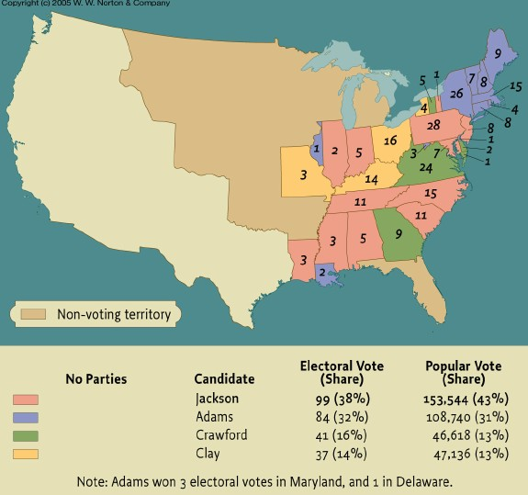

Slide 9
Jackson about the “Corrupt Bargain”
"[I] will save the nation from the rule of demagogues who by intrigue are, and have been attempting to cheat the people out of their constitutional rights, by a caucus of congressional members."

Slide 10
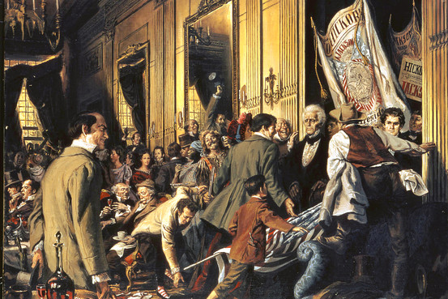
Jackson in the White House, 1828
Grassroots campaigning the way that we know it today; Jackson supporters would hand out hickory sticks like buttons
Extension of voting rights: removal of the voting restrictions of land and religious qualifications
This changes everything- allows participation of the common man/ Jackson’s supporters
Jackson won by a landslide b/c of the extended voting rights, common man
Kitchen cabinet= close knit group of unofficial advisors

Slide 11
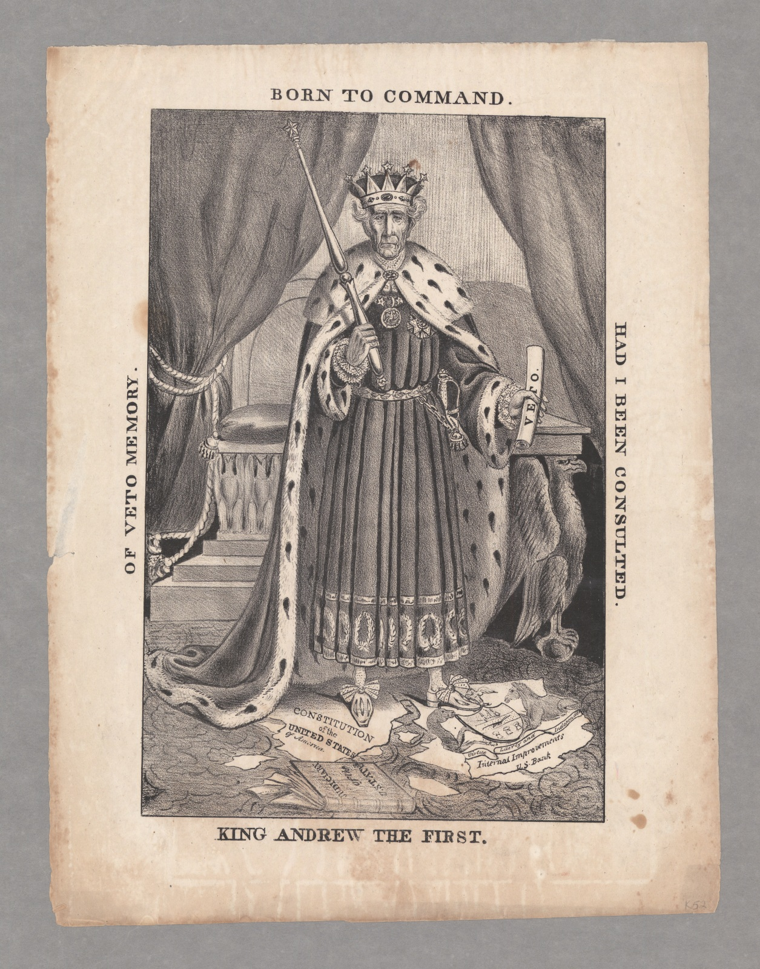
King Mob, or King Andy
1st act as president was to fire several district/ WH employees, some who worked for Washington
He removed more than all of the other presidents combined, 10-20% of all Federal employees fired
He puts his supporters in those position, opponents called it the “work of the Devil”
“To the victor goes the spoils”- creation of the “Spoils system”, rotation-in-office

Slide 12
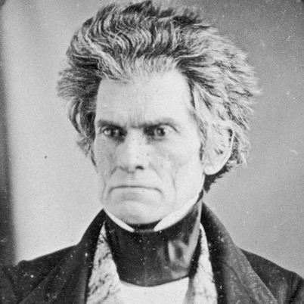
Tariff of Abomination, 1828
Congress passed a tax on cheap cloth to protect NE manufacturing
The South was mad b/c they needed that cloth for slaves= raise of cost of business
VP John Calhoun felt that Jackson would support the south
Jackson toasted “Our federal union must be preserved” settling the debate on whether he would support the Nat. gov. or state rights
Calhoun rebels from Jackson over this tariff b/c he felt it hurt the southern industry to protect the North economy
Calhoun promoted Nullification (states declaring a law unconstitutional, disregard) and state sovereignty in the South
South Carolina formally nullified the tax, had their militia marching, Jackson was ready to lead the Nat. army against SC
He wrote a letter to the state urging to keep the union together, avoid treason; a “union of people, not states”
Clay argued in Congress to lower the tariff, agreed by SC and signed by Jackson
John C. Calhoun
“I will hang all of them, there will not be a bare tree in the South!”
Andrew Jackson, referring to the proponents of nullification

Slide 13
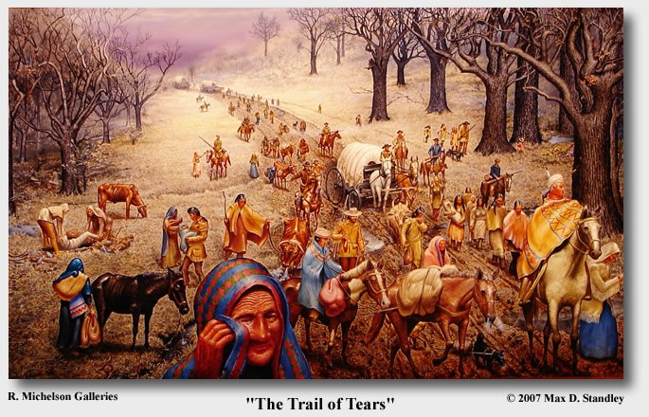
Trail of Tears
The Cherokee in Georgia/ Florida had assimilated into the culture; read and write the English language, European clothes, bought land…
Worcester v. Georgia, 1932 case over Native American territorial rights
The Supreme Court ruled that the Cherokee could stay
He was a slave owner, that viewed himself as “the Great White Father”, Cherokee today call him Jackson the Devil
Indian Removal Act – Jackson argued that the Cherokee were not a real nation, therefore US law does not apply to them
“John Marshall made his ruling, now let him enforce it”
Everything is personal w/ Jackson
The Trail of Tears was a forced removal of the Cherokee from Georgia/ Florida

Slide 14
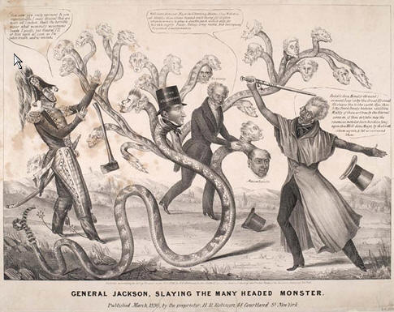
Jackson Against the Banks
Jackson easily won his 2nd term campaign over Henry Clay
His focus for this term was the National Bank of the United States
Jackson said that banks would corrupted institutions through bribery and buying election to gain/ stay in power
Jackson favored state banks= local power= more power to the common man
He argued that the bank had a lot of power and were unelected by the people, so they had no accountability for their actions

Slide 15
Result
The bank would give loans to the wealthy and ignore the majority of the applications of the poor
Jackson decided to “kill” the bank by removing all of the federal money from the bank, he fired 2 Secretaries of the Treasury b/c they refused to do this
Many viewed this as Jackson trying to destroy the US economy over a grudge w/ the banks president
The president of the bank started a small crash and depression w/ comments about the stability of the bank and the economy
In 1836, the charter of the bank lapsed and was not renewed, shutting it down

