Slide 1
Gilded Age

Slide 2
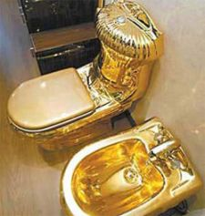
Gilded Age
Gilded= Covered with gold on the outside but made with a cheaper metal inside

Slide 3
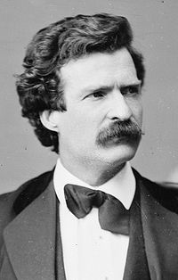
Mark Twain
The US had skyscrapers, electric light bulbs, telephone…
Twain argued that this was because of the corruption, poverty, crime
Golden on the outside but inside dirty and worthless

Slide 4
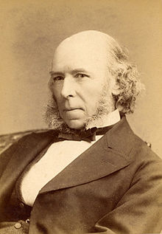
Herbert Spencer
English philosopher that proposed Social Darwinism
The rich were more evolved than the poor, because of natural selection

Slide 5
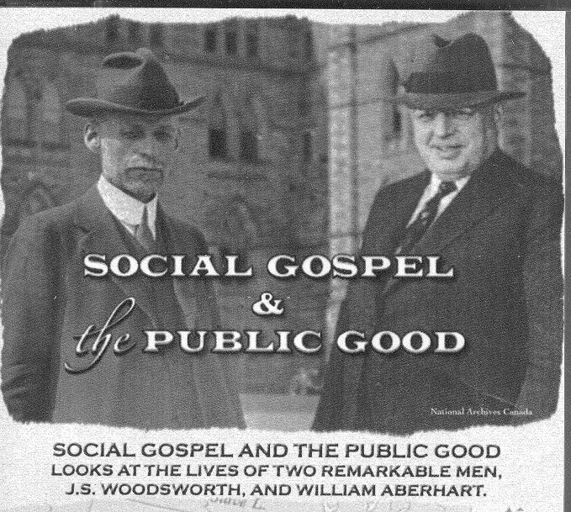
Social Gospel
SG= Movement to improve conditions in cities, according to biblical ideals
This argued that people behaved badly because of social conditions
Settlement houses: Establishments that provided homes, food, medical care… to the poor

Slide 6
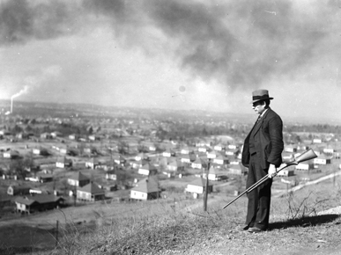
Company Towns
Paid in “company bucks” that were only good in the town stores
Workers often had no local government, no voice
Armed guards would watch the city and not let people leave

Slide 7
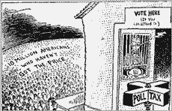
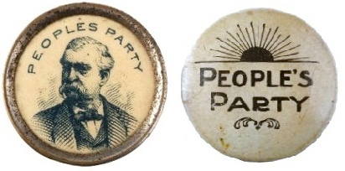
Populists
African Americans joined with poor whites to challenge the elites
They created their own political party called the Populists
Weaver

Slide 8
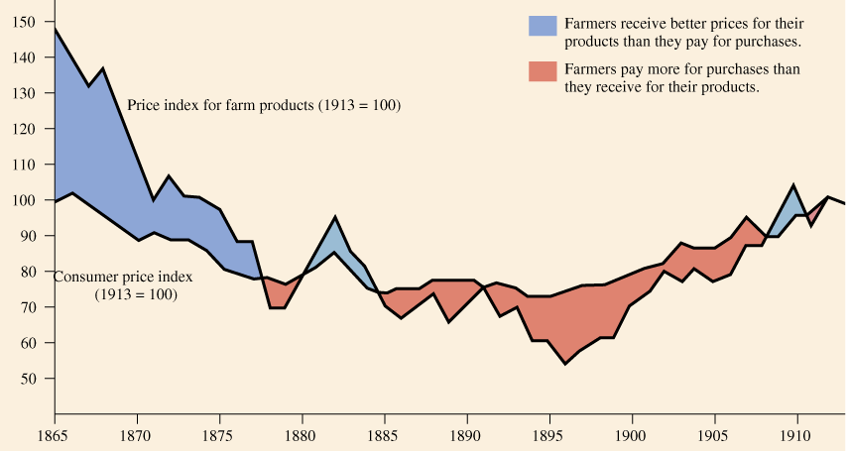
Thinking Question #1: In which year is it most likely that the Populists would gain more support?
Price Indexes for Consumer & Farm Products: 1865-1913

Slide 9
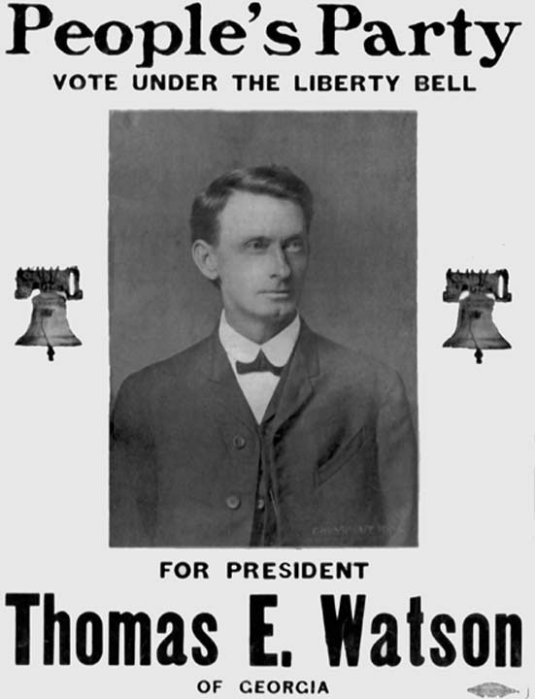
Populists, cont…
The movement failed because the democrats turned the Blacks against the poor whites
Populist were the beginning of the Progressive movement

Slide 10
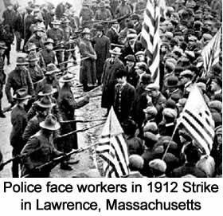
Unions
Laborers organized unions to fight for better conditions at work
The unions would resort to strikes and other protests after negotiation failed

Slide 11
Goals of the Knights of Labor
Eight-hour workday.
Workers’ cooperatives.
Worker-owned factories.
Abolition of child and prison labor.
Increased circulation of greenbacks.
Equal pay for men and women.
Safety codes in the workplace.
Prohibition of contract foreign labor.
Abolition of the National Bank.

Slide 12
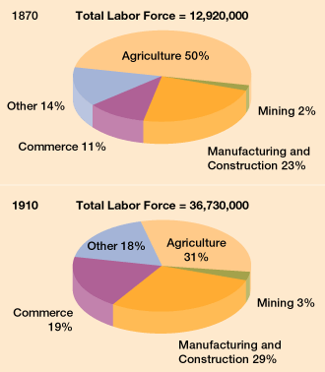
The Changing American Labor Force
Thinking question #2: Based on the graph, why did the Populists lose power after 1870?

