Slide 1
Great Depression- Review

Slide 2
Causes of the Great Depression
Buying on Margin
Great Depression
1. Over production of crops
2. Stock Market crash
3. Use of Credit
Value of crops was too high, leading to collapse

Slide 3
Causes, cont…
5. Uneven Wealth
4. Bank Failures
6. International Depression
No FDIC; protection
The Great Depression

Slide 4
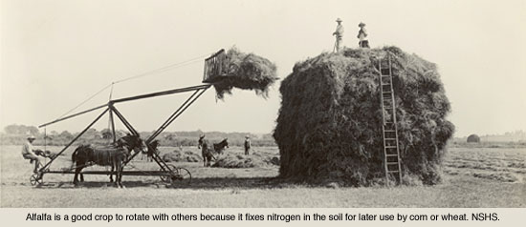
1. Overproduction of Crops
Farmers invested heavily during WWI when prices were high
They bought tractors, more fields, etc. with loans.
When prices fell after the war, there was an oversupply of food and farmers lost income
Farmers couldn’t afford the investments they had made

Slide 5
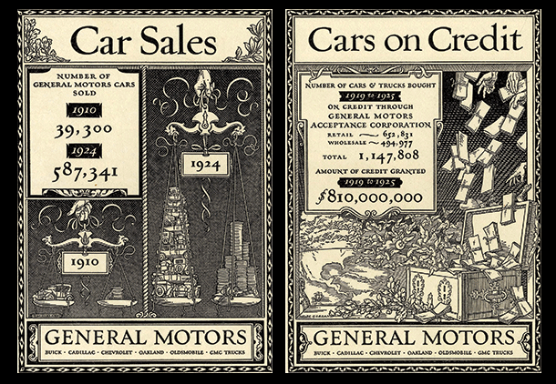
2. Use of Credit
Many Americans used credit during the 1920s
Thanks to the advertising and buying on credit changes of the 1920s, people were spending beyond their means
By 1929, commercial banks loaned more $ to the purchase of stocks and real estate than to commercial business
Debt was high
When people were laid off and had no income, they could not pay back their loans – principal or interest

Slide 6
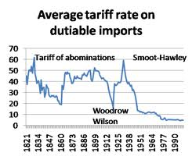
High Tariff
The US had a heavy tariff during this time to protect US econ. interests
Other nations did not want to trade with the US

Slide 7
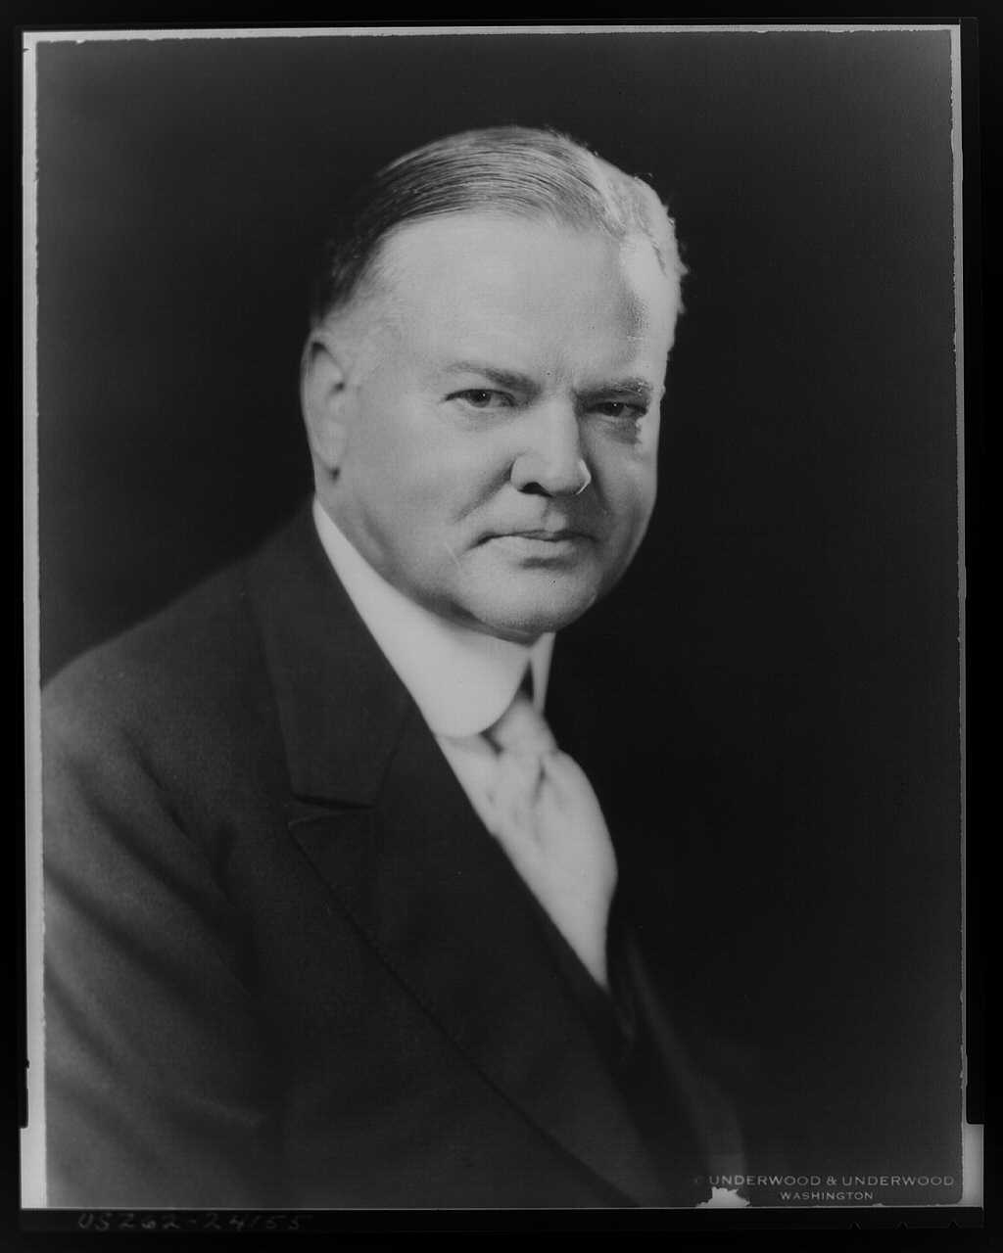
Herbert Hoover
Small town boy
Self made millionaire
Quaker upbringing; traditional views
Great humanitarian after WWI
Pro-business campaign
Won the nomination easily in 1928

Slide 8
Ideology of Hoover
Public money should go to big public projects and large business= trickle down
Rugged Individualism- You do not rely on government for help
Relief was best from the state, and private charities
He was unwilling to give direct federal money to the individual

Slide 9

Hoover’s policies
Optimistic
We have always came back in the past

Slide 10
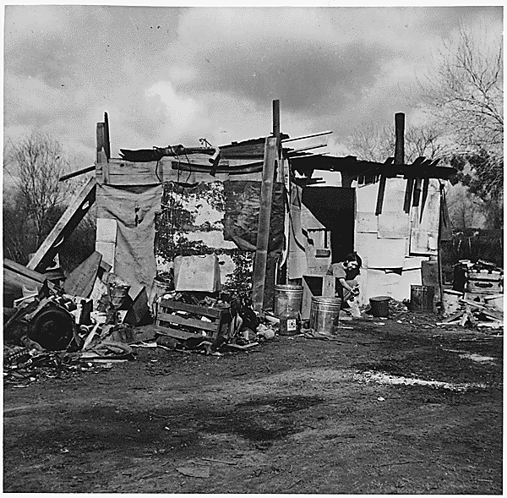
Hoovervilles
Hoovervilles- Poor “towns” of shacks
Hoover flags- Empty pockets
Hoover blankets- Newspaper used to keep warm

Slide 11
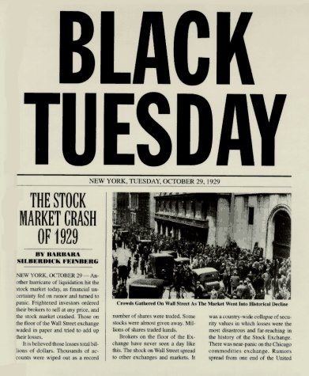
Stock Market Crash
Black Tuesday, October 29 1929
The Market was artificially high – people got so excited to play the game (speculation), they bought on margin (credit) and prices soared above what was realistic
Little/ No government regulations
Empty value stocks- Stocks were over priced
When some people predicted prices would start falling and began selling shares, everyone panicked and tried to sell all at once
Since many had bought stock with money they borrowed, many couldn’t pay back their loans unless their stock made money.
The stock market lost more than 10- 15 billion in one day
During the GD the market lost up to 90% of its money

Slide 12
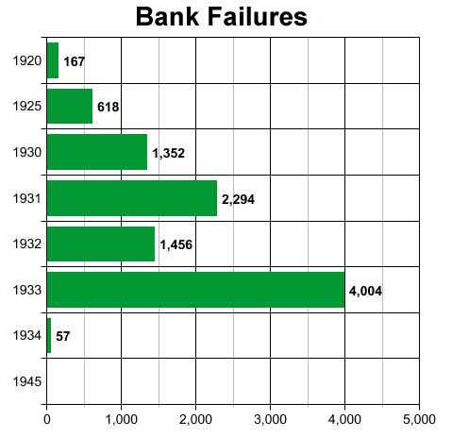
3. Bank Failures
5% of the wealthiest had more $ than the bottom 60%, 1% of the nation’s banks controlled 50% of the national resources
Everyone tried to withdrawal his/her money at once
Banks couldn’t give back the money because it was lent to others in the form of mortgages, personal, and business loans and those people defaulted (couldn’t pay)
9 million savings accounts were wiped out!
The Federal Reserve refused to bail out banks
Hoover’s Rugged Individualism

Slide 13
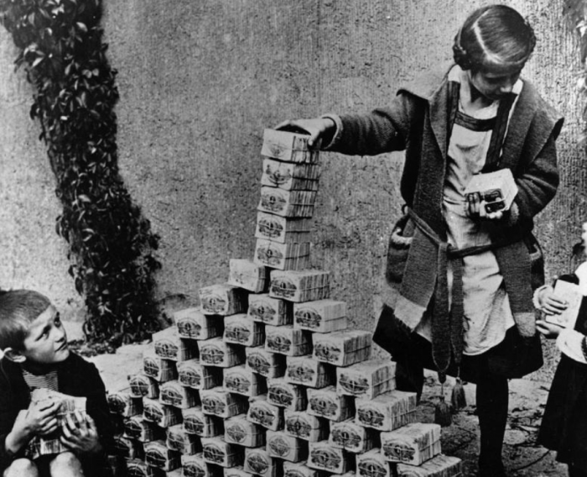
5. World Wide Depression
The US had a heavy tariff during this time
Other nations did not want to trade with the US
During WWI, the United States loaned huge quantities of money to Europe to help them fight Germany and rebuild their societies after the war ended.
When the stock market crashed many nations believed that the US would destroy itself

Slide 14
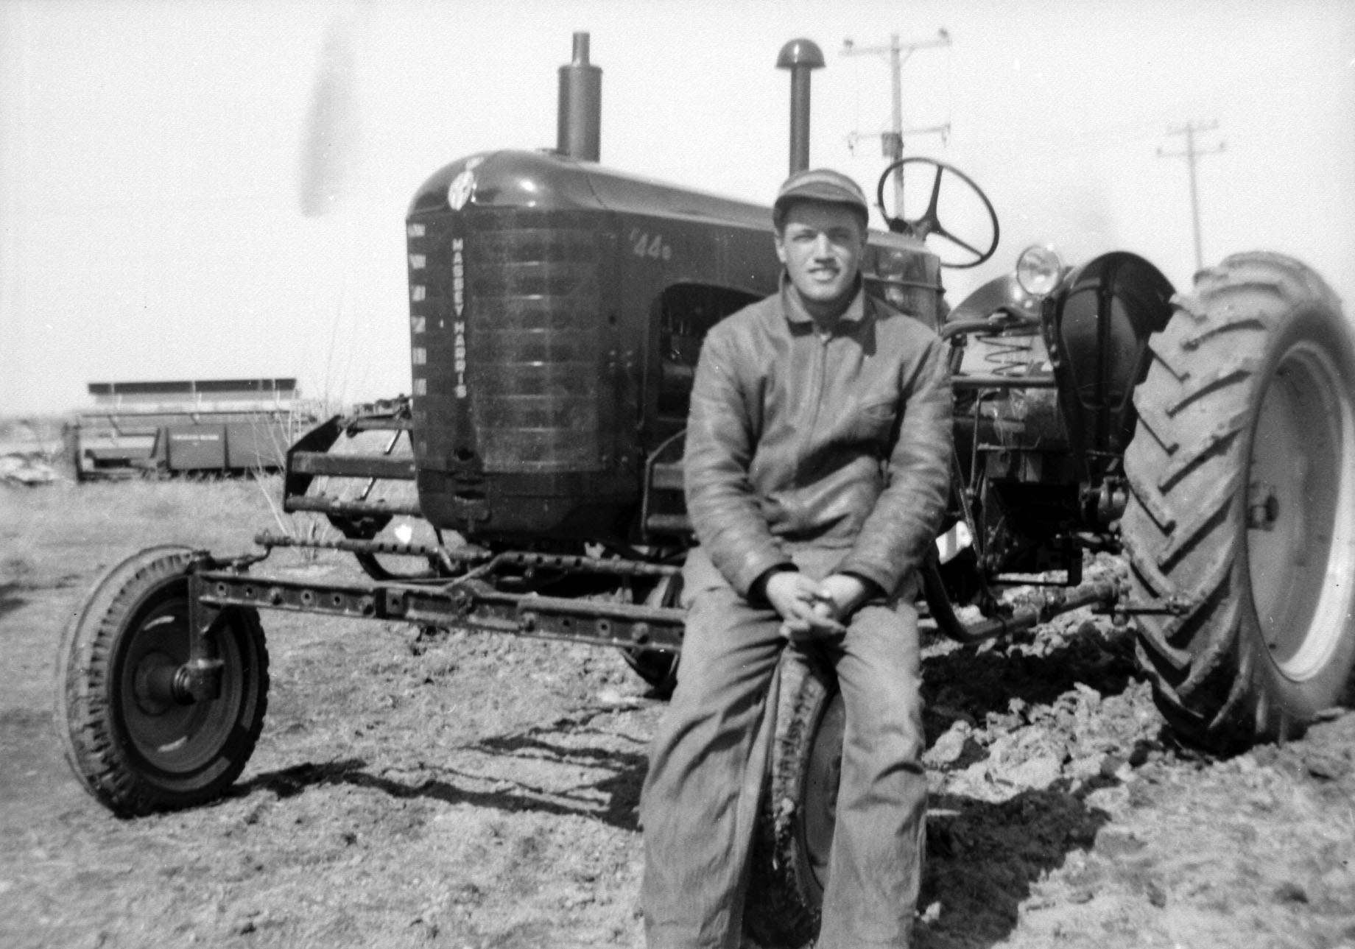
6. 1920s; Not Booming For All
50% of the people at or below the poverty line
Many were farmers, whose crops sold at very low prices
By 1932, the US had 10 million unemployed workers, 20% of the workforce
Minorities were hit harder; African Americans were 4% of the pop. In Chicago but 16% of the unemployed

