Slide 1
Chesapeake Colonies/ NE Colonies Review

Slide 2
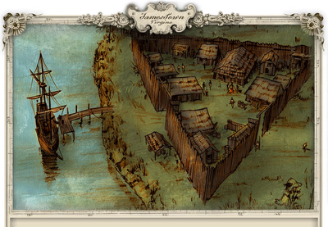
Chesapeake- Jamestown
  Importance: Jamestown was the first permanent UK colony in NA
  Jamestown (after the King) was founded by a joint stock company, private investor- who wanted new sources of raw materials and markets, about 120 years after Columbus
  The settlers of Jamestown were mostly concerned with
    Defense from 2 groups: Spanish navy (inland) and NA by land (peninsula)
    They were looking for gold, not for new permanent homes

Slide 3
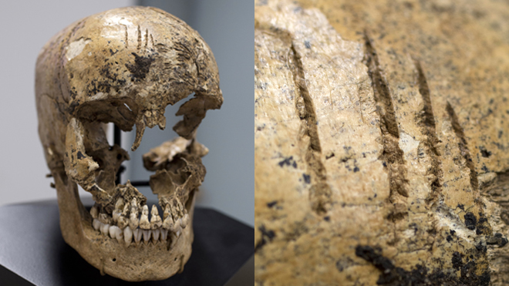
The Starving Time

Slide 4
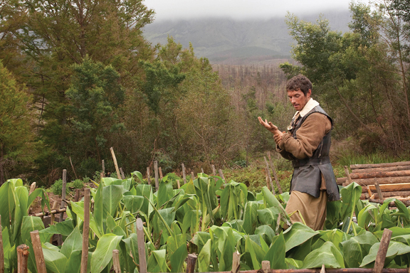
Tobacco; The 1st Cash Crop
John Rolfe planted the 1st cash crop in the US, tobacco
This became the most important crop to the nation until the rise of cotton

Slide 5
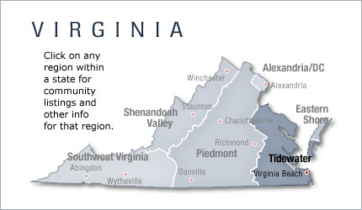
Farming Areas in Virginia
Piedmont= poor growing area, farmed mostly by the poor
Tidewater= great growing area, farmed by the rich

Slide 6
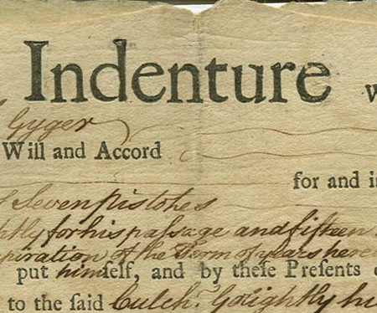
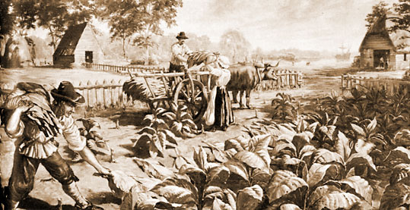
Indentured Servants
In return for passage to the US, young men and women for fixed terms of service (4-5 years)
They would trade work for the possibility of land and possible supplies, after service
Headright program: Offer of 50 acres, if they paid their own way to North America
+ 50 per indentured servant

Slide 7
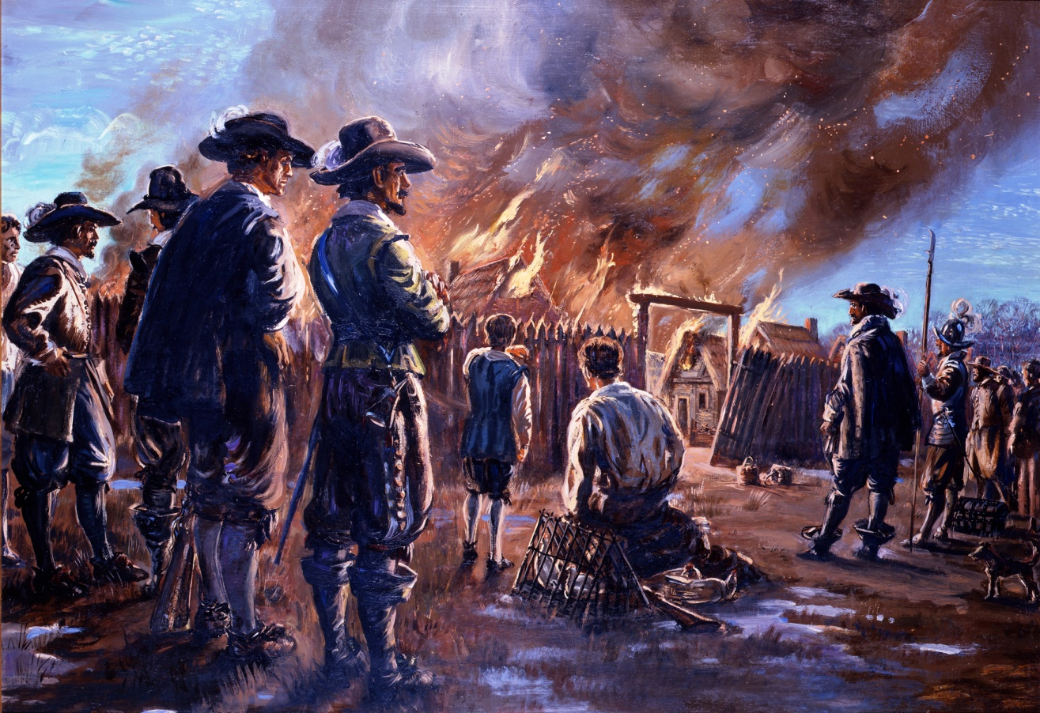
Bacon’s Rebellion
(1676)
  Nathaniel Bacon’s Rebellion- Started b/c the governor of Virginia gave away the majority of land, leaving none for incoming immigrates
  Virginia: required large land ownership to vote; taxed the Peidmont more, created anger towards the rich
  Poor whites rose against what they viewed as the ruling class (rich) and joined with the freed blacks
  This rebellion caused an increase in the African slave trade as a means of limiting indentured servants
    Impact #1- The colonial system moved from primarily indentured servants to slavery
    Increased desire for UK control of the colonies

Slide 8
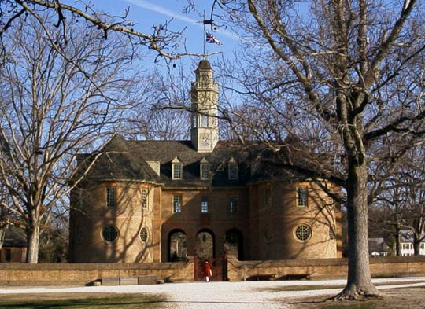
House of Burgesses
  1st step toward self-government
  House of Burgesses= Each of the Virginian cities sent 2 representatives (22 total), elected by popular vote, to the colonial assemblies
  All laws passed by the body could be vetoed by the governor
  Only land owning males could vote for representatives
  After Virginia became a royal colony, its power was limited

Slide 9

Maryland: A Haven for Catholics
Lord Baltimore permitted high degree of freedom of worship in order to prevent repeat of persecution of Catholics by Protestants.
  High number of Protestants threatened because of overwhelming rights given to Catholics.
Maryland Toleration Act of 1649
  Supported by the Catholics in MD.
  Guaranteed toleration to all CHRISTIANS.
  Decreed death to those who denied the divinity of Jesus [like Jews, atheists, etc.].
  In one way, it was less tolerant than before the law was passed!!

Slide 10
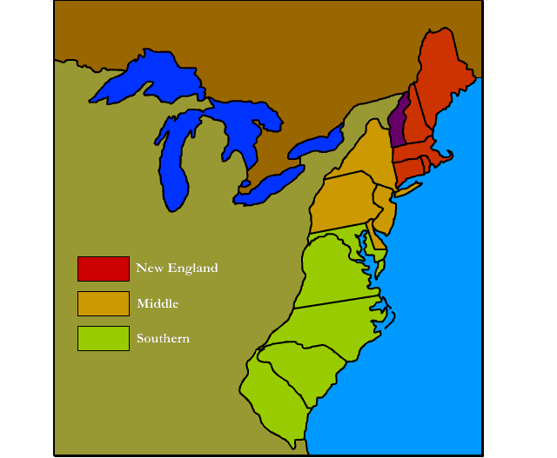
NE Colonies

Slide 11
Types of Colonies
Charter: This is a self-governing colony, in which the governor is chosen by the colonists. Examples are Conn. and Rhode Island
Proprietary: The governor and other officials are selected by the proprietor.
Joint-stock: Investors produce the funds to create the colony. Jamestown is an example.
Royal (Crown): The governor and other officials are selected by the king. The majority of the colonies were this type.

Slide 12
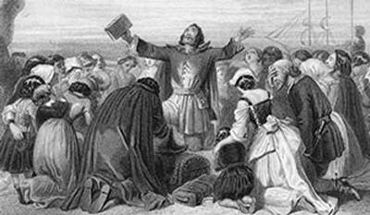
The Puritans
    The Puritans wanted to purify the Anglican church of all Catholic influence (rituals, traditions), from British society
    They were persecuted for not following the Anglican Church

Slide 13
Division of the Christian Churches
Catholic Church
Anglican
Puritans
Separatists
Protestant

Slide 14
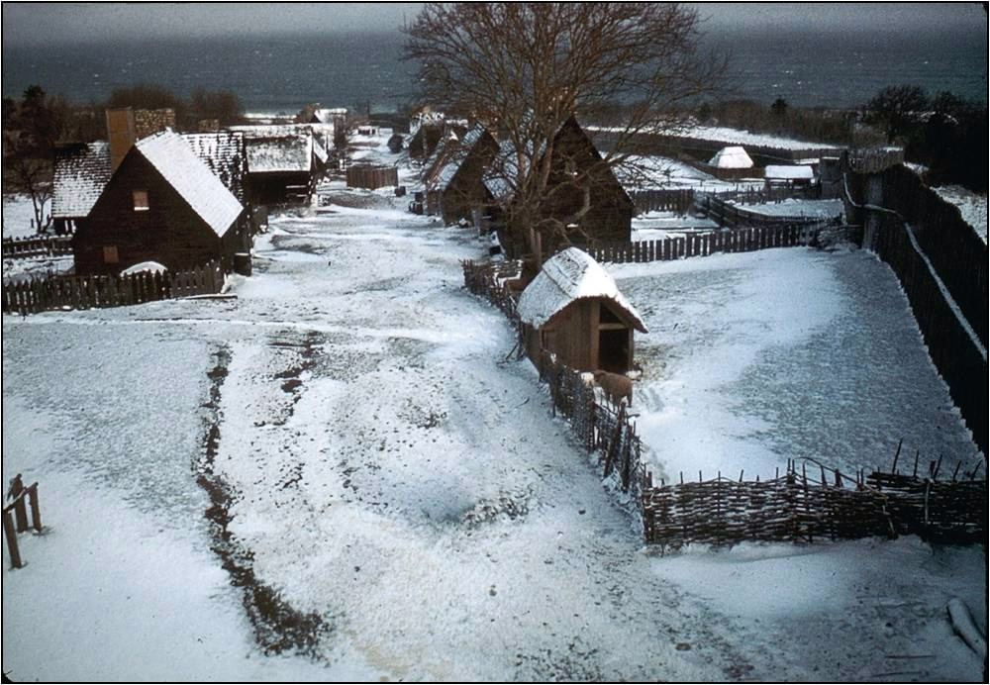
Plymouth Plantation

Slide 15
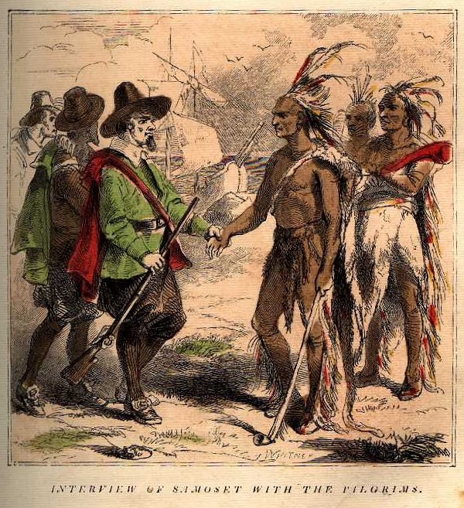
Squanto

Slide 16
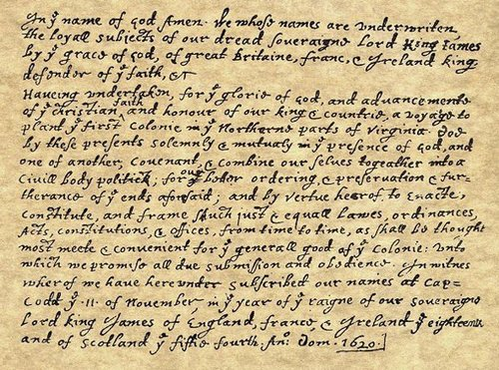
The Mayflower Compact
November 11, 1620
  Written and signed before the Pilgrims disembarked from the ship.
  Not a constitution, but an agreement to form a crude govt. and submit to majority rule.
  Signed by 41 adult males.
  Led to adult male settlers meeting in assemblies to make laws in town meetings.

Slide 17
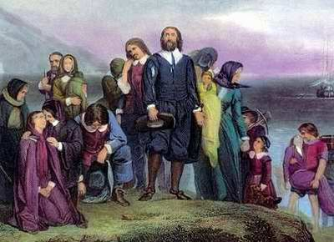
Excerpt, “City Upon The Hill” Speech
  John Winthrop was a Puritan Englishman whose attempts to purify the Church of England failed
  He saw the Mass. Colony as an opportunity to create the perfect Puritan society
  Believed that he had a “calling” from God to lead there.
  Served as governor or deputy-governor for 19 years.

Slide 18
Effects of the Plague
“Whole towns of them (Indians) were swept away, in some of them not so much as one soul escaping the destruction”. By the time the Indian populations of New England had replenished themselves to some degree, it was too late to repel the intruders”.
  From “Lies My Teacher Told Me”, James Loewen

Slide 19
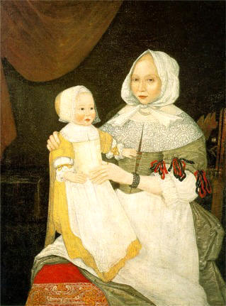
NE Society
  Authoritarian male father figures controlled each household.
  Patriarchal ministers and magistrates controlled church congregations and household patriarchs.
  While set up as an escape from persecution, Pilgrims were not tolerate of outside religion
  Only church members could vote on

Slide 20
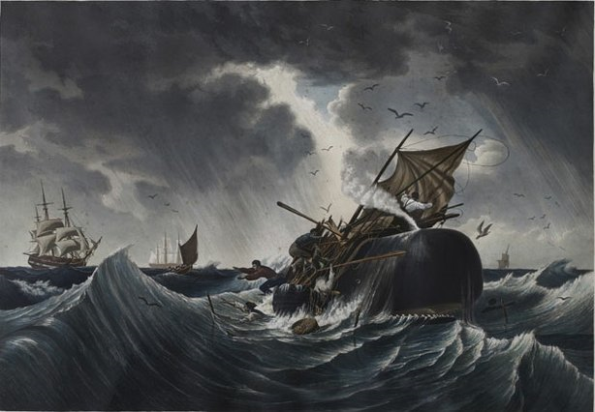
New England Colonial Economy
NE had a growing number of merchants, even though this was against British law
Whaling and fishing were a large part of the economy b/c of the difficulty of farming
Education of NE was higher b/c families wanted children to be able to read the bible

Slide 21
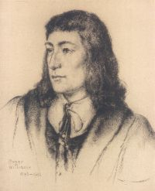


Puritan “Rebels”
Young, popular minister in
Salem.
  Argued for a full break
  with the Anglican Church.
  Condemned MA Bay
  Charter.
    Did not give fair
    compensation to Indians.
  Denied authority of civil
  govt. to regulate religious
  behavior.
1635 → found guilty of preaching newe & dangerous opinions and was exiled.
Roger Williams

Slide 22
Salutary Neglect
Period of time where the colonists were able to have self-government, little British involvement
The goal was to make $, serve the motherland
If a colony made money, than it didn’t matter if they had their own government

Slide 23
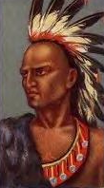
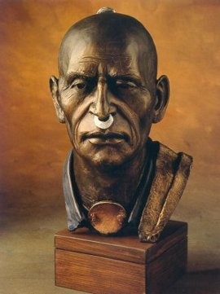
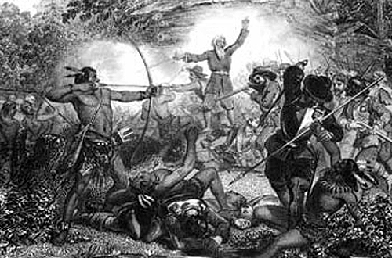
King Philip’s War (1675-1676}

Slide 24
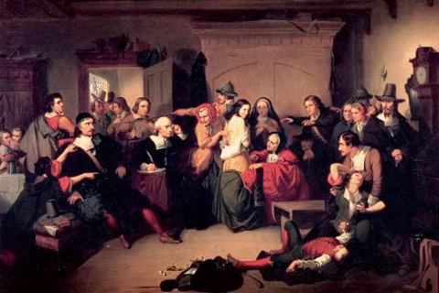
Salem Witch Trials

