Slide 1
Teddy Roosevelt

Slide 2
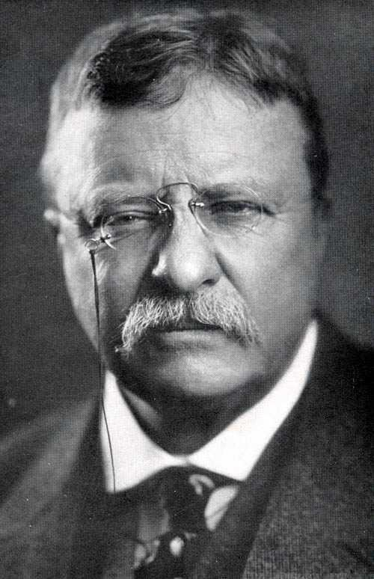
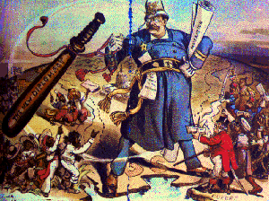
Philosophy of Theodore Roosevelt
“Speak softly, but carry a big stick; you will go far”

Slide 3
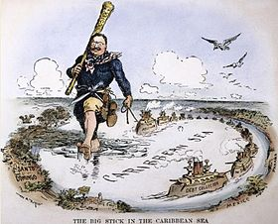
Big Stick Policy
Teddy would threaten US attacks if nations did not do what he wanted
This became his big stick policy

Slide 4
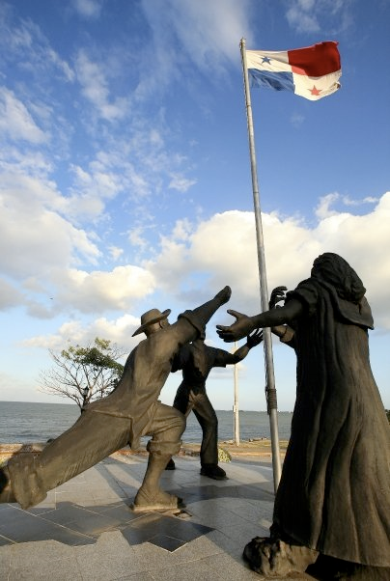
Panama
Panama was under the control of Columbia
The people of Panama wanted to be free

Slide 5
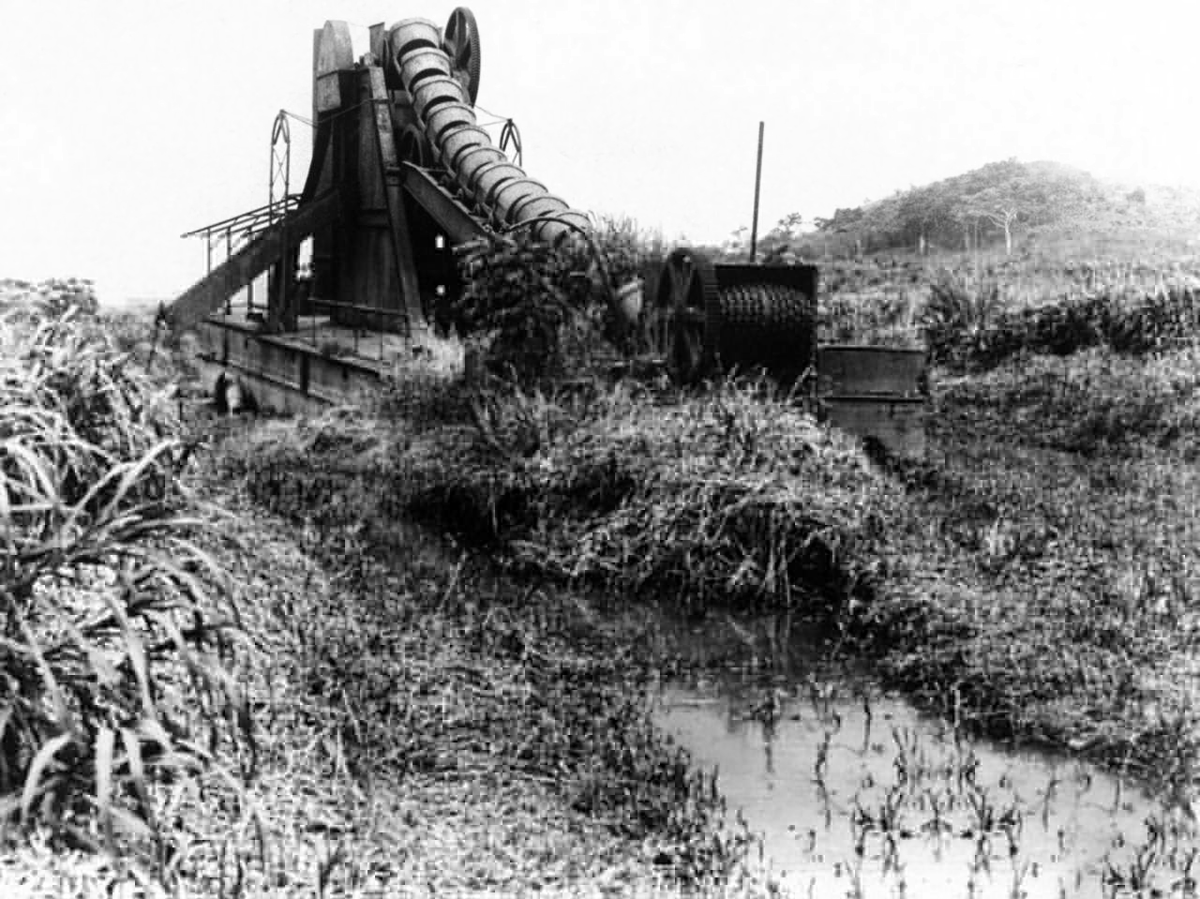
Attempts At Building
The French were the first to try and build a canal but failed
Disease and difficult terrain, or land, made the French quit

Slide 6
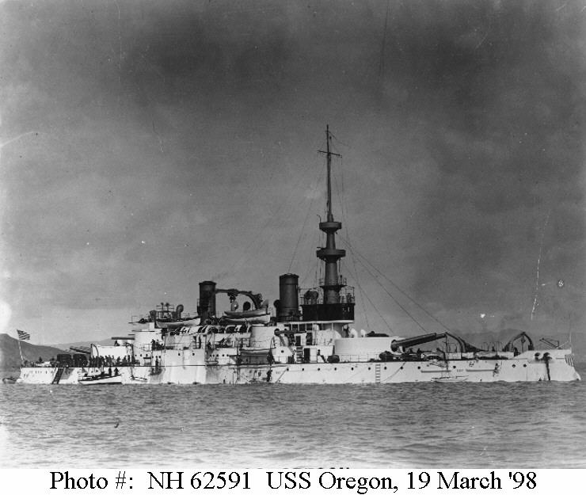
Reasons For Canal
During Spanish American War, the US tried to send ships to Cuba
It took the USS Oregon 74 days to get to Cuba
The US wanted a shorter route through Latin America

Slide 7
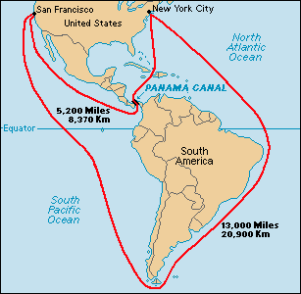

Slide 8
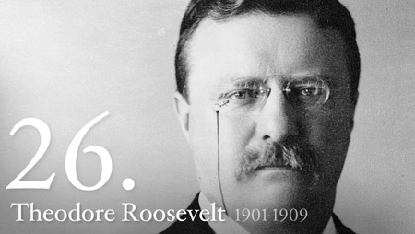
Teddy Roosevelt
After he became President he sent US ships to Columbia
Columbia did not want to fight the US, so Panama became independent
Then US began to build the canal in Panama

Slide 9
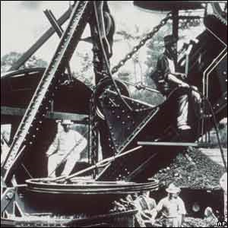
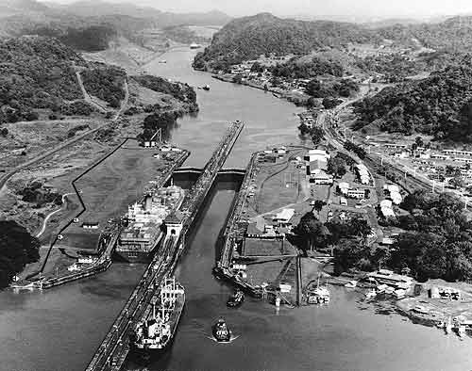

Slide 10
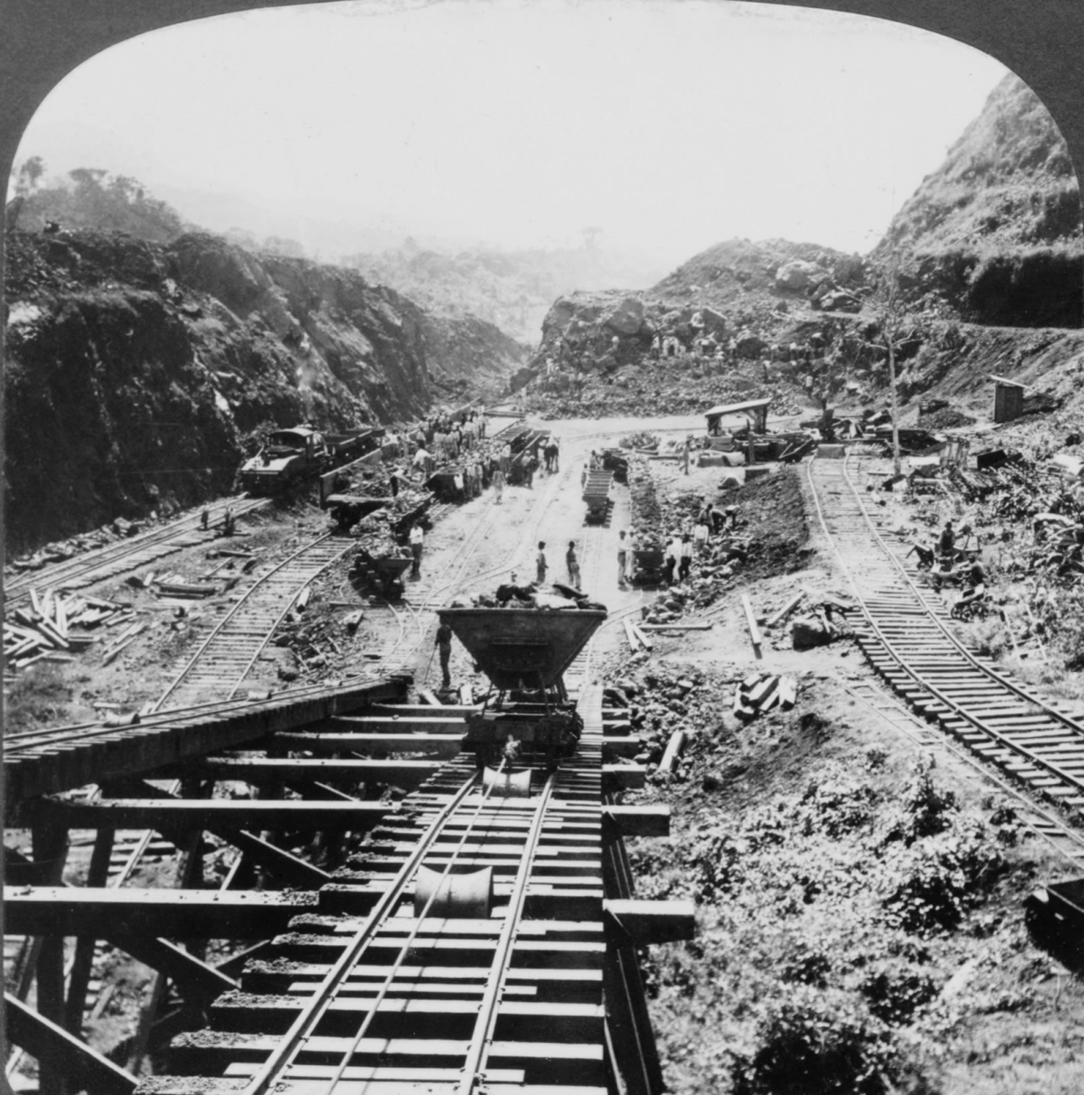
Building The Canal
Swamps were drained to lessen disease
Conditions were very difficult and many workers died
Landslides, malaria were the top killers of the workers

Slide 11
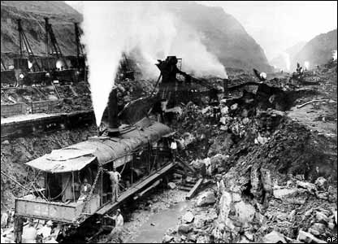
Building The Canal, cont…
The Canal cost $380 million dollars and thousands of people died
The US owned the land of the canal
However, the US and Panama have made millions by charging ships to use the canal

Slide 12
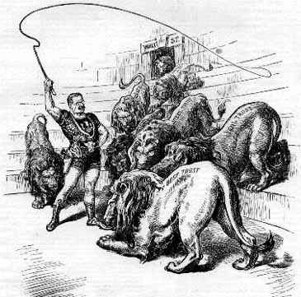
Trust Busting
Trust= Monopoly
TR believed in a “square deal”= Fair chance at achieving success
He brought lawsuits on monopolies
Companies that he had sued lost and had to pay a lot of money
TR became a “trustbuster”

Slide 13
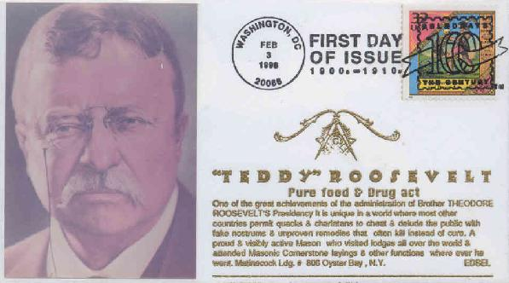
Reforms in Food
The Pure Food and Drug Act passed in congress in 1906
This prohibited the manufacture, sale or shipping w/out government inspection

Slide 14
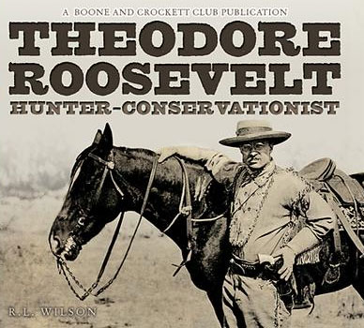
National Parks
TR was a sickly child
He loved to be outdoors; hunting, sightseeing…
He created five national parks (2x existing number); 18 national monuments and more than 100 million acres' worth of national forests

