Slide 1
WWII- Review

Slide 2
U. S. Lend-Lease Act,
1941
Great Britain.........................$31 billion
Soviet Union..........................$11 billion
France..................................$3 billion
China..................................$1.5 billion
Other European......................$500 million
South America.......................$400 million
The amount totaled: $48,601,365,000

Slide 3
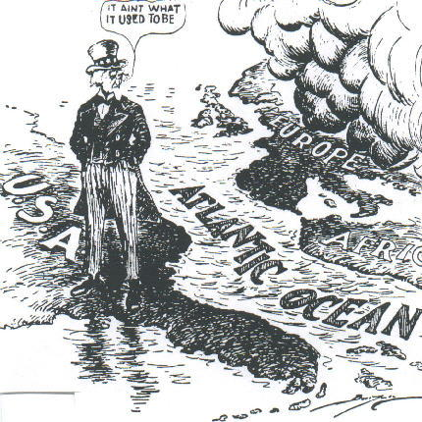
U. S. Neutrality Acts:
1934, 1935, 1937, 1939

Slide 4
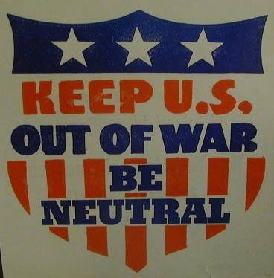
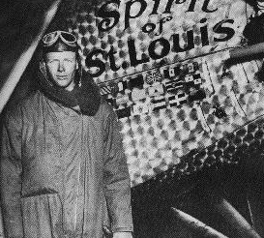

America-First Committee
Charles Lindbergh

Slide 5
Terms
Fascism- Glorifies the state over the individual
This demands a strong central government
Totalitarian state- Government that controls all aspects of the people
Inflation- The rate of increase in costs

Slide 6

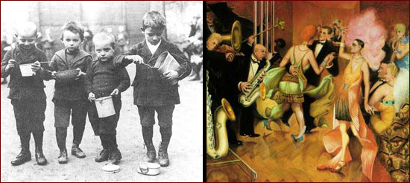
Weimar Republic

Slide 7
Excerpts From Mein Kampf
“We National Socialists must hold unflinchingly to our aim in foreign policy, namely, to secure for the German people the land and soil to which they are entitled on this earth.”
“The result of all racial crossing is therefore in brief always the following:
* Lowering of the level of the higher race;
* Physical and intellectual regression and hence the beginning of a slowly but surely progressing sickness.”

Slide 8
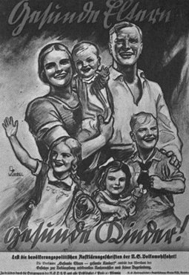
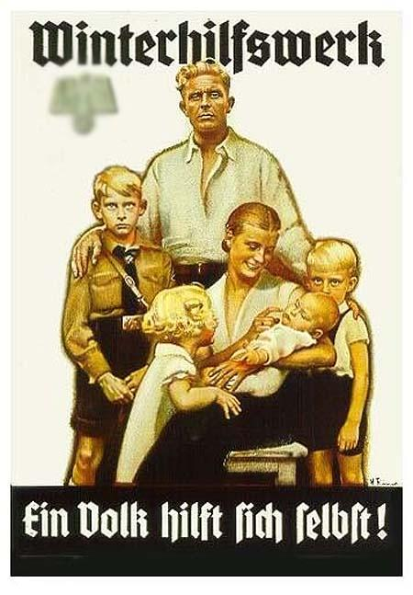
Beliefs of Hitler
Aryan= Ideal German; Blonde hair, blue eyes

Slide 9
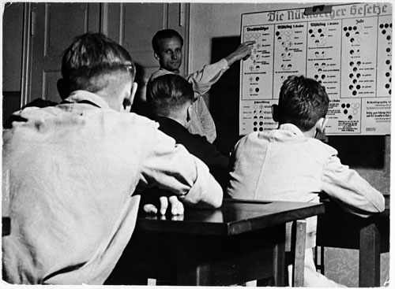
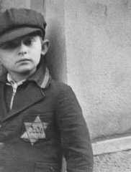
Nuremberg Laws
Teacher explaining the racial definitions chart to his students

Slide 10
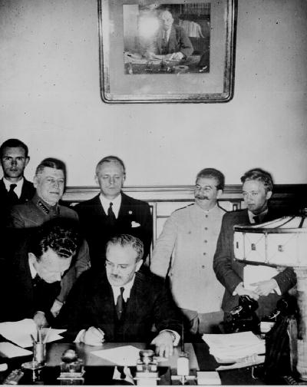
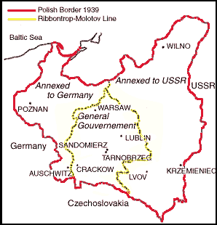
The German- Soviet Non-Aggression Pact, 1939
Foreign Ministers
von Ribbentrop & Molotov

Slide 11
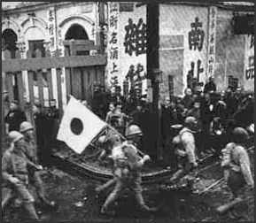
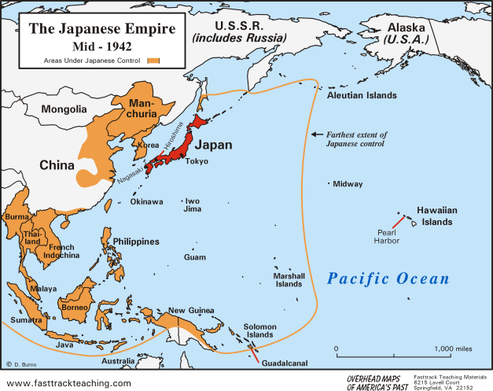

Slide 12
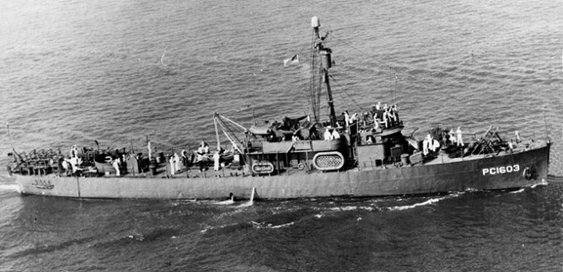
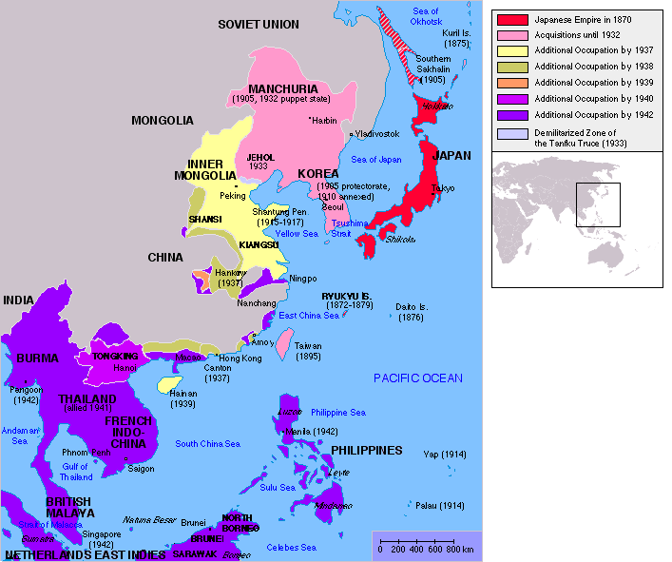
Blockade of Japan
Embargo-
No trade to a nation
Blockade- Surrounding a nation with naval units

Slide 13
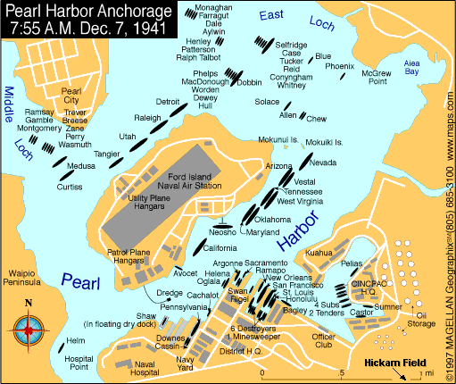
Pearl Harbor

Slide 14
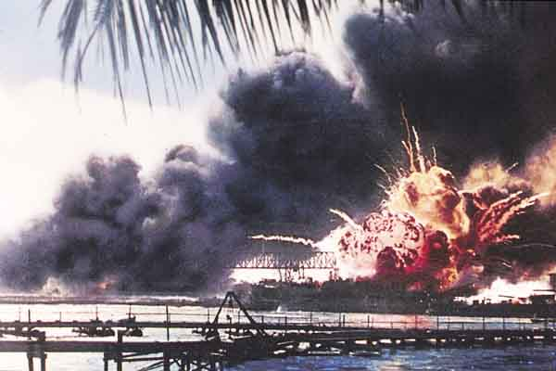
Pearl Harbor – Dec. 7, 1941
“A date which will live in infamy!”

Slide 15
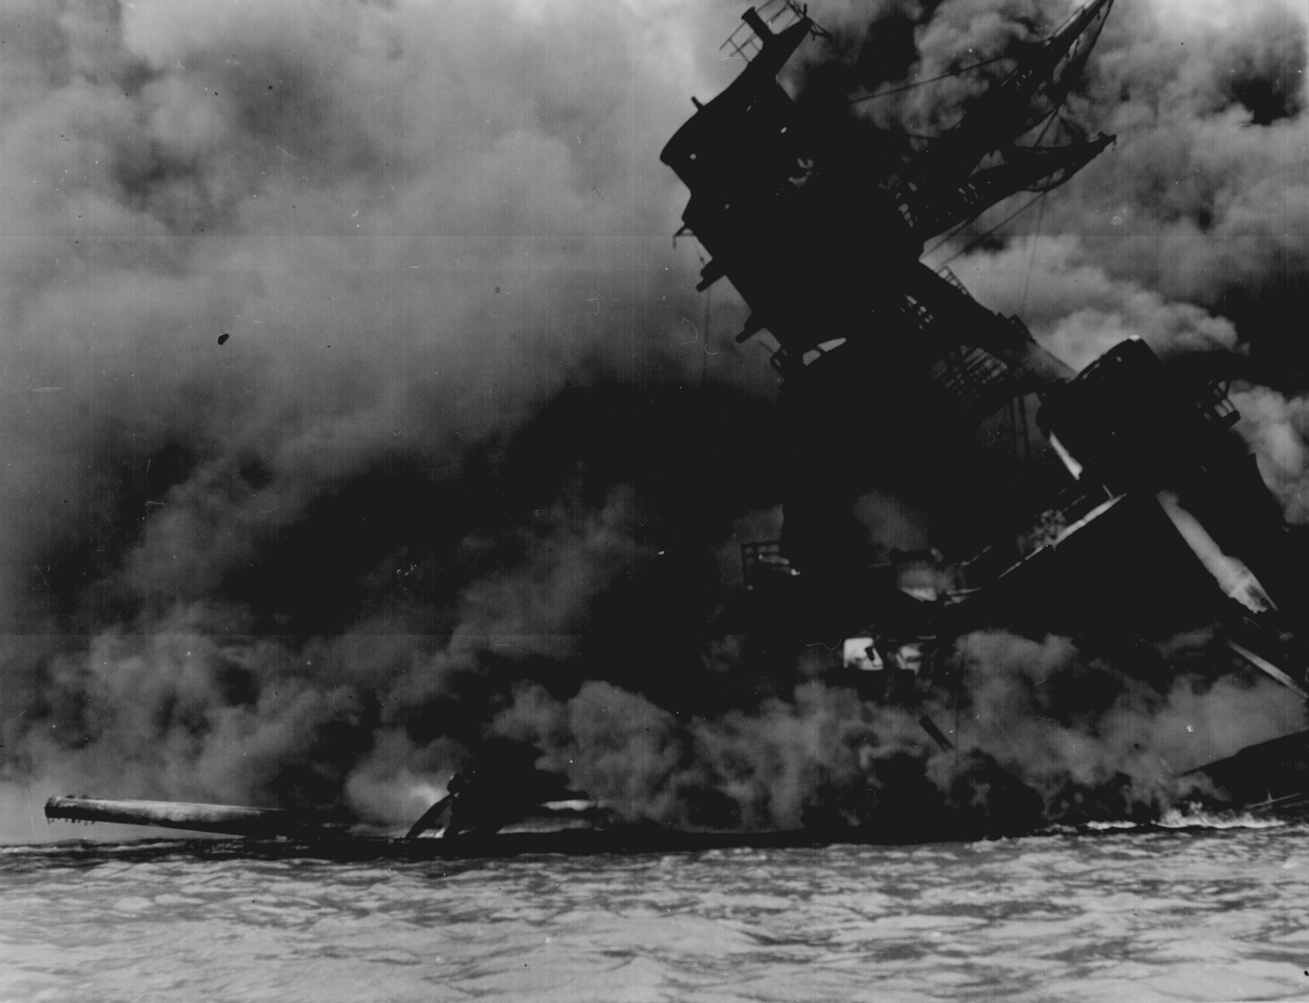
USS Arizona, Pearl Harbor

Slide 16
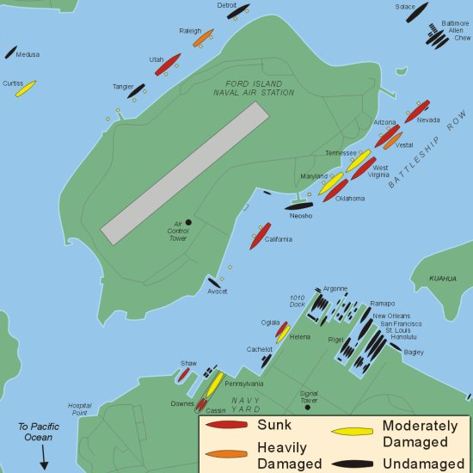

Slide 17
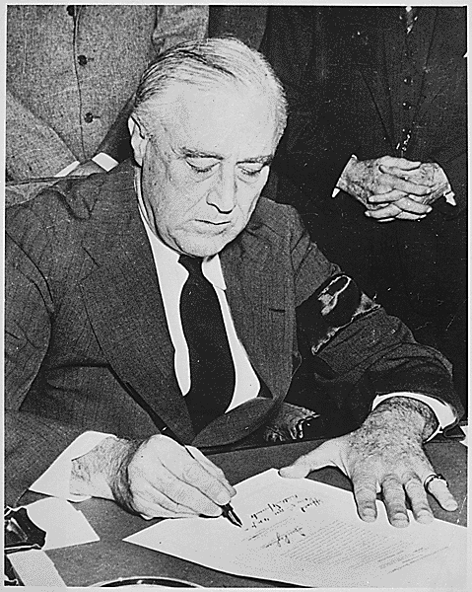
FDR Signs the
War Declaration

Slide 18
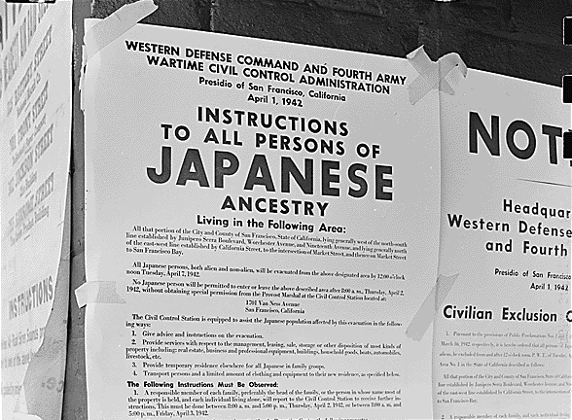
Executive Order 9066

Slide 19
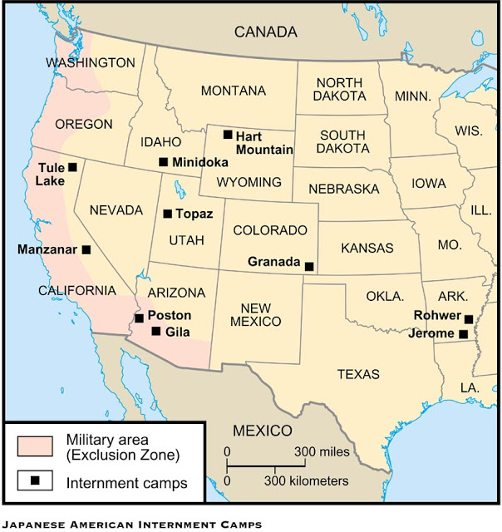

Slide 20
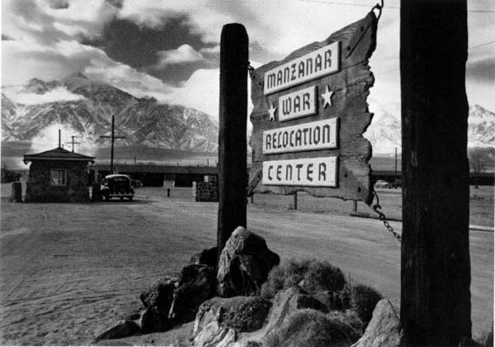

Slide 21
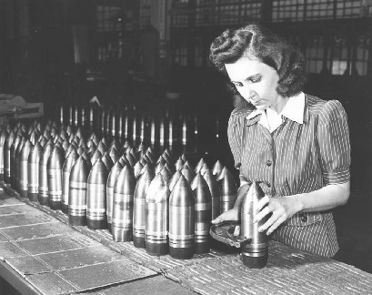
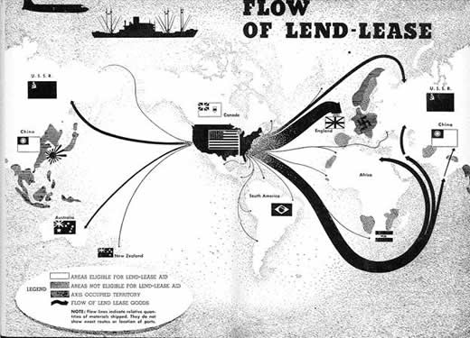
Arsenal of Democracy

Slide 22
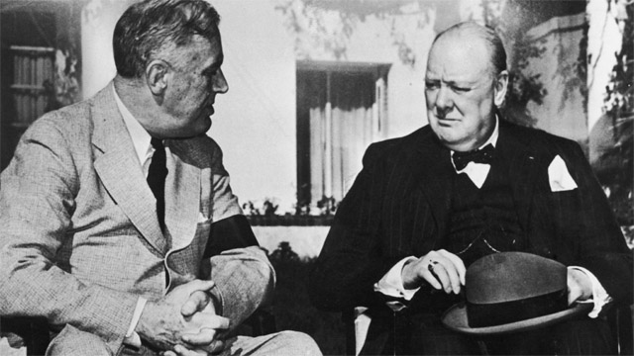
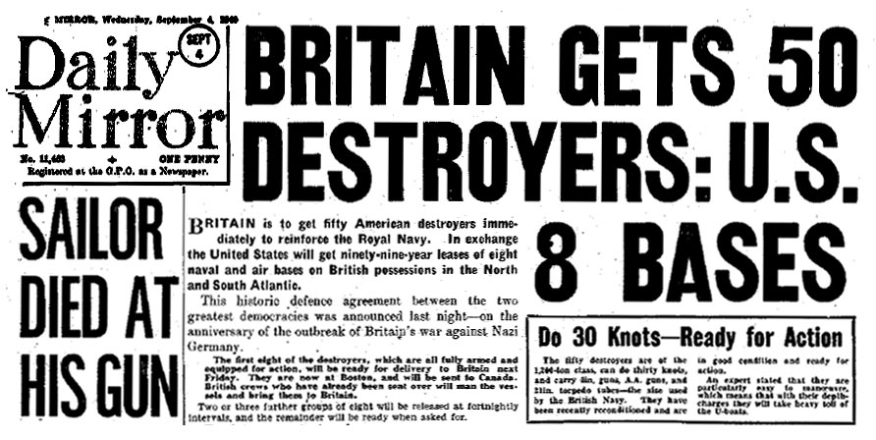
The Destroyer Deal

Slide 23
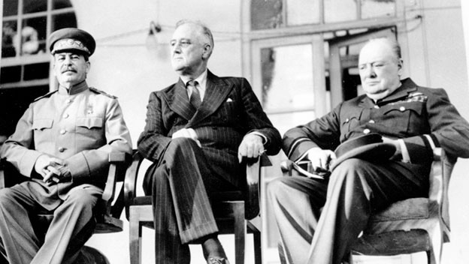
Tehran Conference
Began in Nov. 1943
The conference was a meeting between (The Big Three) FDR, Stalin and Churchill
The leaders agreed that they would all work together to defeat Hitler first
Then the concentration would be on Japan

Slide 24
D-Day
On June 6, 1944, an American led unit invaded Nazi held France
The soldiers attacked on Higgins boats on the beaches of Normandy, FR
This was the largest amphibious invasion in the history of the world
The success of this led to Hitler having to fight a 2 front war with Russia and France

Slide 25
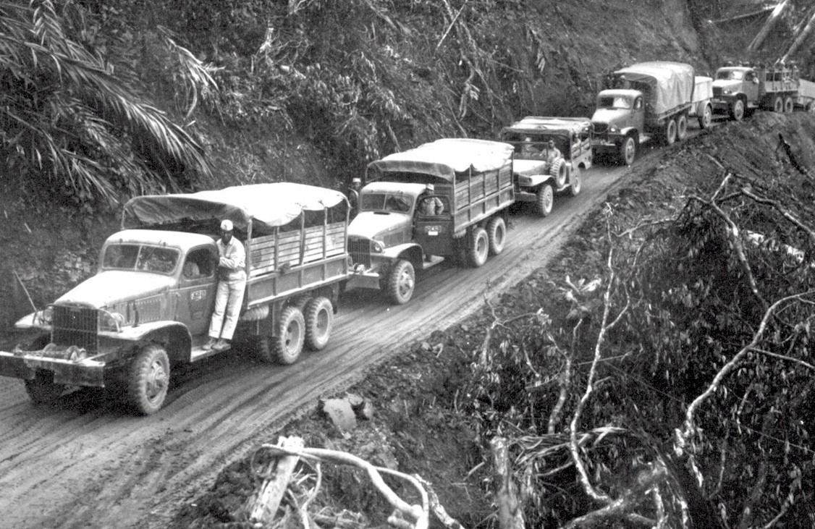
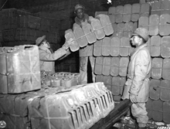
“Red Ball Express”

Slide 26
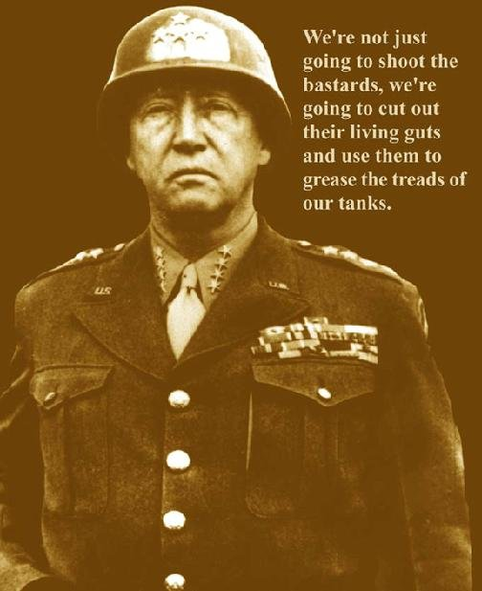
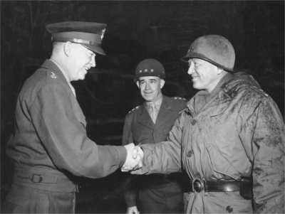

Slide 27
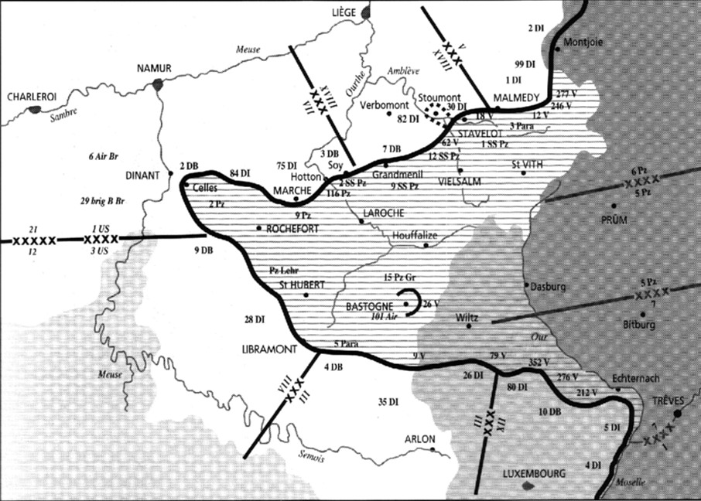
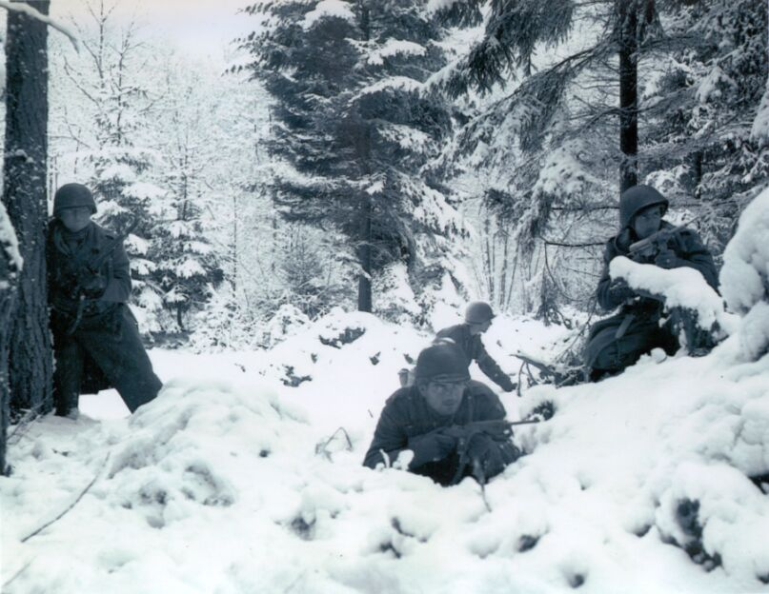
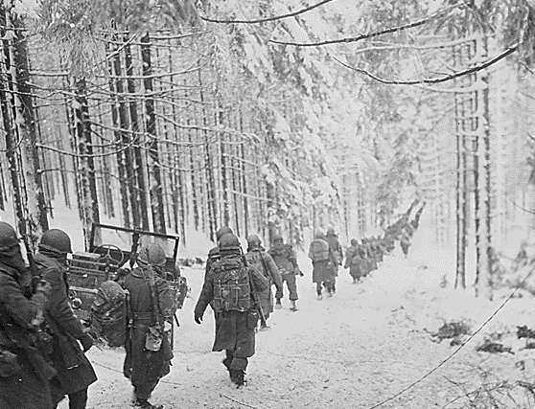
The Battle of the Bulge:
Hitler’s Last Offensive
Dec. 16, 1944
to
Jan. 28, 1945

Slide 28
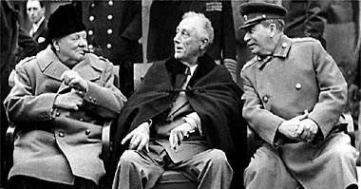
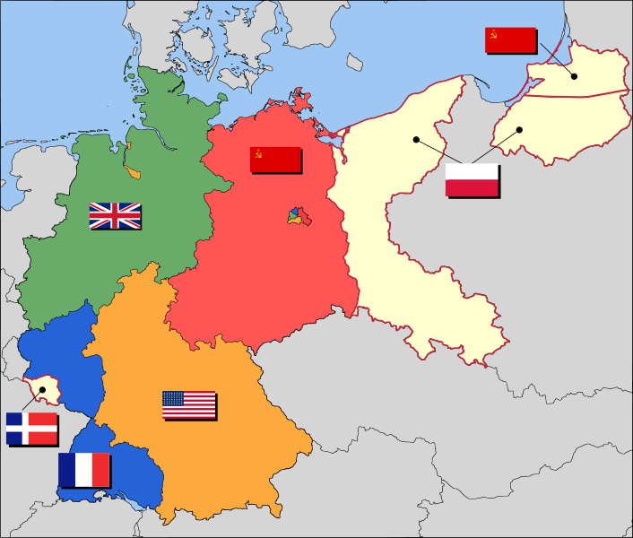
Yalta: February, 1945
This was the meeting to decide what to do with Germany after WWII.
FDR & Churchill concede Stalin needs buffer, they give the USSR Poland
FDR & Stalin want influence and a weak Germany.
Churchill wants strong Germany as buffer against Stalin.
FDR argues/ creates ‘United Nations’.

Slide 29
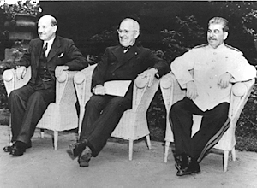
Potsdam Conference:
July, 1945
erAfter the Yalta Conference of February 1945, Stalin, Churchill, and U.S. President Franklin D. Roosevelt had agreed to meet following the surrender of Germany to determine the postwar borders in Europe.
Germany surrendered on May 8, 1945, and the Allied leaders agreed to meet over the summer at Potsdam to continue the discussions that had begun at Yalta.
The major issue at Potsdam was the question of how to handle Germany. At Yalta, the Soviets had pressed for heavy postwar reparations from Germany, half of which would go to the Soviet Union.
President Truman’s July 24, 1945 conversation with Stalin, during which time the President informed the Soviet leader that the United States had successfully detonated the first atomic bomb on July 16, 1945.
The Ally leaders give Japan the option to surrender
P.M. Clement President Joseph
Atlee Truman Stalin

Slide 30
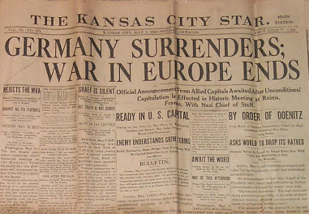
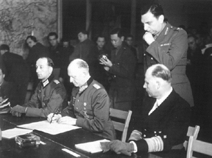
V-E Day (May 8, 1945)
General Keitel

Slide 31
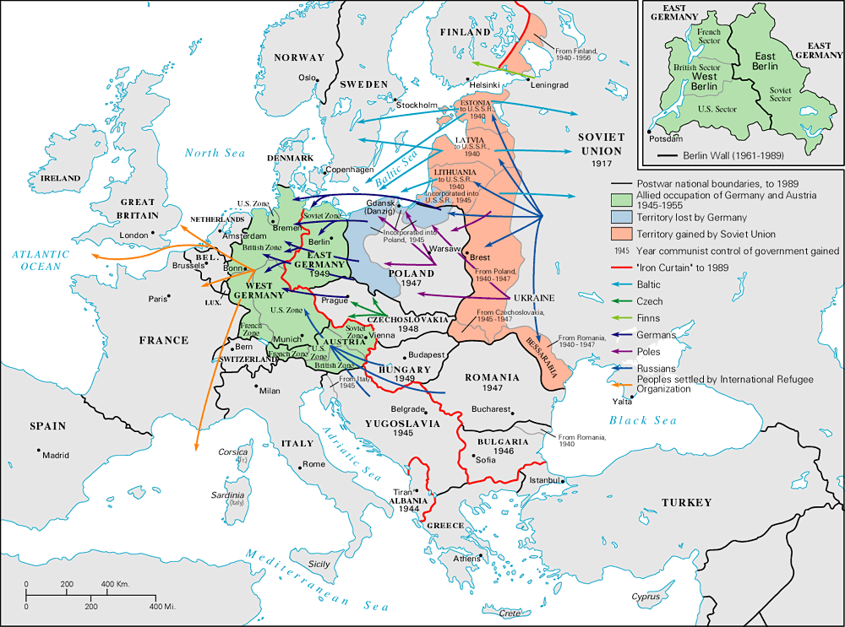
The Bi-Polarization of Europe: The Beginning of the Cold War

Slide 32
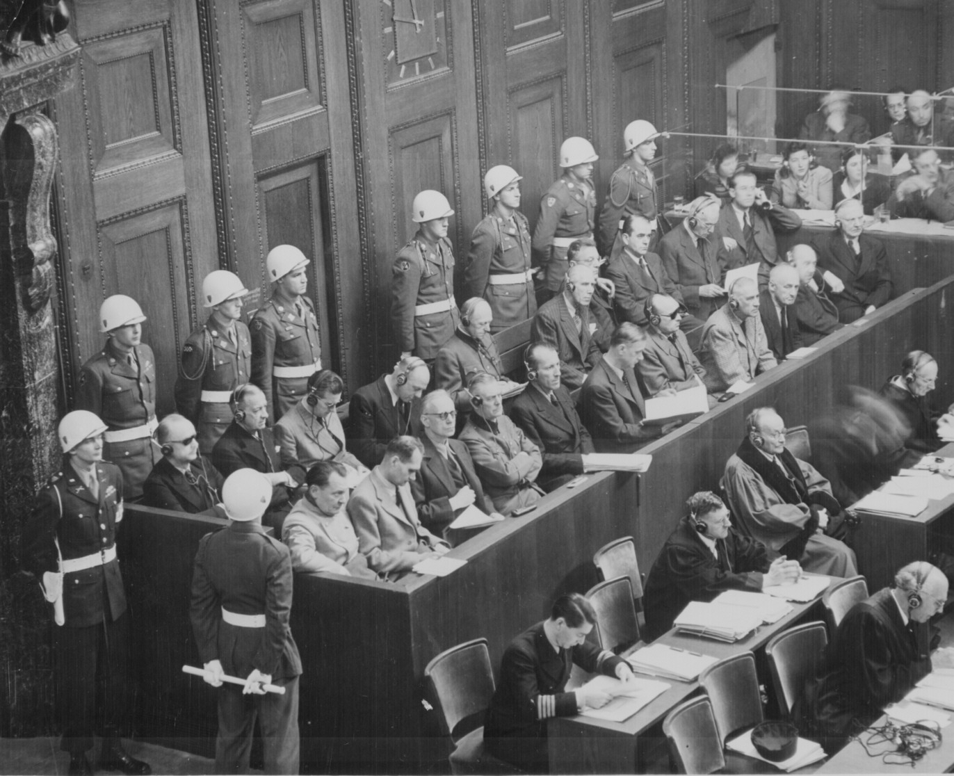
Nuremberg Trial
These were trials for Nazi war crimes; such as the Holocaust
Held in 1945 and 1946, Germany was blamed for the war
Many committed suicide, rather than go to the trial
War crimes were held in Japan and Italy as well

Slide 33
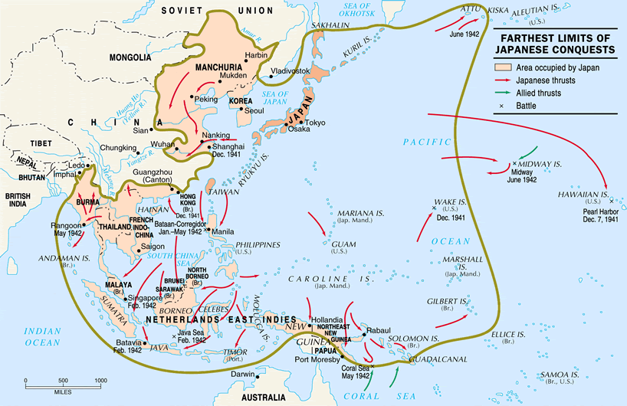
Farthest Extent
of Japanese Conquests

Slide 34
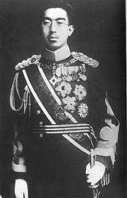
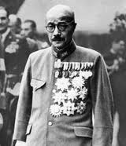
Japanese Leadership
Tojo- He had a reputation for sternness and discipline
Tojo was given command of the 1st Infantry Regiment upon returning to Japan after WWI and spending time in Berlin
He saw that the Nazis were poised for power and pushed for the alliance with Germany
Tojo became a virtual dictator after pushing the prince out of power
He demanded the Pearl Harbor attacks and those which followed after PH
Hirohito (1901- 1989 was emperor of Japan from 1926 until his death.
Hirohito became regent for his chronically ill father and assumed the duties of emperor.
The people of Japan were told that he is the living embodiment of God

Slide 35
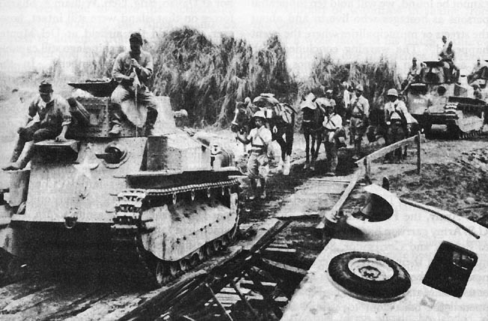
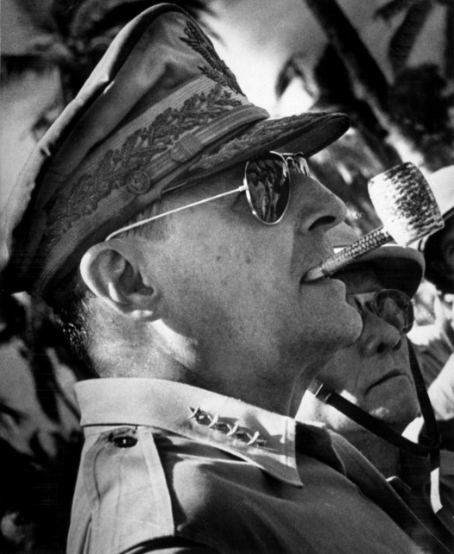
Fall of the Philippines
  The attack on the Philippines began just a few hours after Pearl Harbor was bombed.
  More than 40,000 Japanese troops landed on 22 December, reflecting the high priority that resource-starved Japan gave to the Philippines. US Army troops in conjunction with a Filipino detachment continued to fight while retreating southward towards Bataan.
  Nearly 15% of the more than 75,000 US/ Filipino POWs died during the Bataan death march
Douglas MacArthur

Slide 36
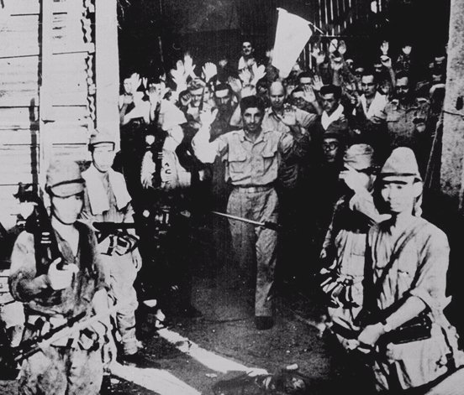
US Surrenders at Corregidor, the Philippines (March, 1942)

Slide 37
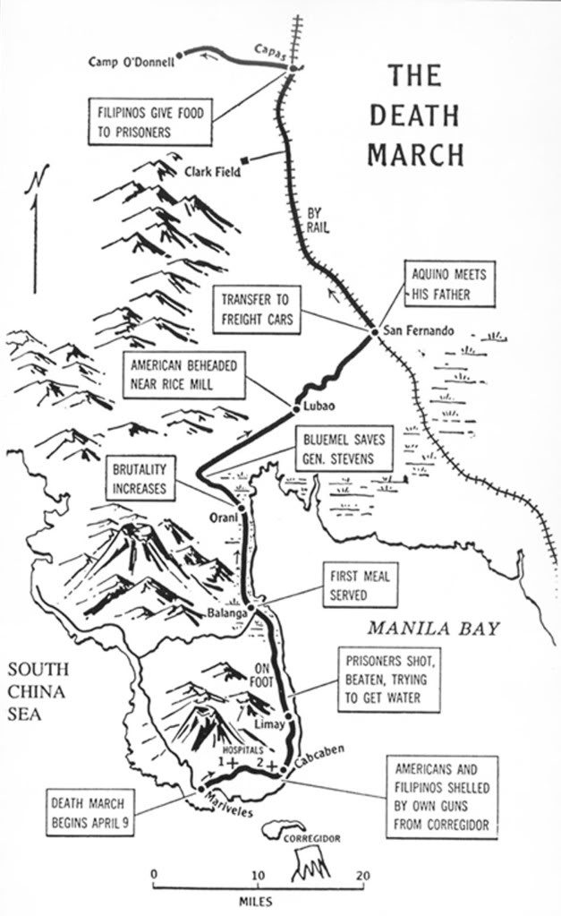
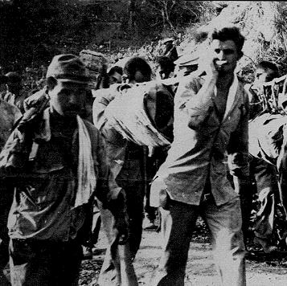
Bataan Death March

Slide 38
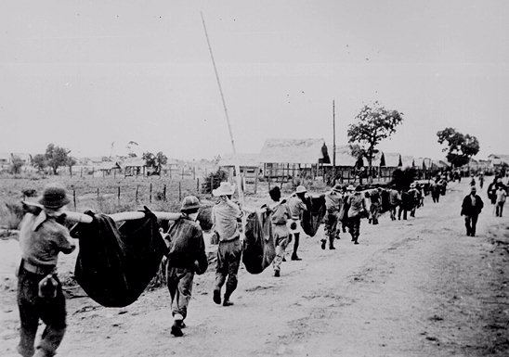
Bataan Death March: April, 1942
76,000 prisoners [12,000 Americans] Marched 60 miles in the blazing heat to POW camps in the Philippines.

Slide 39

Allied Counter-Offensive:
“Island-Hopping”

Slide 40

Midway- “Turning Point of the War”
Six months after the attack on Pearl Harbor, the United States defeated Japan in one of the most decisive naval battles of World War II
The battle happened because the Japanese wanted to sink the aircraft carriers that escaped Pearl Harbor
The US cracked the code of the Japanese
Nimitz placed available U.S. carriers in position to surprise the Japanese moving up for their preparatory air strikes on Midway Island itself.
The Americans sank four fleet carriers–the entire strength of the task force–Akagi, Kaga, Soryu, and Hiryu, with 322 aircraft and over five thousand sailors. The Japanese also lost the heavy cruiser Mikuma.
American losses included 147 aircraft and more than three hundred seamen.
Turning point of the war in the Pacific; Japan defended and US attacked
“Put an end to the long period of Japanese offensive action”

Slide 41

Taking Back the Philippines
Japanese sneak attacked the US navy there; one of the largest naval battles in WH
Philippines- over 80,000 Japanese killed, less than 1,000 surrendered
1st time that Kamikaze were used in combat
MacArthur returned to the Philippines
Amphibious tractor; Amptrac or “Alligator”

Slide 42


Japanese Kamikaze Planes:
Suicide bombers
Kamikaze Pilots
Suicide Bombers

Slide 43

Gen. MacArthur “Returns” to the Philippines! [1944]
“People of the Philippines, I have returned. By the grace of Almighty God, our forces stand again on Philippine soil.”

Slide 44

Iwo Jima
Key island: close to Japan to help damaged bombers, take off for fighters
Volcanic island with hard, rugged land; black sand from the volcano
Navy and air force bombed the island for over 2 months
US marines landed on the beach expecting a serious fight
Japanese dug in; tunnels, caves and pillboxes
Some of the Japanese tunnels/caves were several stories deep
Tiny island took over a month to take

Slide 45

Mt. Suribachi
Over 22,000 Japanese, only 212 surrendered
More than 6,800 marines died to get the island; 18, 070 wounded
Only time more US KIA/ wounded than Japanese in the Pacific

Slide 46
The Battle of Okinawa
Okinawa was the largest amphibious invasion of the Pacific campaign, and the last major battle in the Pacific campaign.

Slide 47


Slide 48
Impact of the Pacific Campaign
The strategy of island hopping got the US close enough to Japan to bomb Japan
With these airfields, the US bombers attacked the Japanese cities until the end of the war

Slide 49

Harry S. Truman
After FDR died, Harry S. Truman became president
He was faced with guiding the US through the rest of WWII
The lower estimates of an invasion of Japan were around 1,000,000 soldiers casualties
The unprecedented American losses on Okinawa -- one third of the invasion force was killed, wounded or missing
The atomic bomb could be a way of avoiding this
One advisor said that Truman would be impeached if he did not use the bomb

Slide 50
Fire Bombing of Japan
B-29; Super fortress, dropped thousands of bombs on Tokyo before the nuclear bombs
The air raid of 9–10 March, 1945, is estimated to be the most destructive bombing raid in history
Over 50% of Tokyo was destroyed by the end of World War II.

Slide 51



Slide 52


Slide 53

The Manhattan Project
This was a group of scientists who created the atomic bomb; 12 years to make the bomb
People from all over the world went to the US to be a part of the project
Germany won the most Nobel’s in 1933, US after that because many people left b/c of the Nuremberg laws
Bombs cost 2 billion $, 30 billion today
The project was created in Los Alamos, New Mexico
The residents of Los Alamos–known as site or project "Y"–lived highly restricted lives: Their mail was censored, their phone calls were monitored and even their interaction with family members was tightly controlled.
Needed to find a way to sustain split atoms/ explosions
Groves- Military man; same leader of the creation of the Pentagon
Oppenheimer- easily stressed out, “couldn’t run a hot dog stand”
Created over 1,000 different plants to house the reaction in; the magnets pulled the nails out of the wall

Slide 54

The Trinity Bomb
Trinity test; had wires hanging off it, tape to hold it together, “garage bomb”
The scientists were afraid that it would set the atmosphere on fire

Slide 55


Trinity test of the first nuclear bomb

Slide 56



The Manhattan Project:
Los Alamos,
NM
I am become
death,
the destroyer
of worlds!
Major General
Lesley R. Groves
Dr. Robert Oppenheimer

Slide 57

Tinian Island, 1945
Little Boy Fat Man
Little boy= Uranium gun bomb that shot the U235 into another piece of uranium
LB- 9,700 lbs. 10 ft. length X 28 inch diameter
Its components were fabricated at three different plants so that no one would have a copy of the complete design.
Fat Man plutonium bomb; 10,300 lbs., 128 inch length X 60 inch diameter
Fat Man was untested; not enough plutonium for 2 bombs at the time

Slide 58

Col. Paul Tibbets & the A-Bomb

Slide 59


Hiroshima – August 6, 1945
70,000 killed
immediately.
48,000 buildings.
destroyed.
100,000s died of
radiation poisoning &
cancer later.

Slide 60


Hiroshima: After
Hiroshima: Before the bomb

Slide 61
Impact of the Use Of Nuclear Weapons
Nuclear weapons became a major threat to all nations of the world
This weapon creates a lot of fear between the US and the rest of the world

Slide 62


Nagasaki – August 9, 1945
40,000 killed
immediately.
60,000 injured.
100,000s died of
radiation poisoning
& cancer later.

Slide 63


Japanese War Crimes Trials
The Asian countries victimized by the Japanese war machine tried far more Japanese -- an estimated five thousand, executing as many as 900 and sentencing more than half to life in prison.
The Tokyo trials began on May 3, 1946, and lasted two and a half years.
Less people were executed in Japan than Germany because the US wanted favorable terms during our occupation of Japan
General
Hideki Tojo
Bio-Chemical Experiments

