Slide 1
Review- Missed Material

Slide 2
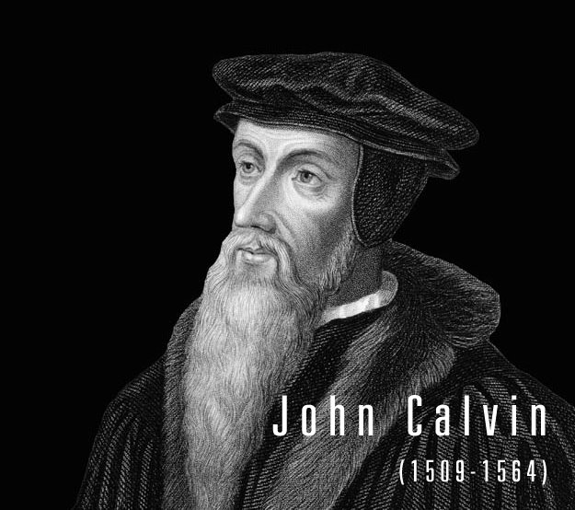
John Calvin
(Unit 1; Pre-US History)
Calvinists believe in the supreme power of God
Human are wicked by nature and needed strict leadership
Key part of the faith- Predestination

Slide 3
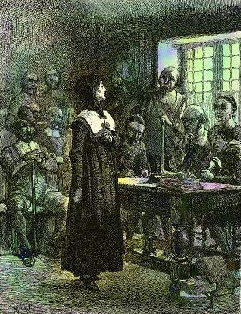
Anne Hutchinson
(Unit 1- Colonial Period)
A. Hutchinson believed in antinomianism; humans did not need to obey man’s laws b/c they were predestined to enter heaven
Hutchinson was punished with banishment by the General Court of Massachusetts and excommunication by the Church of Boston.
She was killed by an Indian raid 6 years later

Slide 4
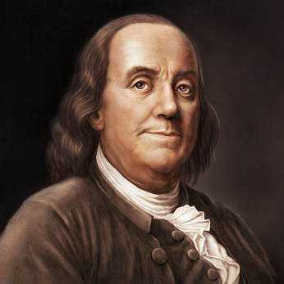
Ben Franklin
(Unit 1- Colonial Period)
One of the leading figures of early American history, Benjamin Franklin (1706-90) was a statesman, author, publisher, scientist, inventor and diplomat.
He helped launch a lending library, hospital and college, and garnered acclaim for his experiments with electricity, among other projects.

Slide 5
Ben Franklin
(Unit 1- Colonial Period)
During the American Revolution, he served in the Second Continental Congress and helped draft the Declaration of Independence in 1776.
He also negotiated the 1783 Treaty of Paris that ended the Revolutionary War (1775-83).
In 1787, in his final significant act of public service, he was a delegate to the convention that produced the U.S. Constitution.

Slide 6
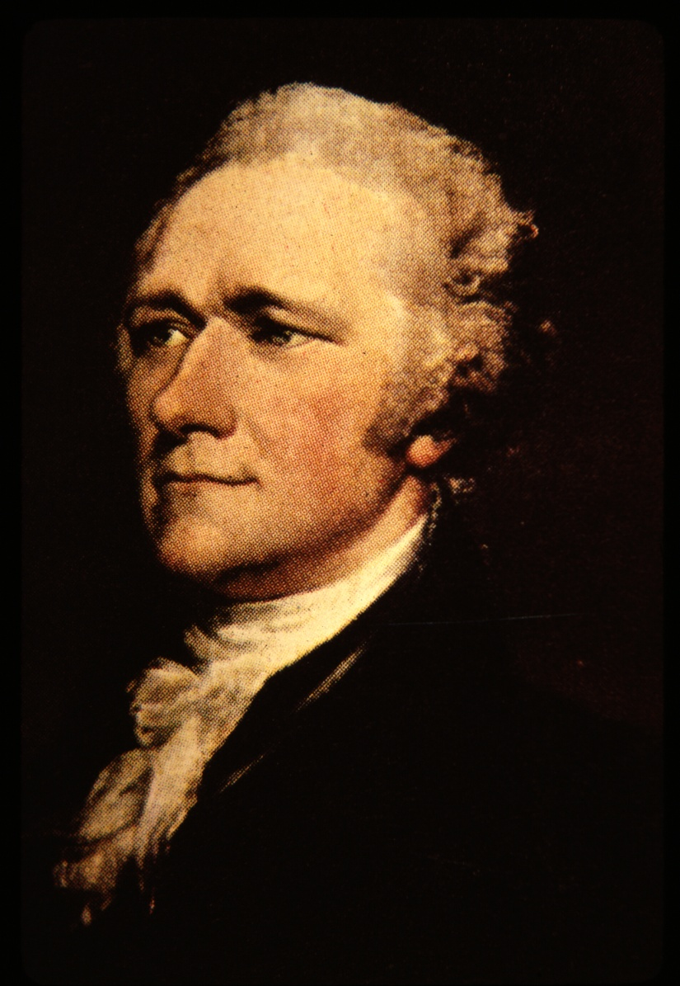
Mobocracy- Term
Mobocracy- Fear of the uneducated choosing a president would be dangerous to the stability of the nation

Slide 7
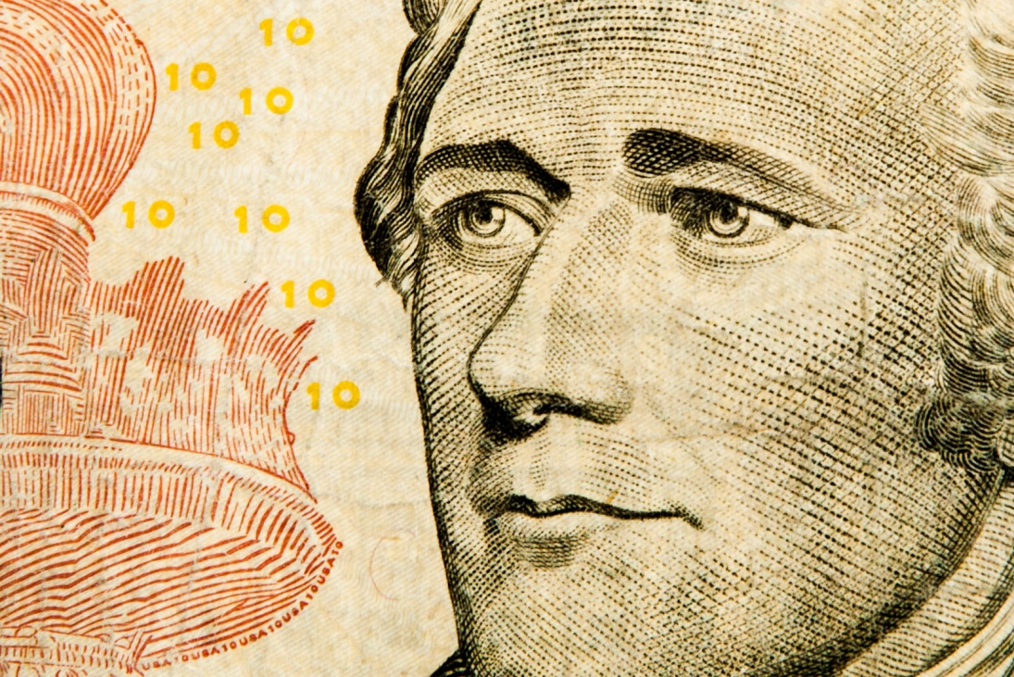
Report on Public Credit
(Unit 2- Early Gov. , 1790)
Report on Public Credit- Explained how monetary and fiscal policy should favor the rich, so they can stimulate domestic growth
Report on Manufactures- Promoted the industrialization of the US and the use of strong protective tariffs

Slide 8
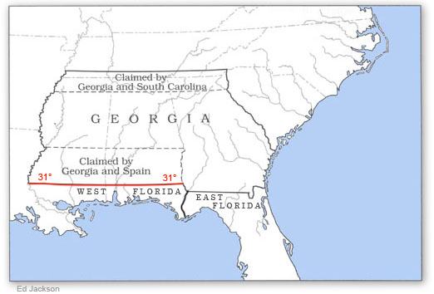
Pinckney Treaty
(Unit 3, 1795)
Opened up the right of deposit at the Port of New Orleans in 1795 with Spain
However, in 1802 Spain revoked the right
Farmers demanded gov. intervention
This was one of the causes of the Louisiana Purchase

Slide 9
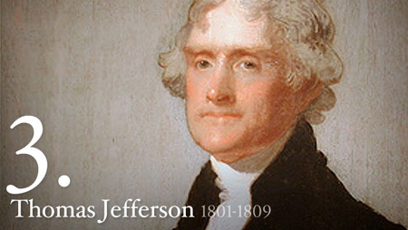
Jefferson’s Attempt to Remove the Federalists Judge (Unit 3)
After the Marbury decision, Jefferson desired to remove Federalist SC judges
A partisan (In favor of one side) House voted to impeach Justice Samuel Chase
The Senate refused to remove Chase without evidence of “high crimes and misdemeanors”

Slide 10
National Republicans, Whigs
(Unit 3, 1834–54)
In 1834 political opponents of President Andrew Jackson organized a new party to contest Jacksonian Democrats.
And in 1840 and 1848, the party captured the White House.
Their only loss in a presidential election during the decade occurred in 1844 when Clay lost by a hair to the Democrats’ James K. Polk, who had greater appeal to voters favoring the expansion both of territory and slavery.
They have been seen as champions of banks, business, corporations, economic growth, the positive liberal state, humanitarian reform, and morality in politics, and as opponents of expansionism, executive tyranny, states’ rights, labor, and the democratic suffrage, among other things. These dissimilar assessments are given the heterogeneity of the party itself, in its leaders, policies and programs, political style, and rank-and-file supporters.

Slide 11

Susan B. Anthony
(Unit 3- 4, 1820- 1906)
Born on February 15, 1820, in Adams, Massachusetts, Anthony grew up in a politically active family. They worked to end slavery in what was called the abolitionist movement. They were also part of the temperance movement, which wanted the production and sale of alcohol limited or stopped completely.
She was founder and first president of the American Red Cross.
She worked in field hospitals during the Civil War, trying to save soldiers wounded in battle

Slide 12
Susan B. Anthony
(Unit 3- 4, 1820- 1906)
President of the National American Woman Suffrage Association.
Anthony was tireless in her efforts, giving speeches around the country to convince others to support a woman’s right to vote. She even took matters into her own hands in 1872 when she voted in the presidential election illegally. Anthony was arrested and tried unsuccessfully to fight the charges. She ended up being fined $100 – a fine she never paid.

Slide 13
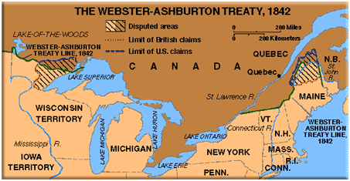
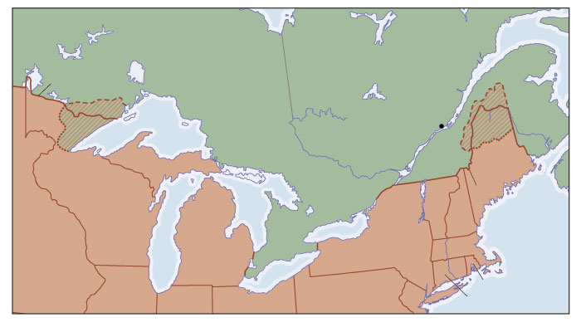
Webster- Ashburton Treaty (1842)
Unit 3
The Webster-Ashburton Treat of 1842 helped to settle disputes over the northern boundary between the United States and Canada, which was controlled by Great Britain.
The treaty signaled a strong partnership and diplomatic success for the two nations.

Slide 14
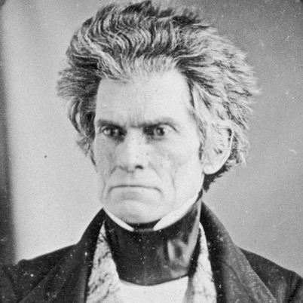
John C. Calhoun
Unit 3, (1782-1850)
Prominent U.S. statesman and spokesman for the slave-plantation system of the antebellum South.
As a young congressman from South Carolina, he helped steer the United States into war with Great Britain and established the Second Bank of the United States.
Calhoun went on to serve as U.S. secretary of war, vice president and briefly as secretary of state.

Slide 15
John C. Calhoun
Unit 3, (1782-1850)
As a longtime South Carolina senator, he opposed the Mexican-American War and the admission of California as a free state, and was renowned as a leading voice for those seeking to secure the institution of slavery.
At first he supported the Tariff of Abomination, but his constituents changed his mind

Slide 16
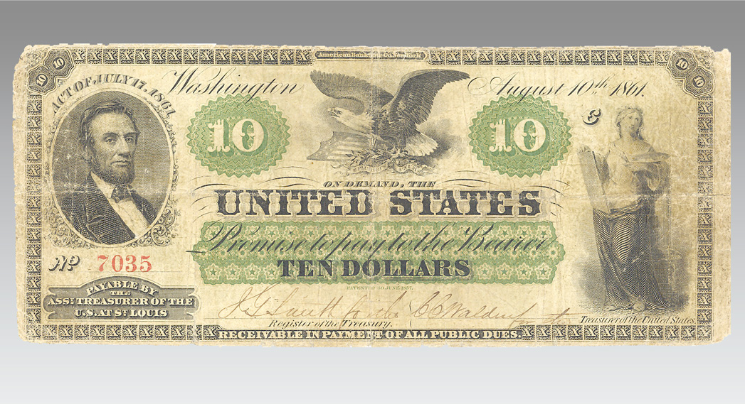
Greenbacks- Term
Unit 4
The national government lacked the financial tools in the winter of 1860-61.
It lacked both a stable currency and supply of credit along with revenue and banking systems.
By the time the sixteenth president, Abraham Lincoln, took the oath of office on March 4, 1861, the country was not only on the verge of Civil War but also a financial disaster.
The nation’s coffers were almost empty, left in disarray from three decades of Jacksonian fiscal policies, and the government faced a continuing liquidity crisis in light of the demands generated by Civil War expenditures.
The first greenbacks were printed in 1862, after the passage of the Legal Tender Act, which President Lincoln signed into law on February 26, 1862.
And a new system of national banks also brought some stability to the nation's finances.

Slide 17
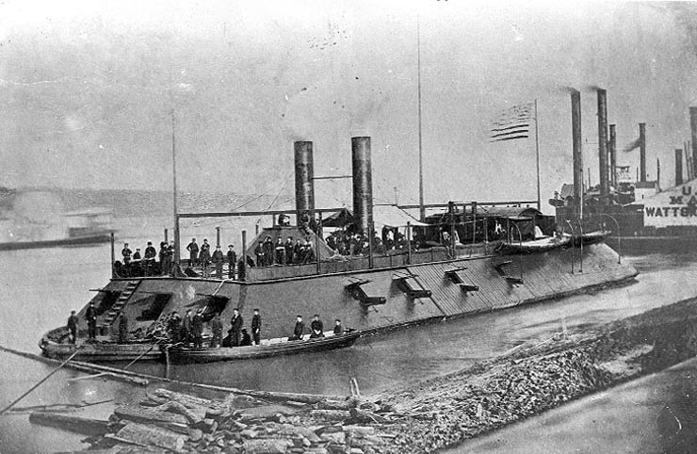
Ironclads- Term
Unit 4
During the American Civil War, the CSS Virginia, a captured and rebuilt Union steam frigate formerly known as the Merrimac, engages the USS Monitor in the first battle between iron-fortified naval vessels in history.
The iron ships showed that the age of wooden ships was over and the majority of the US fleet was converted after the war

Slide 18
Homestead/ Morrill Land Grant Act of 1862 (Unit 4)
Signed into law by President Abraham Lincoln on May 20, 1862, the Homestead Act encouraged Western migration by providing settlers 160 acres of public land. In exchange, homesteaders paid a small filing fee and were required to complete five years of continuous residence before receiving ownership of the land.
Morrill Land Grant- Passed on July 2, 1862, this act made it possible for new western states to establish colleges for their citizens. The new land-grant institutions, which emphasized agriculture and mechanic arts, opened opportunities to thousands of farmers and working people previously excluded from higher education.

Slide 19
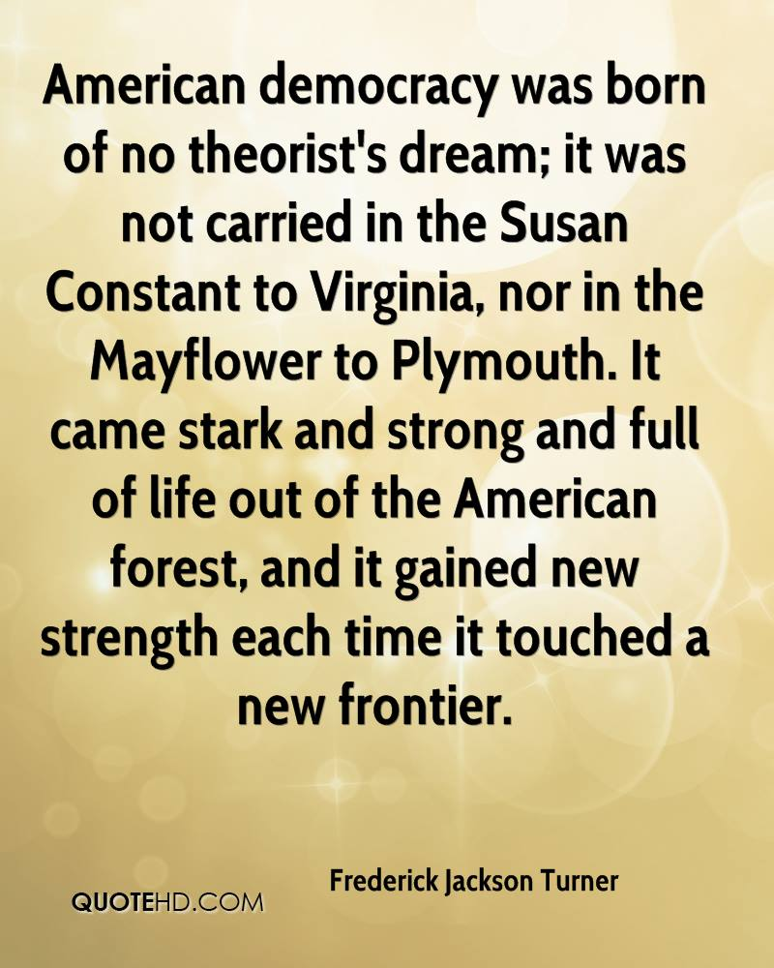
Frederick Jackson Turner “Frontier Thesis” (1893)
Turner argued that the American character was shaped by the frontier and the way that Americans interacted with it

Slide 20
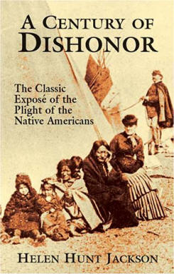
Helen Hunt Jackson
“A Century of Dishonor” Unit 5
H. H. Jackson’s book focused on the mistreatment of the Native Americans
Jackson's book was well received and Congress appointed a commission to look into Indian affairs. The result was the Dawes Act that broke up reservation land into individual plots. The individual plots were given to Indian families. The effect of the Dawes Act, which was mostly well intentioned, resulted in a further destruction of tribal life.

Slide 21
Dawes Severalty Act, 1887
Unit 5
The most important motivation for the Dawes Act was Anglo-American hunger for Indian lands. The act provided that after the government had doled out land allotments to the Indians, reservation properties would be opened for sale to whites. Consequently, Indians eventually lost 86 million acres of land, or 62 percent of their total pre-1887 holdings.
Still, the Dawes Act was not solely a product of greed. Many religious and humanitarian “friends of the Indian” supported the act as a necessary step toward fully assimilating the Indians into American culture. Reformers believed that Indians would never bridge the chasm between “barbarism and civilization” if they maintained their tribal cohesion and traditional ways.

Slide 22
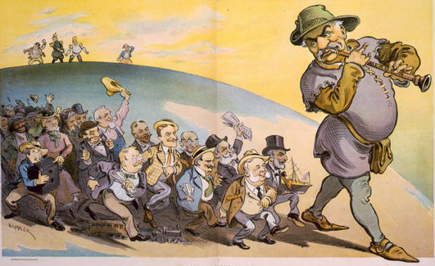
Panic of 1893
Unit 5
At the end of the Harrison presidency the Reading Railroad, a major eastern line, was about to go bankrupt
Stock/ bank crashes followed and the nation was in a major depression
J.P. Morgan and other wealthy financiers rushed to buy the RR and several others, to create one RR monopoly
Morgan soon controlled almost 2/3rds of the RR of the US

Slide 23
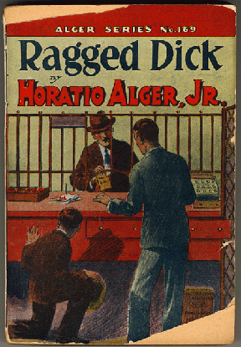
Horatio Alger “Ragged Dick”
Unit 5- Gilded Age
By the end of this, 90% of America’s wealth was held by 10% of the pop.
“Ragged Dick”- Wrote to inspire the poor to work hard and become wealthy like Carnegie

Slide 24
Unions- Labor in the Gilded Age
Unit 5
Scabs, cheap replacement labor, replaced those who went on strike
Some strikers were blacklisted
Yellow-dog contract- Oath that the worker would not join a union
Great RR strike (1877)- RR companies cut pay by 10% during the depression
It was the 2nd time in 4 years that their wages were cut
Pres. Hayes sent Fed. troops to end the strike
Over 100 strikers were killed with no changes in labor conditions

Slide 25
Unions- Labor in the Gilded Age
Unit 5
Closed Shop- Businesses where all employees had to be a member of a union
Pinkerton police- 1850 he formed Pinkerton's National Detective Agency, with the motto "We Never Sleep" and an unblinking eye as its symbol. This would lead to the description of independent detectives as "private eyes."
Pinkerton detectives were often hired as muscle for factory management during bitter labor strikes.
It was the bloodshed during the strike at Andrew Carnegie's Homestead Mill in 1892 that led to laws in 26 states that banned bringing in outside guards during labor disputes.

Slide 26
Eugene V. Debs
(1855-1926) Unit 5
Between 1900 and 1920 Debs was the Socialist party’s standard-bearer in five presidential elections.
In 1912, in a four-way race with Woodrow Wilson, Theodore Roosevelt, and William Howard Taft, he received 6 percent of the vote-his highest total ever.
Between campaigns, Debs was a speaker and organizer for the party, and he traveled the nation defending workers in their strikes and industrial disputes.
He conducted his last campaign for president as prisoner 9653 in the Atlanta Federal Penitentiary while serving ten years for his opposition to World War I.
He received nearly a million votes.

Slide 27
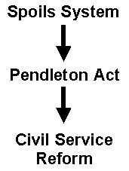
Pendleton Civil Act
Unit 5 (1881)
The Pendleton Civil Service Reform Act of US is a federal law established in 1883 that stipulated that government jobs should be awarded on the basis of merit.

Slide 28
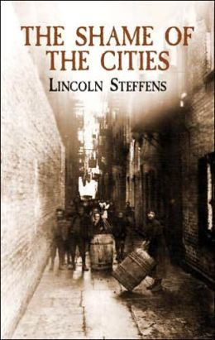
Lincoln Steffens
“The Shame of Cities” (1904) Unit 5
“The Shame of Cities” highlights the corruption and greed of big-city political machines
This was another piece of Progressive literature

Slide 29
The Federal Reserve
Unit 6 (1913)
With the nation confronting another financial crisis in 1907, and the United States the only one of the world’s major financial powers without a central bank, the nation was forced to turn to Wall Street.
Finance mogul J.P. Morgan, who had bailed the government out of a financial crisis in 1895, organized private sector investments and lines of credit to stabilize the banking system amid its latest panic.
Federal Reserve Act (1913)- Banking system of 12 regional banks, public controlled Federal Reserve Board
This was created to control inflation by restricting the printing of US currency and as a “lender of last resort”

Slide 30
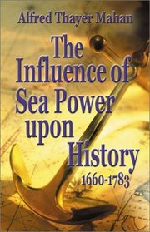
“Influence of Sea Power upon History” Unit 6 (1890)
Alfred Thayer Mahan argued that British control of the seas, combined with a corresponding decline in the naval strength of its major European rivals, paved the way for Great Britain’s emergence as the world’s dominant military, political, and economic power. Mahan and some leading American politicians believed that these lessons could be applied to U.S. foreign policy, particularly in the quest to expand U.S. markets overseas.

Slide 31
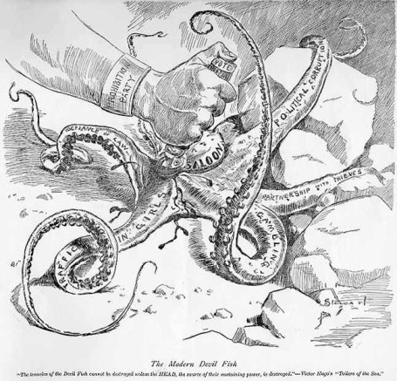
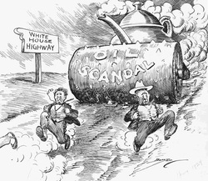
The Ohio Gang or Poker Cabinet
Unit 7 (1920s)
Nickname of the Harding administration b/c of the charges and examples of corruption led by his friends from Ohio
Stories of large poker parties, gambling of priceless White House items were common

Slide 32
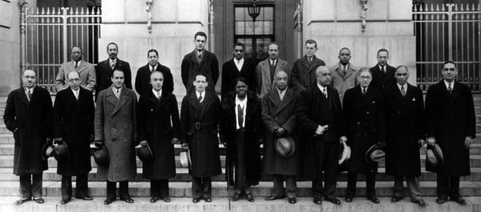
FDR’s Black Cabinet
(1932-44) Unit 8
Eleanor urged FDR to appoint more African Americans to the executive positions
This “Black Cabinet” advised him on Jim Crow and anti-lynching laws
While not of these laws were passed, the event pushed for further involvement of Blacks in federal government

Slide 33
“Brother, Can You Spare A Dime” lyrics by Yip Harburg, music by Jay Gorney (1931)
They used to tell me I was building a dream, and so I followed the mob, When there was earth to plow, or guns to bear, I was always there right on the job. They used to tell me I was building a dream, with peace and glory ahead, Why should I be standing in line, just waiting for bread?
Once I built a railroad, I made it run, made it race against time. Once I built a railroad; now it's done. Brother, can you spare a dime? Once I built a tower, up to the sun, brick, and rivet, and lime; Once I built a tower, now it's done. Brother, can you spare a dime?
Once in khaki suits, gee we looked swell, Full of that Yankee Doodly Dum, Half a million boots went slogging through Hell, And I was the kid with the drum!
Say, don't you remember, they called me Al; it was Al all the time. Why don't you remember, I'm your pal? Buddy, can you spare a dime?
Once in khaki suits, gee we looked swell, Full of that Yankee Doodly Dum, Half a million boots went slogging through Hell, And I was the kid with the drum!
Say, don't you remember, they called me Al; it was Al all the time. Say, don't you remember, I'm your pal? Buddy, can you spare a dime?

Slide 34
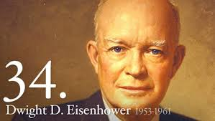
The Eisenhower Administration
Unit 10
WWII European commander, planned/ commanded D-Day
Eisenhower won his bid for the president by a landslide
One of his foreign policy goals was to end the Korea war and de-escalate the Cold War

Slide 35
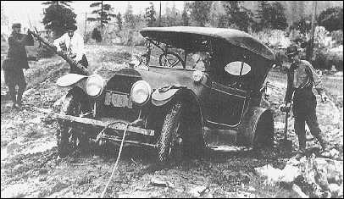
The National Highway Act
While in the military, Eisenhower drove across the US, which took him 62 days
50% of the roads were unpaved

Slide 36
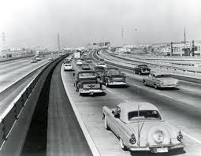
The National Highway Act
Largest construction project in US history
$129 billion to create, 2.4 billion man hours
Construction allowed the by pass of bottlenecks created while travelling through towns on the old HWYs

Slide 37
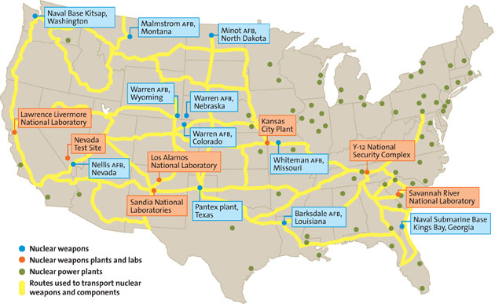
The National Highway Act
The 2nd major reason for the project was the ability for people to flee from a nuke
Also, to move our weapons/ troops quickly across the US

Slide 38
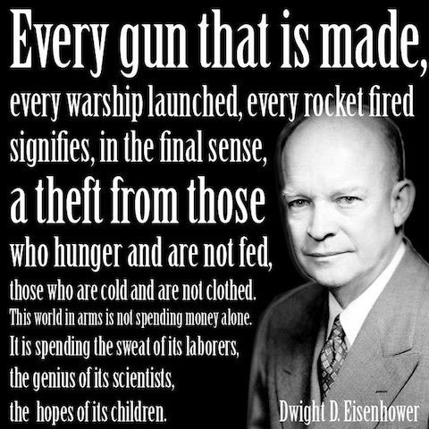
The Industrial Military Complex
Farewell speech to his presidency
Eisenhower urged his successors to strike a balance between a strong national defense and diplomacy in dealing with the Soviet Union.
He did not suggest arms reduction and in fact acknowledged that the bomb was an effective deterrent to nuclear war.
He also told the American people to be wary of too much government control and of the military

Slide 39
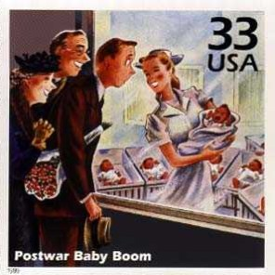
The Baby Boom
(1950s) Unit 10
Almost exactly nine months after World War II ended, “the cry of the baby was heard across the land,” as historian Landon Jones later described the trend.
More babies were born in 1946 than ever before: 3.4 million, 20 percent more than in 1945. This was the beginning of the so-called “baby boom.” In 1947, another 3.8 million babies were born; 3.9 million were born in 1952; and more than 4 million were born every year from 1954 until 1964, when the boom finally tapered off.
By then, there were 76.4 million “baby boomers” in the United States. They made up almost 40 percent of the nation’s population.

Slide 40
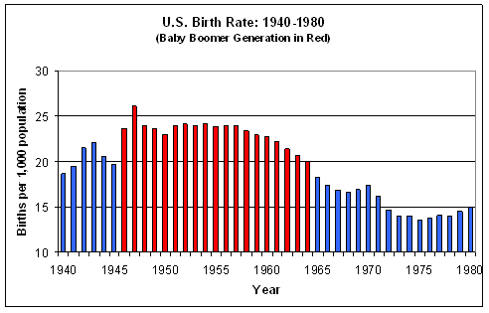
The Baby Boom

Slide 41
Levitown
Levittown, Long Island, the most famous American postwar suburban development, was a household name, the "Exhibit A" of suburbia. It came on the eve of the Baby Boom.
Vets needed housing after the war and they were able to use the GI Bill.
Levittown, Long Island, the most famous American postwar suburban development, was a household name, the "Exhibit A" of suburbia. It came on the eve of the Baby Boom.
Vets needed housing after the war and they were able to use the GI Bill.

Slide 42
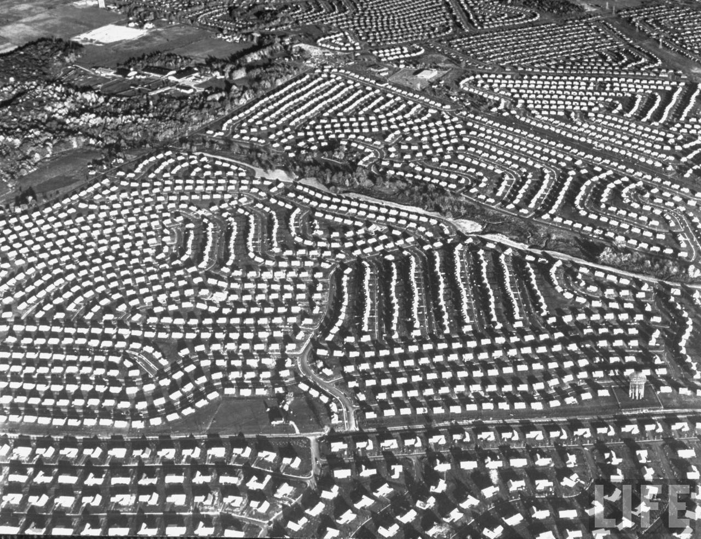
Levittown
13 million homes in 10 years
Farmland to family homes
Formed 1950s domestic culture- Cult of Domesticity
1 house built every 16 minutes, mass production

Slide 43
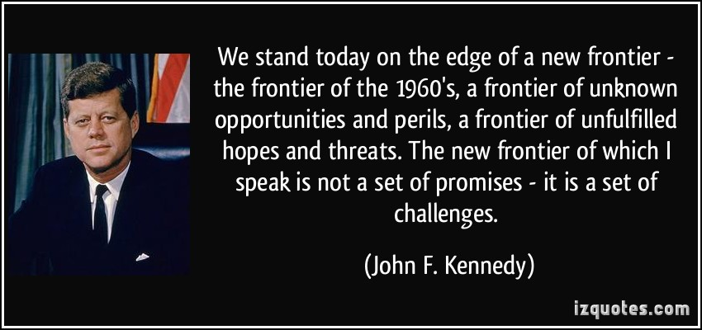
JFK “New Frontier”
(1960)
Kennedy’s Domestic policy- Promises of equality, employment, and financial aid to the needy
The majority of these acts were passed after his assassination by LBJ

Slide 44
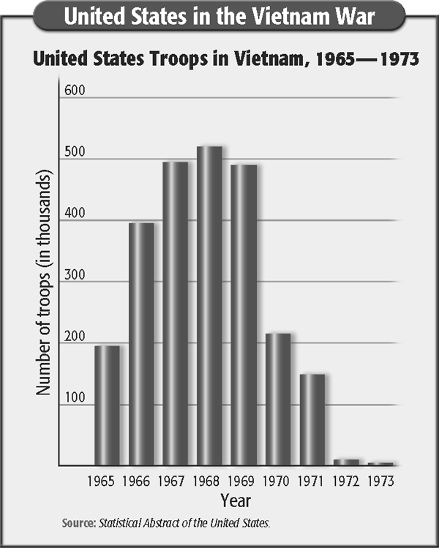
Troops to Vietnam
LBJ- 1964- 1968
Nixon- 1969 to 1974

