Slide 1
Immigration- Gilded Age- Review

Slide 2
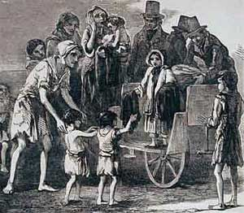
Great Potato Famine
Great Potato Famine
  Hit Ireland in 1840s
  1/3 of the average diet in Ireland,
  The potato blight destroyed 75% of the crops in the nation over 2 years
  Children were dying in the street
  Around ½ of the nation left, 8 million to 4
  100,000s came to North Boston, large northern cities

Slide 3
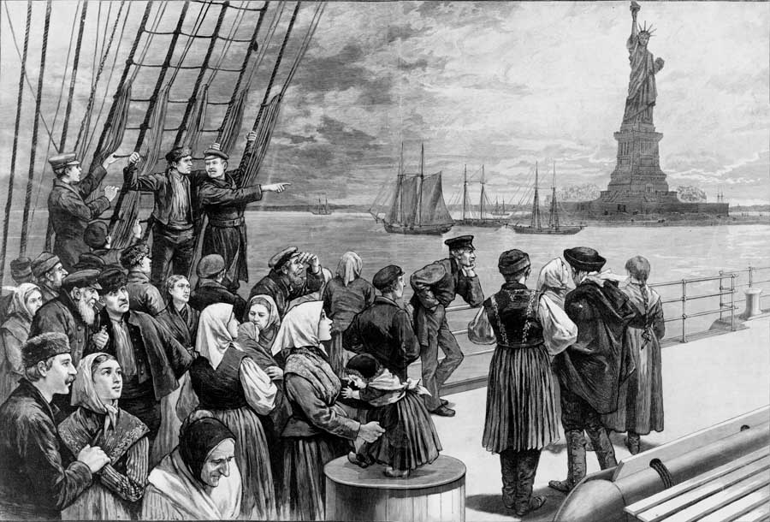
Immigration to the US
14 million immigrates from 1860 to 1900
14 day journey on boat
Before 1890: West and North Europe (Great Britain, Ireland, Germany)
After 1890: New Immigrants- South and East Europe (Italians, Jews, Russians, Baltic)
3 Reasons for immigration
  Escape religious persecution
  No jobs
  Unstable governments

Slide 4
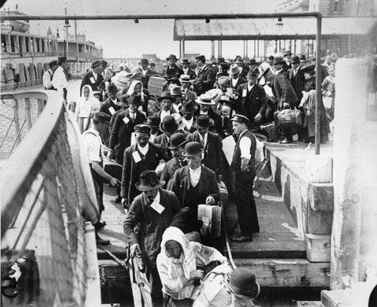
Immigration to the US
Main immigration port for people from the Atlantic side, Europe
5-hour process: physical exam; document, legal check (literacy test, $25)
Doctors would perform 6 second physicals, they could identify illnesses by just a glance
20% held 1 day; 2% returned home
Main 2 reasons for deportation- contagious disease, illegal worker
16 million immigrants total came through Ellis Island, 1892- 1950s

Slide 5
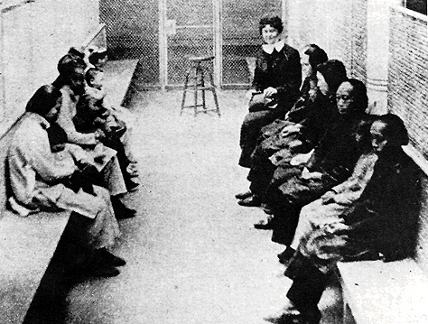
Immigration to the US
Main immigration port for people from the Pacific side, Asia
More people were sent back compared to Ellis island
Muk uk- Wooden housing for immigrates
Mostly Chinese immigrates
The Chinese had more difficult tests and were checked more for physical issues
Chinese exclusion Act- law banned Chinese for 10 years, act was not repealed until 1943
Quota laws were also enforced after WWI, % system based on the number of ethnic group already in the US- again, fight between the “Old” and “New” immigrants
Nativism- Anti-immigration party or view point

Slide 6
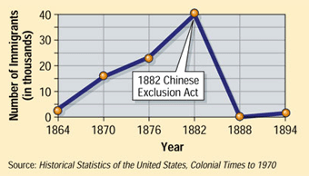
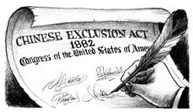

Slide 7
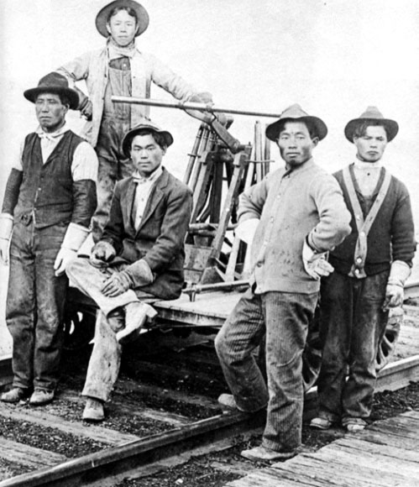
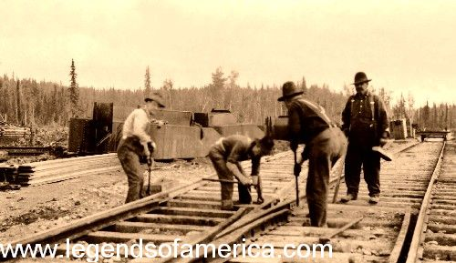
Immigrates and the Railroad
East!!!
West meets …

Slide 8
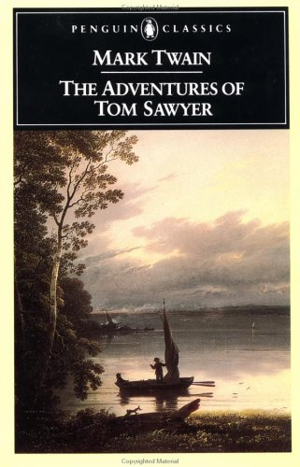
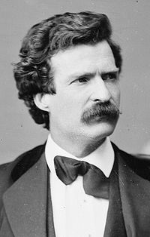
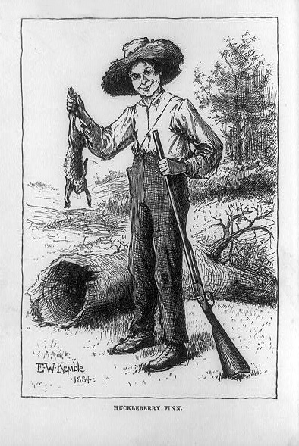
Samuel Clemens=
“Mark Twain”

Slide 9
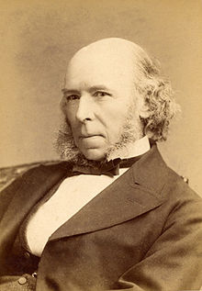
Herbert Spencer
English philosopher that proposed Social Darwinism
Natural Selection- The weak die off, leaving the strong
“Survival of the Fittest (Whitest)”

Slide 10
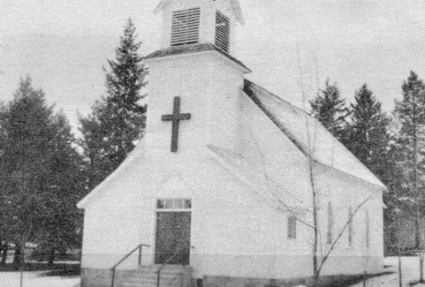
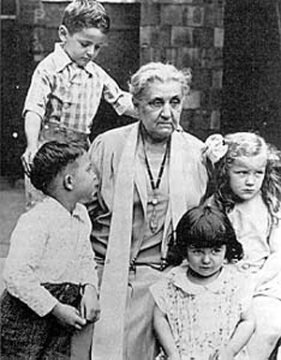
Social Gospel
SG= Movement to improve conditions in cities, according to biblical ideals
People behaved badly because of social conditions
Settlement houses: Establishments that provided homes, food, medical care… to the poor
Jane Addams= Hull houses for the poor
Similar to a halfway house- help getting established
Jane Addams, founder of Hull Houses

Slide 11
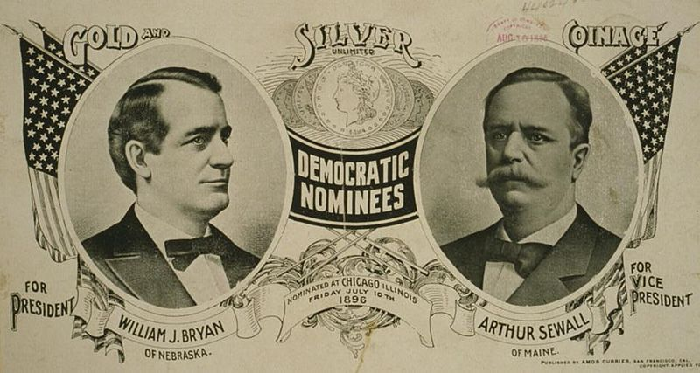
The Populist Movement
Political 3rd party that wanted more power and legislation for farmers
Political 3rd party that wanted more power and legislation for farmers
This group wanted to back the US dollar with a silver standard; each coin is worth its weight in silver
Another goal of the Populist was to cause an inflation of the $, raising worth of the farmers crops
Opposed the gold standard because gold was in a limited supply, so to limits inflation
The farmers wanted to take advantage of the inflation to make $ on their crops

Slide 12
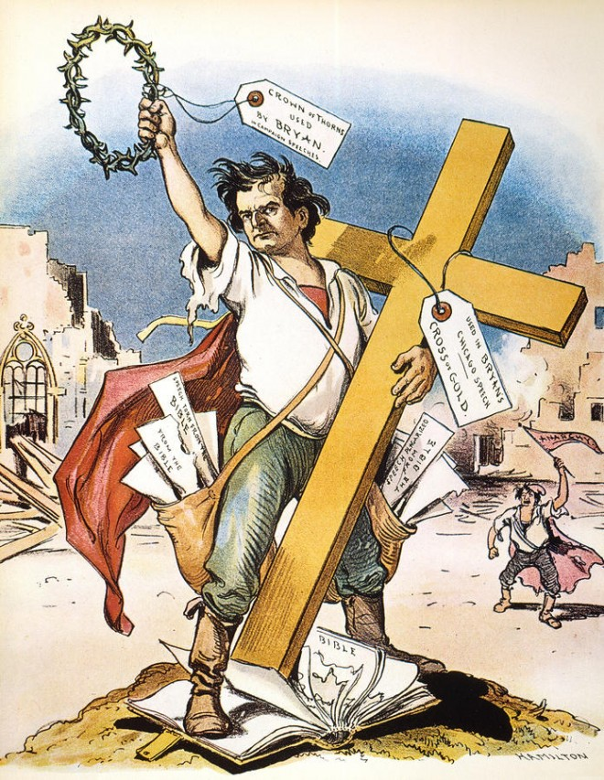
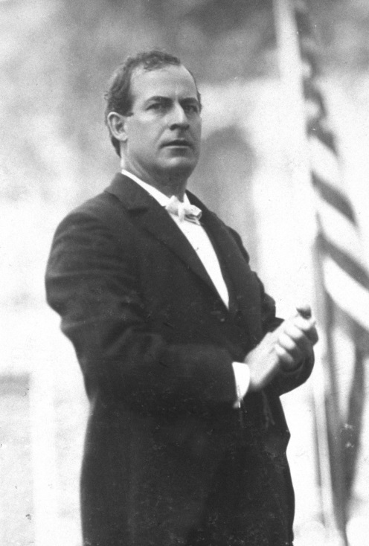
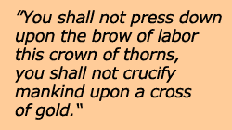
William Jennings Bryan

Slide 13
William Jennings Bryan
He was supported by the Populists and the Southern Democrats
He favored bimetallism- Gold and silver, opponents viewed him as anti-business
Cross of Gold speech
The movement dies off with the gold strikes in Yukon, Alaska w/ the higher amount of gold and the increase of money circulation
US $ stays on the gold standard until 1933 and has never gone back
McKinley used his rich supporters from the East Coast to outspend Bryans campaign, and McKinley won the NE states with the highest population

Slide 14
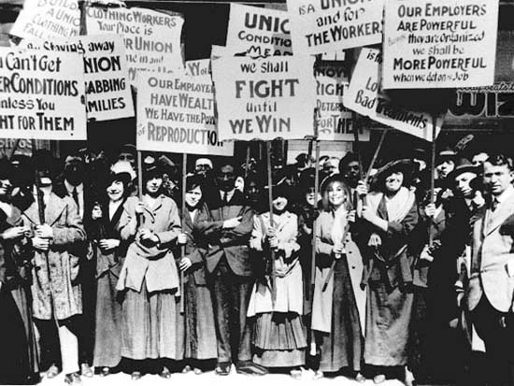
Unions
Unions used collective bargaining to get better working conditions
These unions had very little power until the Franklin Roosevelt administration
Illegal to strike, unionize- weak compared to the power of the rich businesses

Slide 15
Haymarket Square Riot
May, 1886- McCormick Harvester plant in Chicago went on strike
4 strikers were killed the previous day of the strike by the police
Police came to break up the strike the next day
August Spies, a German born anarchist labor activist, organized and began the riot
An explosive was thrown at the police during the strike and the police opened fire
Results were
  The Knights of Labor were blamed for the strike and collapsed
  8 hour work day established
  Anti-Trust and child labor laws were created
However, these laws were not really enforced for 30 years, most workers worked 6 days a week for 12 hour days

