Slide 1
Early Cold War- Review

Slide 2
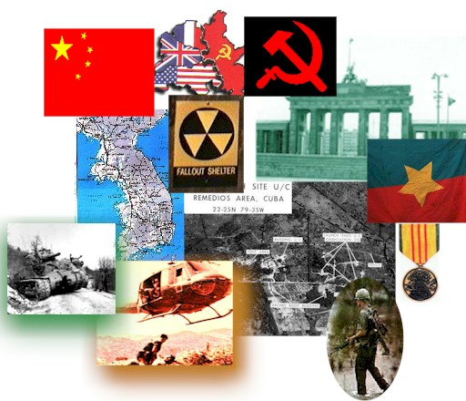
Key Terms
Cold War- Time period after WWII, political conflict between the USSR and the US; (1946- 1990)
Containment- US policy of not letting communism spread

Slide 3
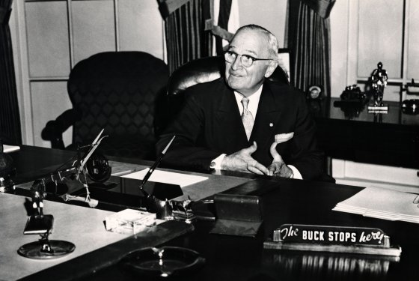
Truman Administration
3rd VP of FDR; 3 months into the jobs and FDR dies
Truman “What can I do for you?” Eleanor “what can I do for you? You’re the one in trouble now.”
He was plain spoken, had little success at other jobs
Heavy campaigning; 30,000 miles of travel, 271 speeches; Dewey 16 speeches
1948 ends segregation, lost popularity in the South
Buck stops here= Truman is responsible for all that goes wrong, Role model for democracy/ capitalism

Slide 4
After WWII
The US and the Soviet Union (USSR) were the strongest nations left after the second world war
The US was already preparing to have a war with the USSR following WWII

Slide 5
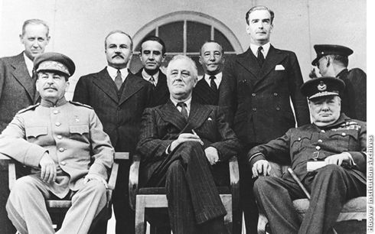
Conflict
US= Capitalist
USSR= Communist
Communism is about not needing to sell with other nations
Opposite of capitalism

Slide 6
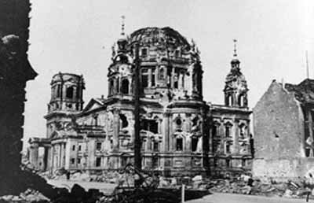
US position on Germany
US was the greatest force to end the war
Treating Germany poorly did not work
Wanted to help the nation become successful
Rebuild Europe
Ally, not an enemy

Slide 7
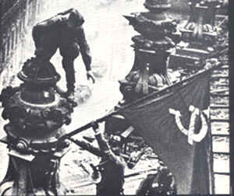
USSR Position on Germany
Russia more lost 20 million people, more than any other nation
USSR took Berlin
Feared invasion
Make sure Germany can never become powerful again

Slide 8
Losses in WWII

Slide 9
Germany
The decision was to split into 4 parts; France, England, US and USSR
Berlin was split in the middle of the city
Berlin was completely on the Soviet side

Slide 10
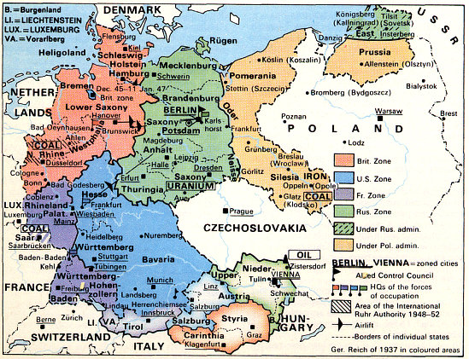
The Division of Germany:
1945 - 1990

Slide 11
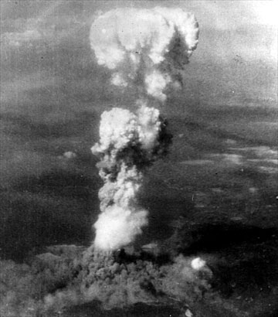
The Atomic Bomb
US wanted to end the war
Japan is very close to Russian territory
US also used the bomb as a power move

Slide 12
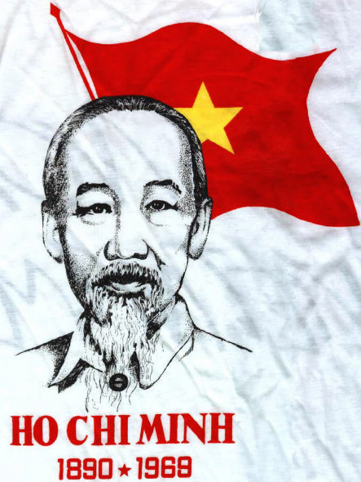
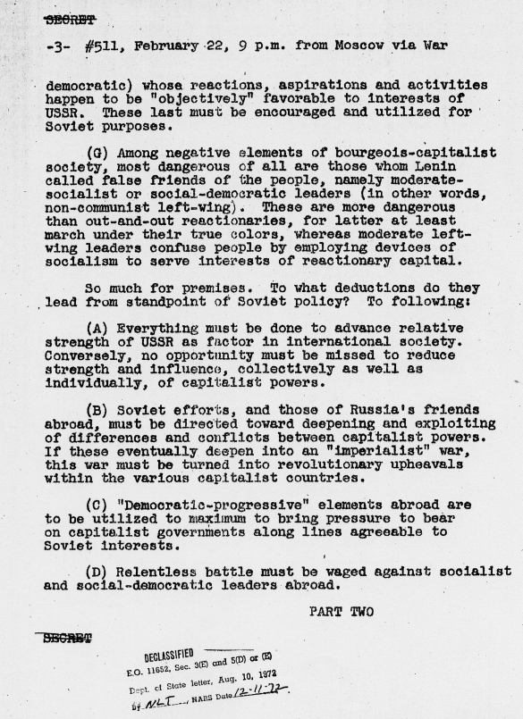
George Kennan
In 1946, while he was Chargé d’Affaires in Moscow, Kennan sent an 8,000-word telegram to the Department, “long telegram”—on the aggressive nature of Stalin’s foreign policy.
Stalin's aggressive speeches and threatening gestures toward Iran and Turkey in 1945-1946 led the Truman administration to decide to take a tougher stance and rely on the nation's military and economic muscle rather than diplomacy in dealing with the Soviets.
The document would become the policy of containment and increased the fear of the Soviets and communism
Ho Chi Minh asked for aid but Truman backed France

Slide 13
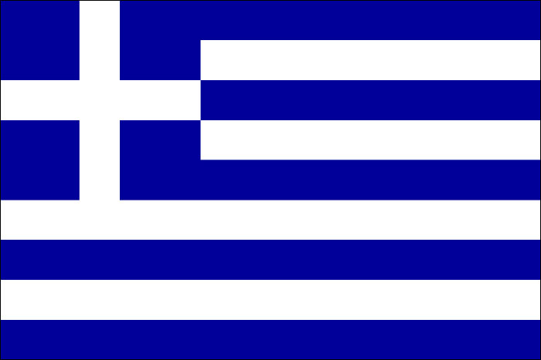
Truman Doctrine
In Greece local communist were fighting a guerrilla war
Aided by nearby communist
West feared that Greece/ Turkey would become communist
England asked US to defend the area
President Truman asked congress for 400 million dollars
First time that America acted on the containment; it was the end of the policy of American isolationism
Greece defeated the guerrillas because of US aid

Slide 14
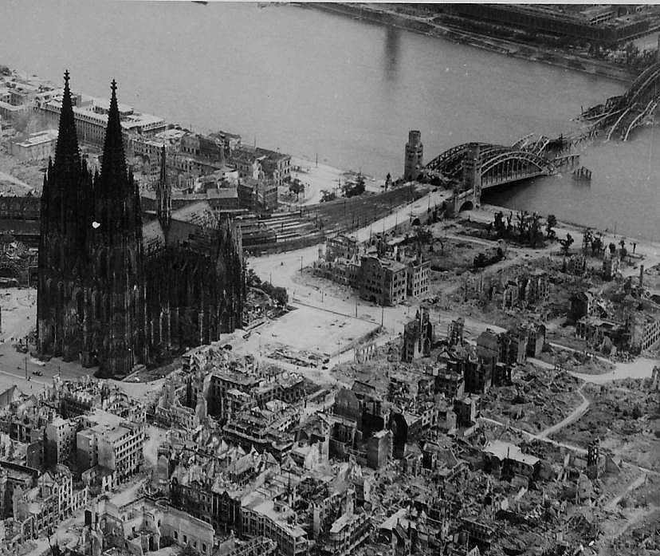
Marshall Plan
Europe was severely weakened after WWII
The US was the only major power in the world that was not majorly damaged
Truman feared that economic collapse would lead to spread of Communism
This would lead to a loss of US markets and influence
To prevent this collapse Truman put the Marshall plan in action
13 billion dollars in aid to Europe in the next 4 years
Shipments of food, fuel and machinery from the United States and later resulted in investment in industrial capacity in Europe

Slide 15
Effects of the Marshall Plan
The Soviets prevented Poland and Czechoslovakia from taking part, despite their eagerness to do so
Rebuilt damaged buildings, RR and other important structures
Boost in productivity
Reduced trade barriers between the nations
Used resources more effectively
Gained new economic opportunities and increased US influence in Europe
United the various capitalist/ democratic nations against the Soviets

Slide 16
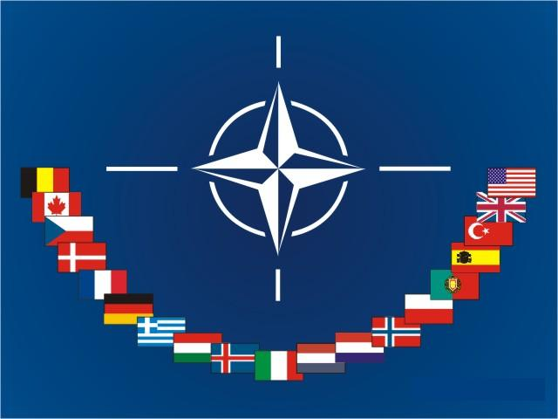
NATO
(North Atlantic Treaty Organization)
In 1949, the prospect of further Communist expansion prompted the United States and 11 other Western nations to form the North Atlantic Treaty Organization (NATO).
For the first time since the 1700s, the U.S. had formally tied its security to that of nations in Europe–the continent that had served as the flash point for both world wars.

Slide 17

Warsaw Pact
The formation of the Warsaw Pact was in some ways a response to the creation of NATO, although it did not occur until six years after the Western alliance came into being.
It was more directly inspired by the rearming of West Germany and its admission into NATO in 1955.
In the aftermath of World War I and World War II, Soviet leaders felt very apprehensive about Germany once again becoming a military power–a concern that was shared by many European nations on both sides of the Cold War divide.

Slide 18
Truman Over History
By the end of Truman’s presidency, he claimed that even his hometown would not hire him as the dog catcher. His popularity rate was at 23%. However, today he is recognized as one of the best presidents in US history.
Unpopular At The End
Recognized By History
“Letting” China go to communism
Korean War b/c the US wasn’t attacked
Corruption charges Democrats
End of WWII
The success of the Marshall Plan
Starting the Civil Rights movement with the de-segregation of the armed forces

Slide 19
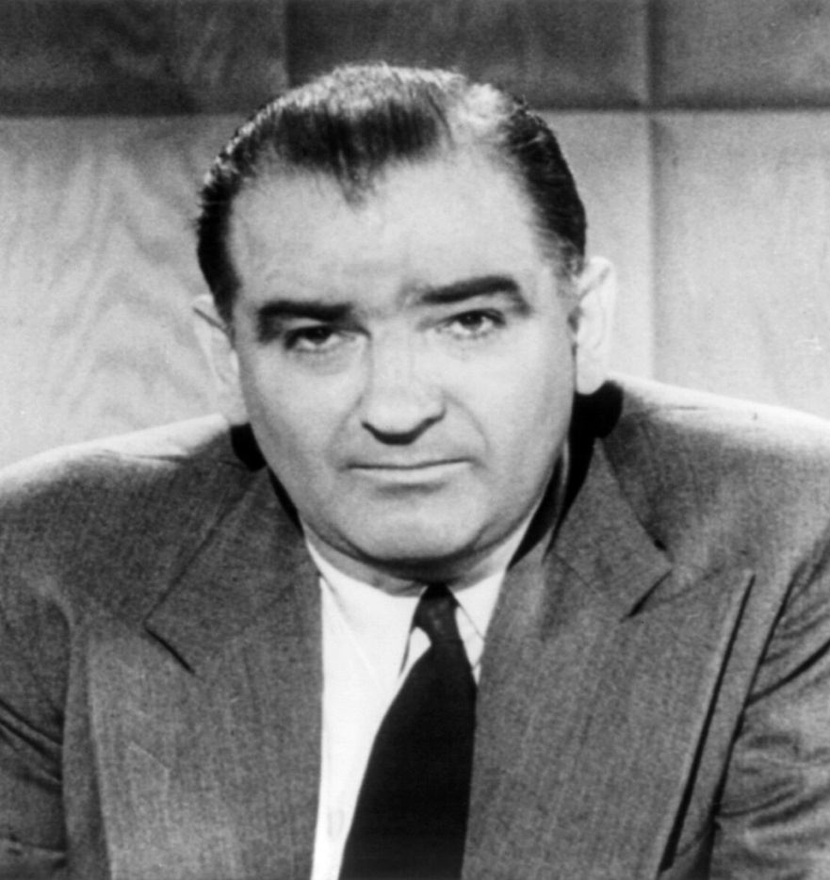
Background- Joseph McCarthy
Started as a Democrat but became a Republican to become a judge
Dirty campaign for this position
Served in WWII; as a clerk
Claimed to have completed many missions
McCarthy won the nomination in the Senate
Soon McCarthy was under investigation for taking bribes and tax evasion

Slide 20
Key Terms of the Red Scare
Subversion= Effort to weaken or overthrow the government
McCarthyism= To use intimidation and un-founded accusations in the name of fighting communism

Slide 21
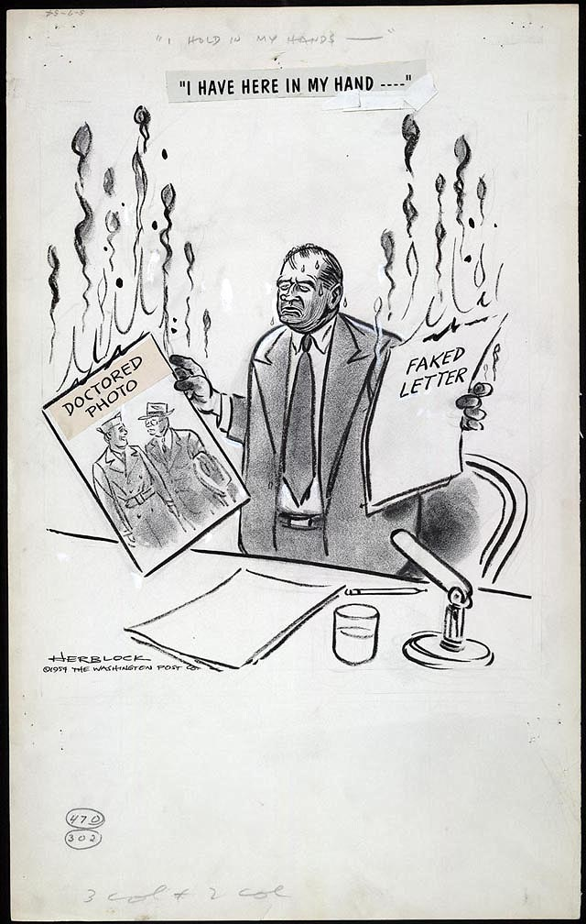
The List
McCarthy needed something to take the attention off of his problems
Feb. 9, 1950 began his accusations
McCarthy claimed that he had a list of known communists
The List
McCarthy says that there are communist in the US government
Claims that communism thrived in the Truman administration
The number of known communists would vary from place to place

Slide 22
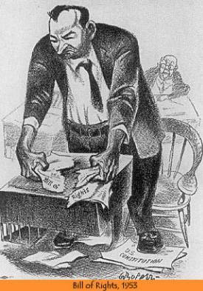
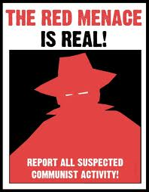
The Red Menace

Slide 23
The Hollywood Ten/ Blacklist
In October 1947, 10 members of the Hollywood film industry publicly denounced the tactics employed by the House Un-American Activities Committee (HUAC), an investigative committee of the U.S. House of Representatives, during its probe of alleged communist influence in the American motion picture business.
These prominent screenwriters and directors, who became known as the Hollywood Ten, received jail sentences and were banned from working for the major Hollywood studios.
Their defiant stands also placed them at center stage in a national debate over the controversial anti-communist crackdown that swept through the United States in the late 1940s and early 1950s.
Besides the Hollywood Ten, other members of the film industry with alleged communist ties were later banned from working for the big movie studios. The Hollywood blacklist came to an end in the 1960s.

Slide 24
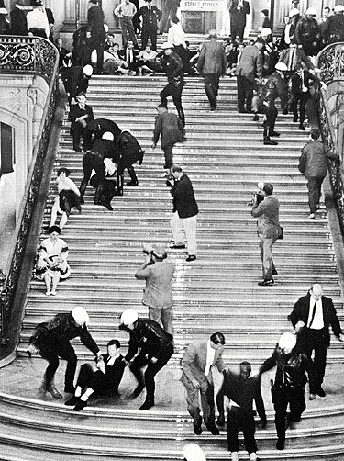
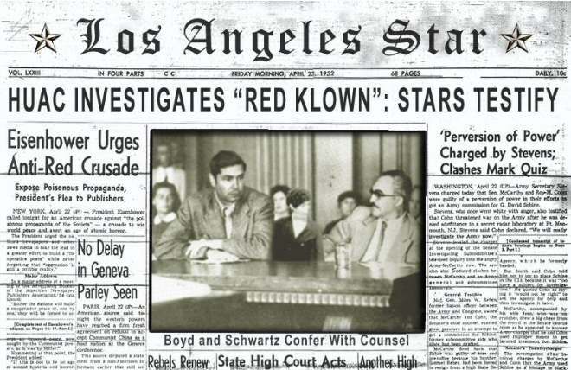
HUAC (House of Un-American Activities Committee)

Slide 25
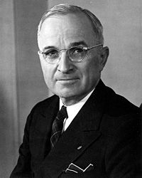
“McCarthyism… the meaning of the word is the corruption of truth... It is the use of the big lie and the unfounded accusation… This horrible cancer is eating at the vitals of America and it can destroy the great edifice of freedom.”
      Harry S. Truman, Nov. 17 1953

Slide 26
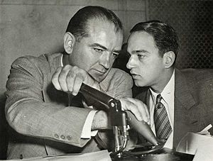
The End of McCarthy
McCarthy claimed that there were communist in the US army
For this he had to take the stand
Joseph Welsh destroyed McCarthy in court
This was because McCarthy had no evidence
1954 the Senate voted to condemn/ take away his voting rights McCarthy
This was the beginning of the end for McCarthy
Heavy drinking and poor living caught up to him
McCarthy died in 1957

