Slide 1
Unit 3 Review

Slide 2
Thomas Jefferson

Slide 3
Thomas Jefferson- 3rd President of the US, owned slaves, had a child with one, writer of the Declaration of Independence

Slide 4
Louisiana Purchase

Slide 5
LP- 300,000 acres purchased from France, Napoleon sold the land because he lost his colony in Haiti

Slide 6
Lewis and Clark

Slide 7
Lewis and Clark- Explored the area of Louisiana and were the first Americans to reach the Pacific Ocean by foot

Slide 8
Explain Jefferson’s beliefs.

Slide 9
Jefferson believed that the US would benefit from a series of small farms, not from an increase in industry

Slide 10
Federalists

Slide 11
Federalists- Believed in a strong central government, the adoption of the Constitution and did not believe that the Bill of Rights was necessary

Slide 12
Anti-Federalists

Slide 13
Anti- Federalists- Believed in strong state governments, opposed the adoption of the Constitution and believed that the Bill of Rights was necessary

Slide 14
Manifest Destiny

Slide 15
Manifest Destiny- The belief that God has a destiny for the American people to expand from the Atlantic to the Pacific

Slide 16
James K. Polk

Slide 17
Polk- Ran his presidential campaign on the concept of Manifest Destiny, he led the US to war for Mexican lands and encouraged the settlement of Oregon; 54’40 or fight

Slide 18
War for Texas Independence

Slide 19
Texans outnumbered Mexicans 10-1, they refused to follow Mexican laws

Slide 20
Santa Anna

Slide 21
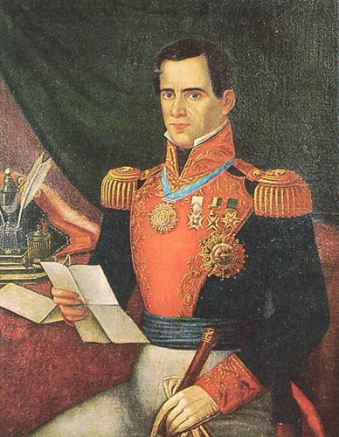
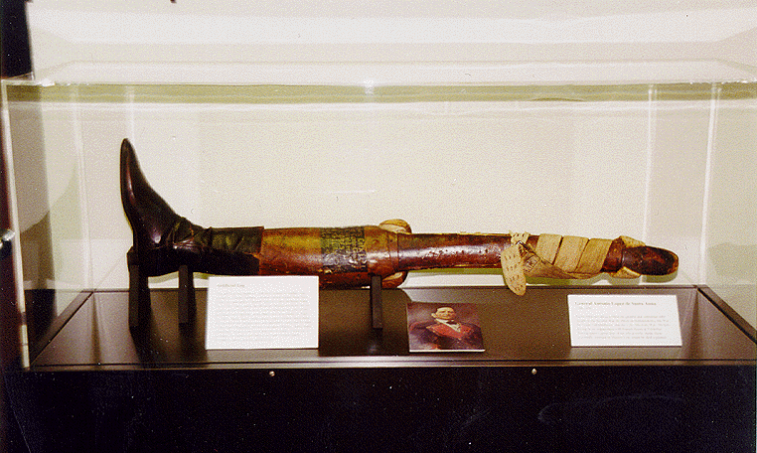
Leader of the Mexican Army, lost a leg in the Texan War

Slide 22
Which states did the US gain from the Mexican-American War?

Slide 23
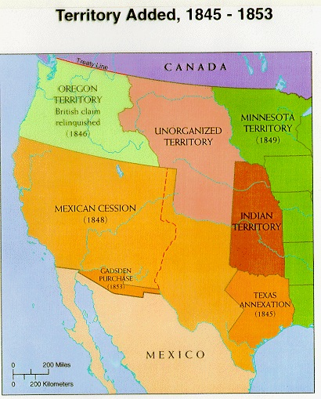
New Mexico, Arizona and California

Slide 24
Joint Occupation

Slide 25
UK and the US shared the Oregon territory before the Oregon Trail

Slide 26
Mountain Men

Slide 27
Trappers who guided the settlers through the Rockies

Slide 28
Describe the Oregon Trail

Slide 29
2,000 miles, took about 5-6 months, disease, toll roads

Slide 30
Describe the Cowboys

Slide 31
½ were non-white, they would drive the cows to the RR from Northern Mexico/ Texas

Slide 32
Explain the Trail of Tears

Slide 33
  The Supreme Court ruled that the Cherokee could stay
  Indian Removal Act – Jackson argued that the Cherokee were not a real nation, therefore US law does not apply to them
  The Trail of Tears was a forced removal of the Cherokee from Georgia/ Florida

Slide 34
Describe the events of Wounded Knee

Slide 35
The US army went to move the Sioux from their land, a deaf Indian's gun went off
The medicine man; someone fired a shot. 25 cavalrymen were killed and 300 men, women and children Sioux died.
Bury 167 in one mass grave

Slide 36
Who was Geronimo?

Slide 37
Apache war chief that fought the US and Mexican armies over his land in the SW United States

Slide 38
What is a boomer? What is a sooner?

Slide 39
Boomer- Those who wanted for the OK Land Rush to start
Sooner- Cheaters

