Slide 1
1920s- Review

Slide 2
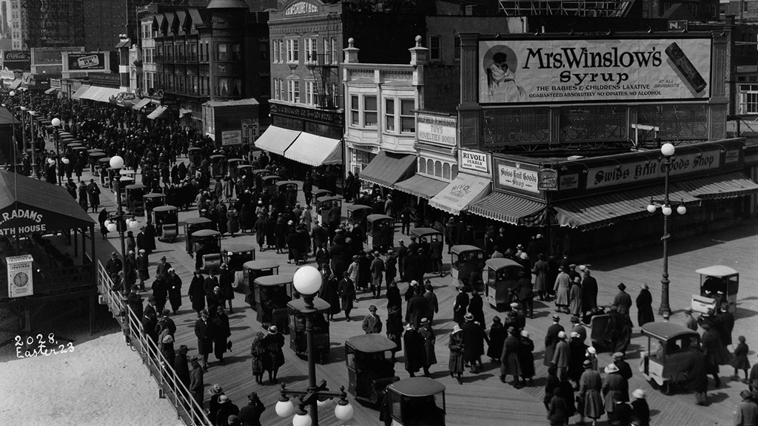
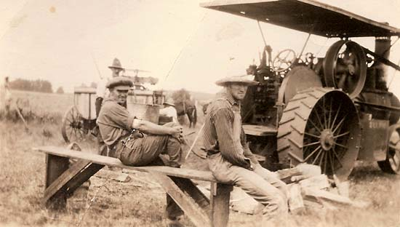
Rural to Urban
Most of the population of the US lived in villages before 1920s
Farming dropped because it was subsidized for the war effort
For the first time in US history more people lived cities than in the country

Slide 3
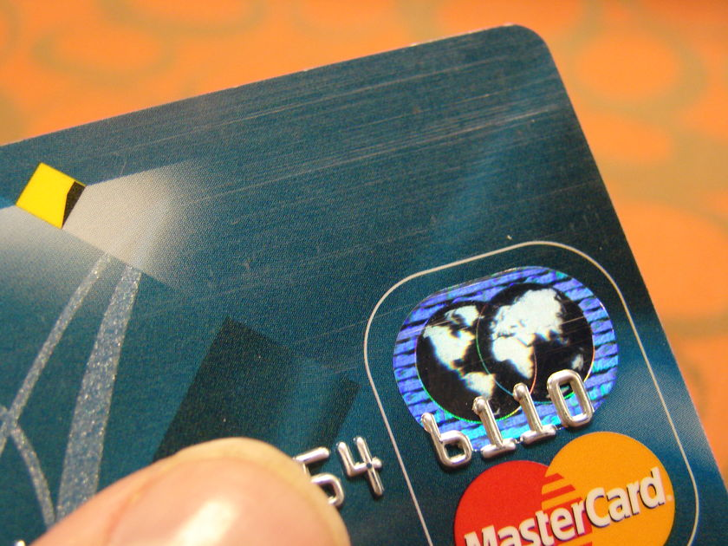
Credit
This was the first time in US history that credit was heavily used
People spent more money than they had with the use of credit, “I got to have it now”
If you were fired- no payments for your credit; lost everything
Over half of the nation's automobiles were sold on credit by the end of the decade.
Consumer debt more than doubled between 1920 and 1930.
There was a serious drop in durable goods production
You could buy everything with a very small down-payment- washing machine, cars, telephones…
One cause of the Great Depression

Slide 4
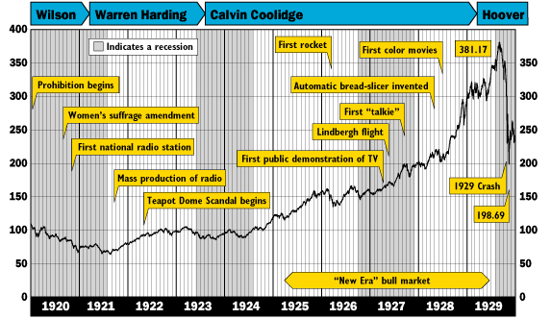

Slide 5
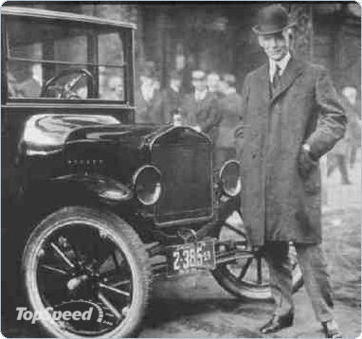
Henry Ford
Ford didn’t invent anything, he perfected the assembly line and the cheap car
Model T was the first vehicle that was affordable to most
Model T= stripped down basic car
The conveyor belt assembly line took production from 12 ½ hours to under 6 for a finish car, within a year it was down to 93 minutes
Average family income was 2,000 dollars a year, New car 300 dollars
He would pay his works $5 a day min., the national average was $2.34
1927, Americans owned 4 out of 5 of the world’s cars
Roads, gas stations, increased shipping and markets, rubber
The need for these services helped to drive the economy of the US; several new businesses
This all happens very fast; stop lights, plates, Drunk driving

Slide 6
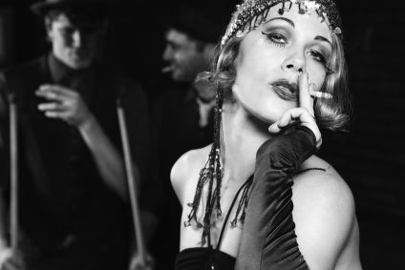
Flappers
Flappers were the opposite of females before them
Empowered by the women’s fight for rights
Greater opportunities for jobs and education
19th amendment- 15 years before there were no women in bars.
Women could be arrested for smoking in public; more liberal society/culture
Short hair “bob cut” and shorter dresses
They smoke and drank
Much more independent (worked jobs, voted…)

Slide 7
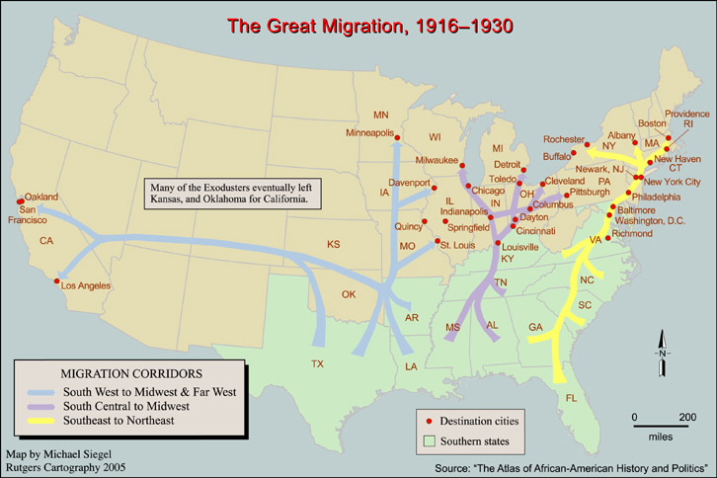
Great Migration

Slide 8
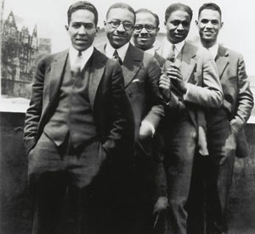
Harlem Renaissance
Time period of a boom in African American literature and artists
Development of racial pride, community and organizations
Jazz and Blues music began to be popular during this time period and in the northern region

Slide 9
Harlem Renaissance Poem
AMERICA
Although she feeds me bread of bitterness,
And sinks into my throat her tiger's tooth,
Stealing my breath of life, I will confess
I love this cultured hell that tests my youth!
Her vigor flows like tides into my blood,
Giving me strength erect against her hate.
Her bigness sweeps my being like a flood,
Yet as a rebel fronts a king in state,
I stand within her walls with not a shred
Of terror, malice, not a word of jeer.
Darkly I gaze into the days ahead,
And see her might and granite wonders there,
Beneath the touch of Time's unerring hand,
Like priceless treasures sinking in the sand.
Claude McKay

Slide 10
What impact did the Harlem Renaissance have?
African American were no longer content with being second class citizens
Foundations of Blues and Jazz music becoming mainstream
Beginnings of the Civil Rights movement in the United States

Slide 11
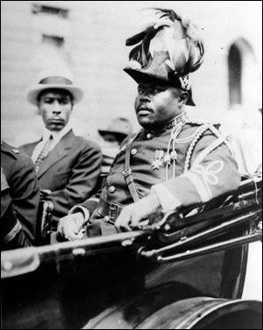
Marcus Garvey
Negro Nationalism- Glorified the black culture and traditions of the past.
“Back to Africa” movement; all African Americans should leave the US and go back to Liberia
This was because they could never find justice or equality in the US

Slide 12
Espionage and Sedition Acts
Espionage Act (1917)- Provided for the imprisonment of up to 20 years for persons who either tried to incite rebellion in the armed forces or obstruct the operations of the draft.
Sedition Act (1918)- Prohibited anyone from making "disloyal" or "abusive" remarks about the US government.

Slide 13
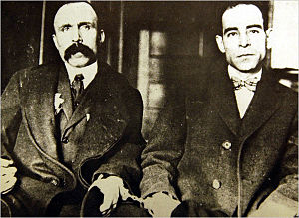
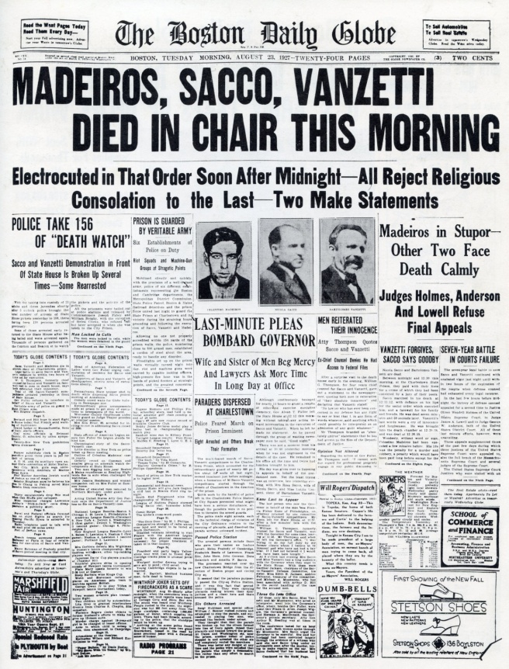
Sacco and Vanzetti
They were two Italian-born laborers and anarchists who were tried, convicted and executed via electrocution on August 23, 1927 in Massachusetts for the 1920 armed robbery and murder of a pay-clerk and a security guard in South Braintree, Massachusetts.
The case incited controversy based on questions regarding the question of the innocence or guilt of Sacco and Vanzetti, and conformance, the question of whether the trials were fair to Sacco and Vanzetti.

Slide 14
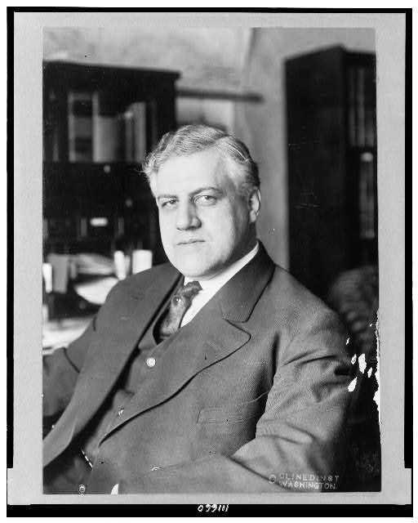
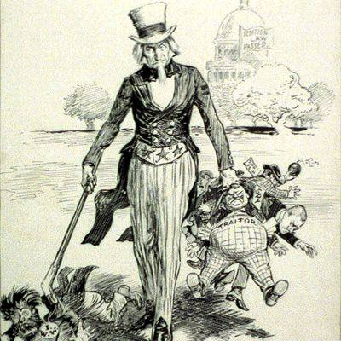
The Palmer Raids

Slide 15
Palmer Raids= Raids and arrests of suspected communist/ anarchists without trial
June 2nd, 1919 Carlo Valdinoci accidentally killed himself and blew up the front of Mitchell Palmer’s house in Wash. DC
Massive labor strikes and clashes with police were happening and tensions were high
Palmer became convinced that there was a communist plot to take down the US gov.
J. Edgar Hoover was put in charge of the investigation with the newly created Bureau of Investigation, (forerunner to the FBI)
Using the Espionage/ Sedition acts, Hoover/ Palmer had almost 250 radicals deported to Russia “Red/ Soviet Ark”
Nov. 7th, 1919 (2nd anniversary of the Russian Rev.) over 10,000 suspected communists/ anarchists were arrested w/out proof of plotting a revolution or a trial
About 2 months later, 6,000 more were arrested mostly members of the Industrial Workers of the World (IWW, or Wobblies) which was a strong union

Slide 16
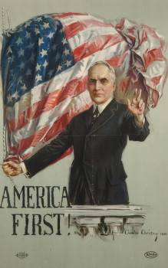
Warren G. Harding
Laissez-Faire capitalism: This was the political slogan of the new Republican presidents (Harding, Coolidge and Hoover)
This was a movement away from the Progressive ideals
Harding- His campaign pledge a “return to normalcy”= The way it was in the 1890s (Gilded Age); booming economy, little gov. control

Slide 17
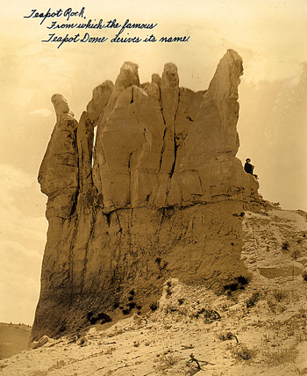
Teapot Dome Scandal
Harding died while in office, books later came out stating that his wife killed him with poison and he was having affairs, little proof on either but it was still a national sensation
Less than a year after his death scandals began to surface
Albert Fall, Harding’s Secretary of the Interior, was accused of illegal leases of the area of Teapot Dome
The wealthy oilmen paid Fall an illegal kickback, bribe, for the land
Harding was probably similar to Grant, he wasn’t involved but it was the people he hired/ friends that were the truly corrupt ones

Slide 18
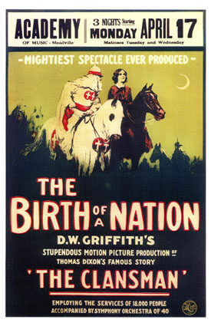
Rebirth of the KKK
Changes in political opinions- moved from mostly targeting freed-blacks to immigrants groups (Jews, non-protestant)
3 million members nation-wide, (Supreme Court judge, mayors, police men…)
Rise in the amount of lynching, 8,000+ 1920-30
Birth of a nation- KKK propaganda film, showing the KKK defeating their enemies, including black men attempting to rape white women during Reconstruction
The film presented a distorted portrait of the South after the Civil War, glorifying the Ku Klux Klan and degrading blacks
The Klan was portrayed as the South's savior from this alleged tyranny
Riots followed the film, in many major cities, as well as attacks on blacks

Slide 19
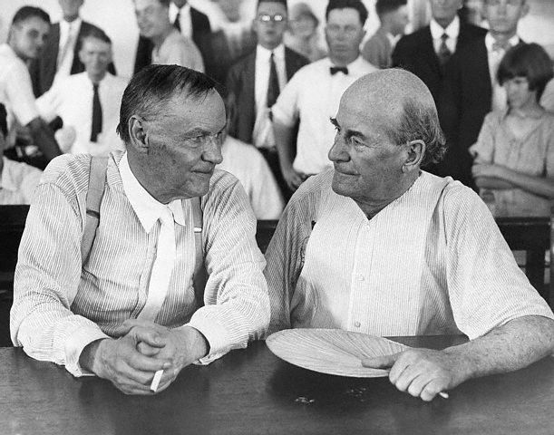
Scopes Trial
This was the 1st US trial to be broadcast over the radio
In 1925, John Scopes was convicted and fined $100 for teaching evolution in his Dayton, Tenn., classroom.
ACLU (Darrow) against Bryan for the fundamentalist group
Scopes’ lawyer was the legendary Clarence Darrow, a renowned defense attorney for labor and radical figures.
Also known as the Monkey Trial, b/c of the evolutionary beliefs
The jury found Scopes guilty of violating the law and fined him $100.
This is the best example of changing in American society, people moving to the city and losing “Old America”
Clarence Darrow (left) and William Jennings Bryan

Slide 20
