Slide 1
Declaration of Independence

Slide 2
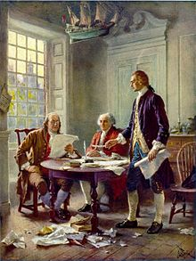
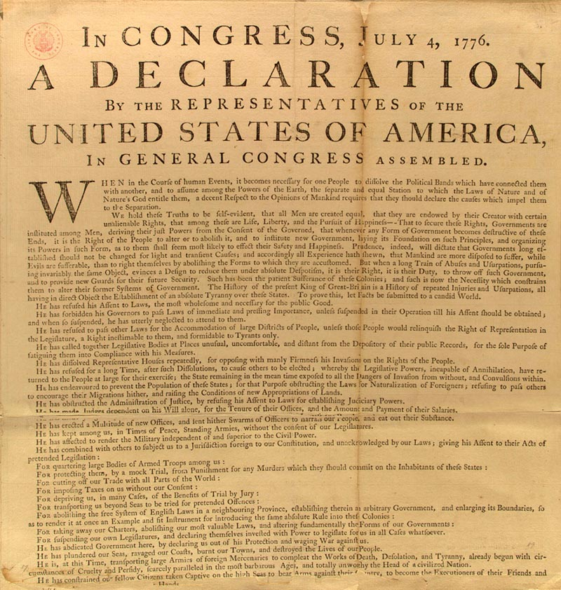

Slide 3
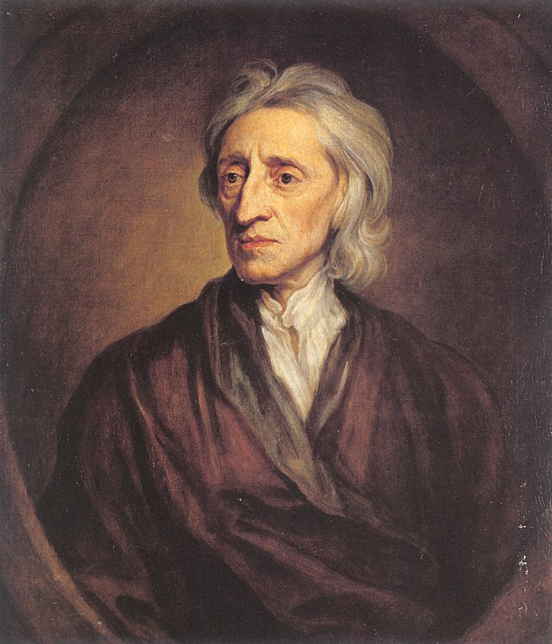
There are certain natural rights that are endowed by God to all human beings.
  life, liberty, property!

Slide 4
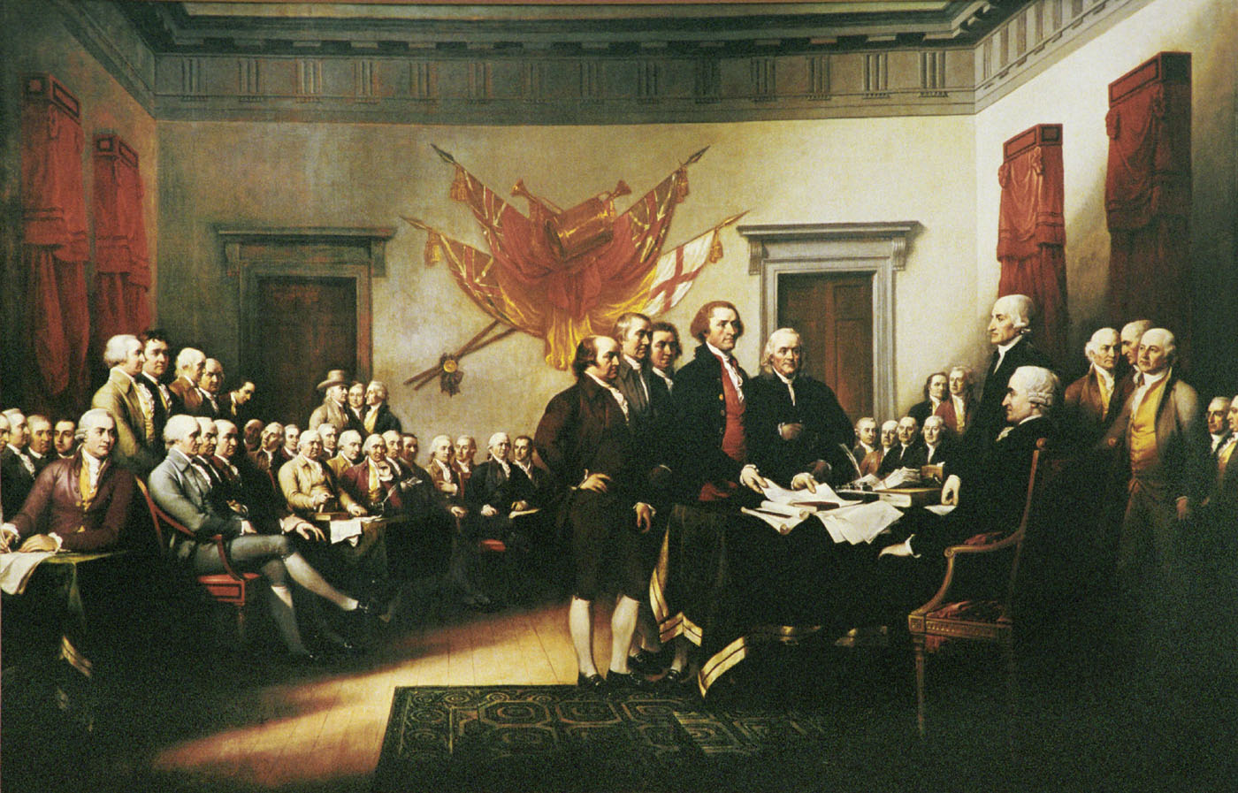
Principles of the Document
Equality and rights
Consent of the governed- Taxes!
Right to revolt, if the government does not provide these
Statement of grievances
27 different complaints against King George
These complaints gave the US the right to revolt from England
Formal declaration of independence from England
Because of these unsolved issues, the US who fight for its freedom

