Slide 1
Civil War- Reconstruction Review

Slide 2
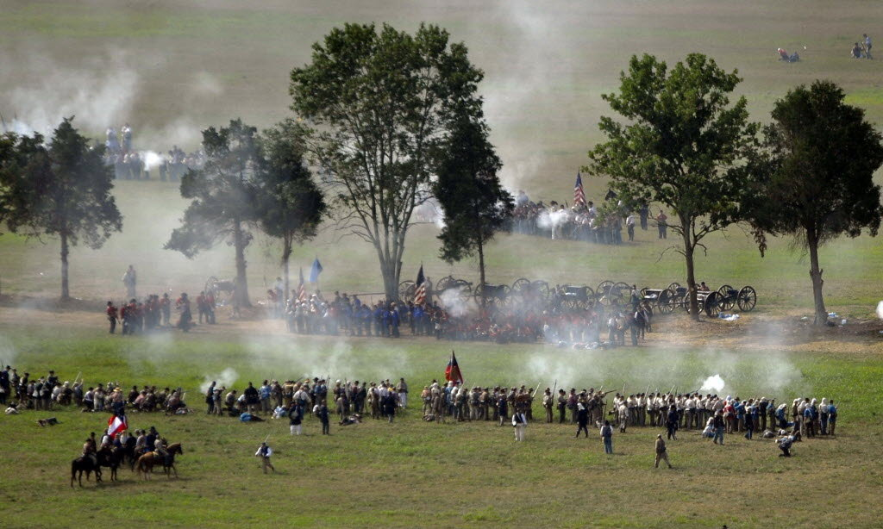
Bull Run, VA. (July 21, 1861)
Battle of Bull Run, fought in Virginia just miles from Washington DC, on July 21, 1861
Lincoln pushed cautious B. Gen. Irvin McDowell, (Commander N. Virginia) to attack the Confederate forces, under Beauregard (Sumter)
The goal was to defeat the majority of the Confederate army here and open the way to Richmond
Instead he signed bills for the enlistment of 100,000 troops for 3 years, not 3 months
George McClellan took over command of the army

Slide 3
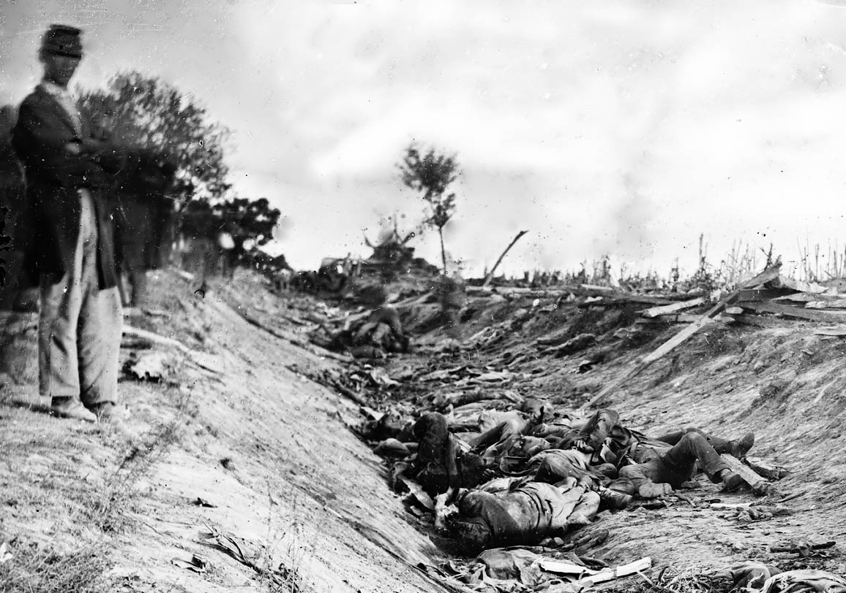
Antietam, Maryland
(September 16-18, 1862)
Lee has to cross back to Virginia through the Potomac river- very dangerous
McClellan decides not to attack out of fear of too many causalities
The single bloodiest day in American military history- More than 12,000 Union causalities, more than 10,000 Confederate; Total 22,717
18 Generals (9 each) were killed at that battle
Lee lost less men but it was ¼ of his troops

Slide 4
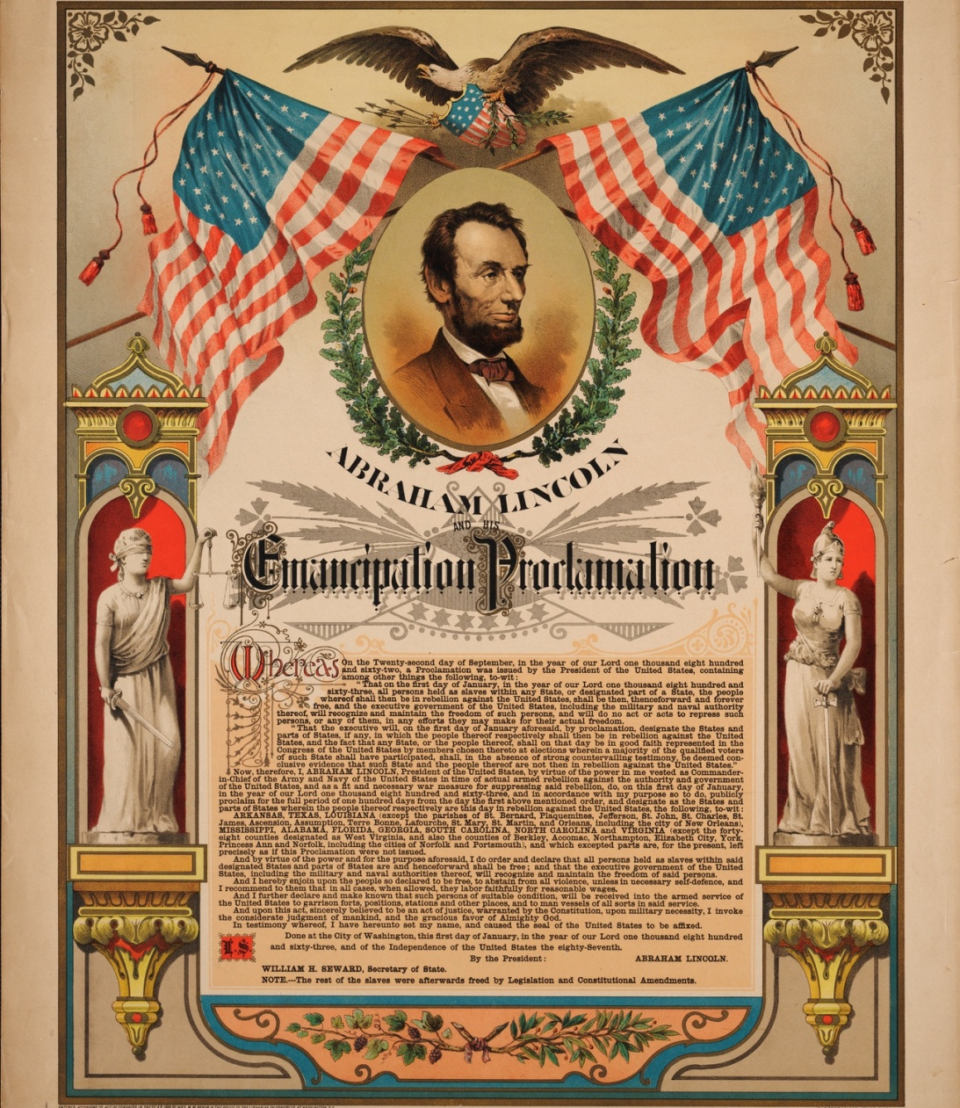
The Emancipation Proclamation
President Abraham Lincoln carefully framed the conflict as concerning the preservation of the Union rather than the abolition of slavery
On September 22, soon after the Union “victory” (draw) at Antietam, he issued a preliminary Emancipation Proclamation, declaring that as of January 1, 1863, all slaves in the rebellious states "shall be then, thenceforward, and forever free."
The proclamation exempted the border slave states and all or parts of three Confederate states controlled by the Union army on the grounds that these areas were not in rebellion against the United States.
Now it was an morale war, Europe wouldn’t support slavery

Slide 5
Gettysburg, Penn.
(July 1-3, 1863)
Lee intended to collect supplies in the abundant Pennsylvania farmland and take the fighting away from war-ravaged Virginia
Goals
  threaten Northern cities
  Gettysburg was a major road/RR hub, that could be key for the Confederates
  weaken the North's appetite for war
  win a major battle on Northern soil, force peace terms
The second day’s fighting involved at least 100,000 soldiers of whom roughly 20,000 were killed, wounded, captured or missing.
The Battle of Gettysburg is by far the costliest battle of the Civil War, 51,000 soldiers from both armies were killed, wounded, captured or missing in the three-day battle.
After this battle, the South would never threaten a Union city or cross into the North again

Slide 6
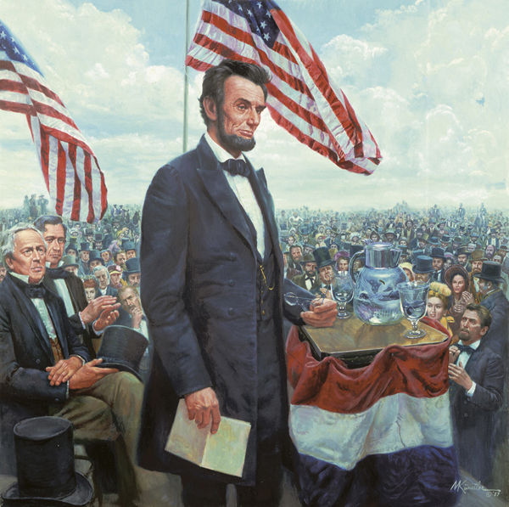
Gettysburg Address
Four months after the battle, President Lincoln used the dedication ceremony for Gettysburg's Soldiers National Cemetery to honor the fallen Union soldiers
Bodies began to be exposed b/c of shallow graves
The federal government provided coffins and dedicated Gettysburg a national cemetery
Lincoln’s 2 minute speech focused on equality and the immense sacrifice of the soldiers

Slide 7
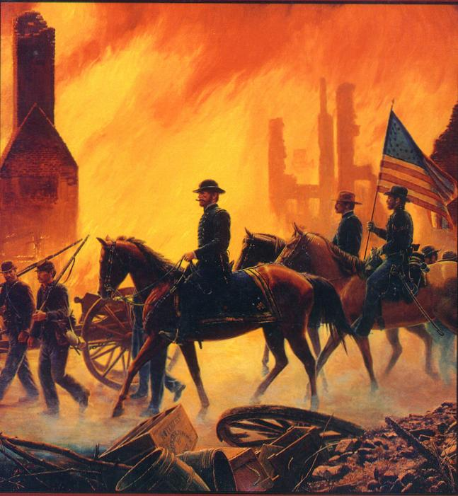
Sherman’s March to the Sea
  After S. Carolina seceded Sherman went to the North
  Red-Haired, agitated, skinny man and prone to fits of rage and sadness
  He refused a higher command b/c he didn’t want to be a “political general”, McClellan “Sherman is gone in the head”
  The Southern evasive strategy could drag out the war for years, so he changed it
  Goal: to destroy anything that helped the South fight
  Nov. 15th, 1864- He burned Atlanta and cut all communication to the Union command
  Over the next 5 weeks, he wrecked a path to Savannah
  Sherman sentinels- Chimneys of burnt houses, Neckties- RR tracks heated and wrapped around trees
  Destroyed crops, food storage…
  1,000s of former slaves joined him as he went
  Dec. 22, he reached Savannah and was the beginning of the end of the Confederate army

Slide 8
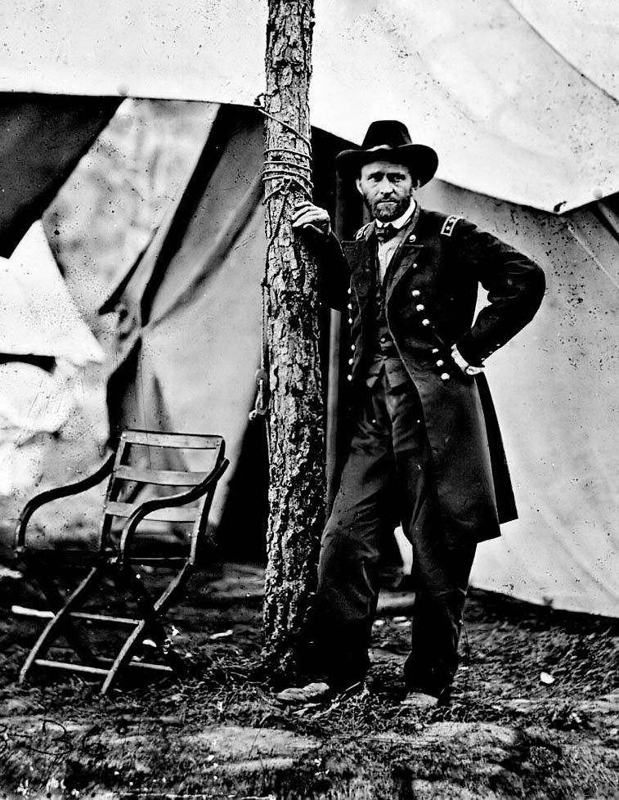
Ulysses Grant
Little history or achievements before that would suggest greatness
Several failed jobs, disagreed w/ the Mex. War but served anyway
He disliked uniforms, and was very humorless “2 songs- Yankee Doodle, and the other wasn’t”
He was made sick by the sight of blood, beat a man for 6 hours for mistreating a horse
Grant was willing to lose massive amounts of troops, “Butcher”
He and Lincoln believed that this would end the war b/c the North had all the tools
War of Attrition was in the favor of the Union, he lost 40% of his troops in Cold-Harbor

Slide 9
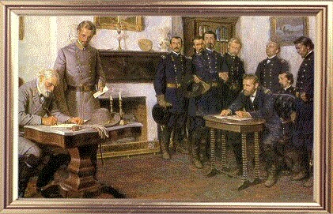
Appomattox Courthouse
Lee was running low/ empty on supplies and weapons
On April 8th, 1865 Lee’s 2 trainloads were captured by Union soldiers, leaving him surrounded, outnumbered 4 to 1, w/out food, water or possible reinforcements
He sent a group of men to try and break through but they found a wall of blue
The North and 1 million men in arms, Con. under 100,000
The two leaders agreed to meet April 9th, 1865 and Lee surrendered to Grant

Slide 10
Aftermath of the Civil War/ Reconstruction
The Southern US was devastated by the Civil War, economically and emotionally
Total war lead by Sherman burned many towns completely to the ground
Many Southerners were very angry with the loss of the war

Slide 11
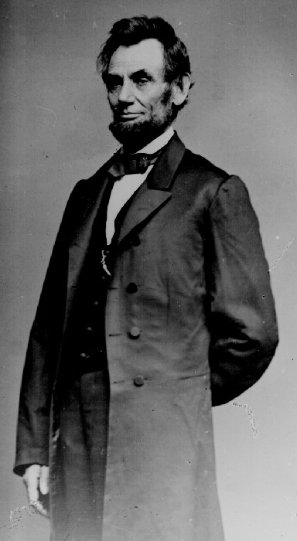
Amnesty and Reconstruction
Amnesty- Pardon for crimes, forgiveness
Reconstruction- time period after the Civil War to build the South back up
The goal was to bring the states back to the Union

Slide 12
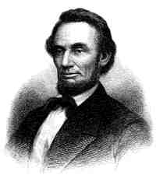
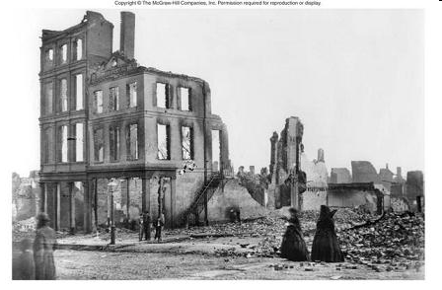
The Reconstruction Plan
Lincoln’s Plan – wanted to reunite the country quickly
1) Offered pardon for all Rebels
2) Required an oath of loyalty from 10%
3) Required a ban on slavery

Slide 13
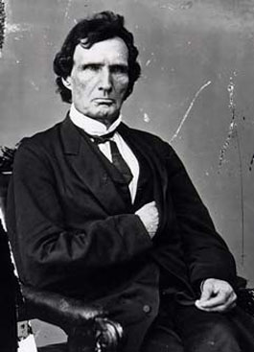
Lincoln vs. The Radical Republicans
Many of the Northern Republicans wanted harsher conditions
2 extra demands
  Wanted voting rights for freed blacks
  Punishment for the South starting the war
Thaddeus Stevens

Slide 14
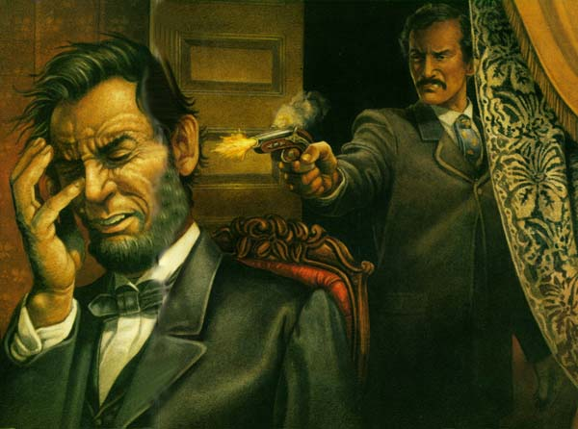
Lincoln’s assassination
Ford’s Theater in Washington DC
He was watching the play when John Wilkes Booth attacked him from behind
Others were attacked and were supposed to be attacked

Slide 15
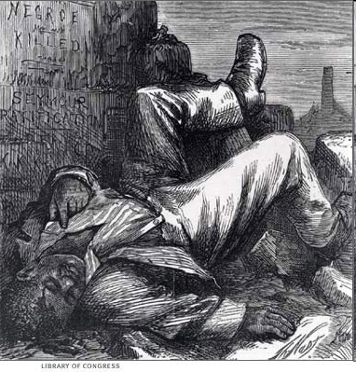
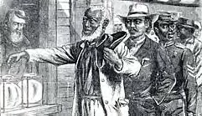
Reconstruction Laws
13th Amendment – Made slavery illegal
14th Amendment – Made all people born in the U.S. citizens except for Native Americans
15th Amendment – Gave black men the right to vote
Civil Rights Act of 1866 – Gave blacks the same rights whites had

Slide 16
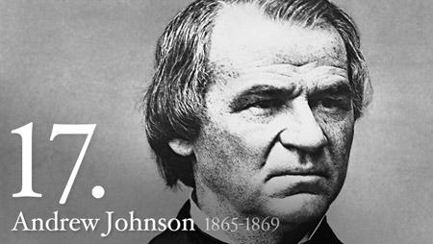
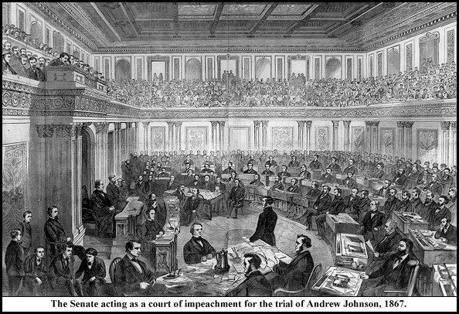
Impeachment of Johnson
Johnson wanted to follow Lincolns more conservative plan
The Congress wanted to punish the South and Johnson kept vetoing (denying) their laws
Johnson was tried in Feb. 21, 1868
Impeached= Charged for a crime in office

Slide 17
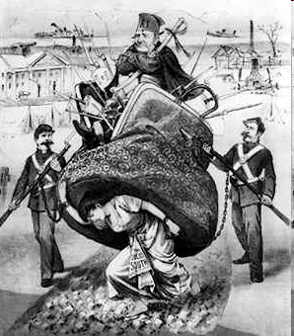
The Players
Freedmen’s Bureau – Provided relief and help to blacks
Radical Republicans – Strong abolitionists who wanted the South to do more before coming back into the Union
Reconstruction Acts – Divided the South into 5 districts controlled by military commanders who made sure the South followed all the rules
Carpetbaggers – Northern Republicans that came south to make money

Slide 18
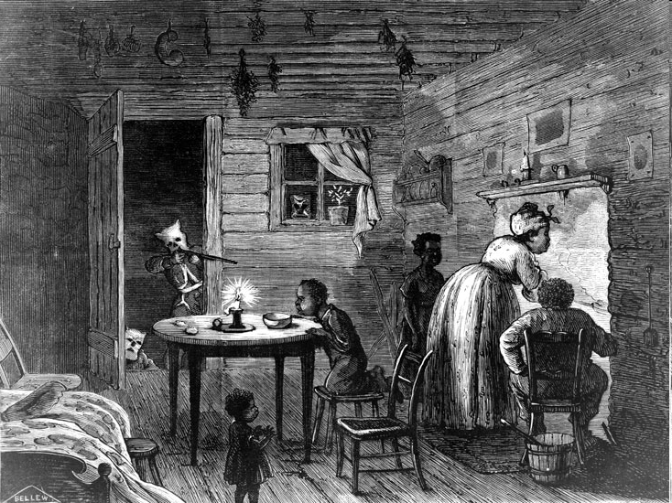
Treatment of Blacks in the new South
Black Codes –Laws limiting the freedom of blacks
Jim Crow – Laws that enforced segregation
KKK – A secret society of white supremacist terrorists
The KKK would attack freed blacks and others who helped them

Slide 19
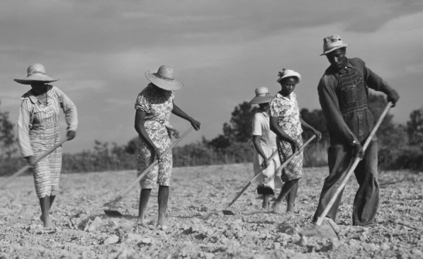
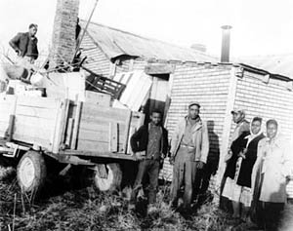
Sharecropper
After the emancipation former slaves were free
However, few had education or valuable skills
Sharecroppers- Pay for land with crops
Most barely grew enough food for rent and to feed their families

Slide 20
Impact Of The Reconstruction
Because of the demand for punishment of the South the area recovered very slowly during the Reconstruction, leading anger towards the Reconstruction policies
The Black Codes stayed a part of the Southern system up until the Civil Rights movement of the 1960s
Soon after the Reconstruction the Black Codes turned into Separate but Equal

