Slide 1
Mexican American War- Western Expansion

Slide 2
Reasons for Going West
Need for raw materials to supply factories of the Industrial Revolution
Spread Beliefs or Christianize the west
Direct Water route to the Pacific
Cities are crowded
Claim land for farming, mining and ranching

Slide 3
Mexican-American War

Slide 4
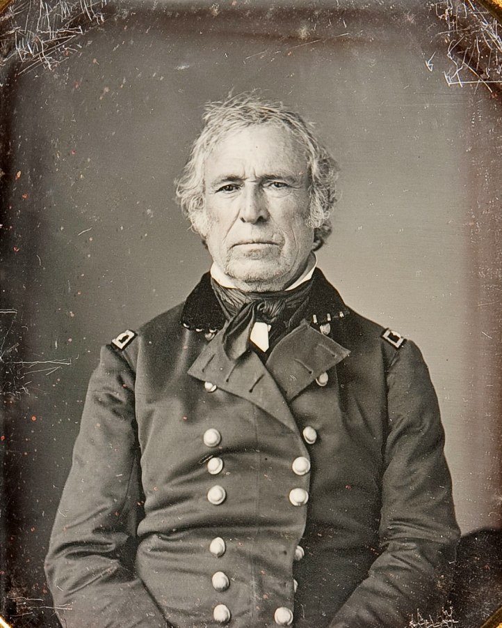
“US Blood Has Been Shed!”
May 7th, 1846
Mexico believed that the border was at the Nueces River, US said Rio Grande
Polk sent Zachary Taylor to the disputed land between the 2 borders
Mexican soldiers attacked Taylor at Paulo Alto, so Taylor set up Fort Texas
The war had begun
The Congress distrusted Polk’s accusations but wanted to support
Taylor is able to win the next battle at Fort Texas because of the Ringgold flying artillery, movable cannons that can be fired within a minute
Popular war in the South “Spot Resolution” Abe Lincoln, not in the North
Zachary Taylor

Slide 5
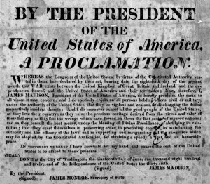
“In making these recommendations I deem it proper to declare that it is my anxious desire not only to terminate hostilities speedily, but to bring all matters in dispute between this Government and Mexico to an early and amicable adjustment; and in this view I shall be prepared to renew negotiations whenever Mexico shall be ready to receive propositions or to propositions of her own.”
Polk Addressing the Congress
May 13, 1846- Congress declares war on Mexico

Slide 6
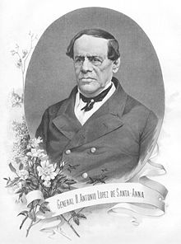
Santa Anna Returns!!!!!!
Santa Anna had been exiled 2 years before this
Anna was the general who attacked the Alamo, then president/ dictator for 10 years, defended Mexico from the French invasion (where he lost a leg), then was exiled by the rich elite of Mexico
The Mexican gov. brought him back from Cuba to lead the army but there is a US blockade
S. Anna convinces Polk that he can get Mexico to compromise, he even wrote letters to Polk about the Mexican people, uses this to get to Mexico

Slide 7
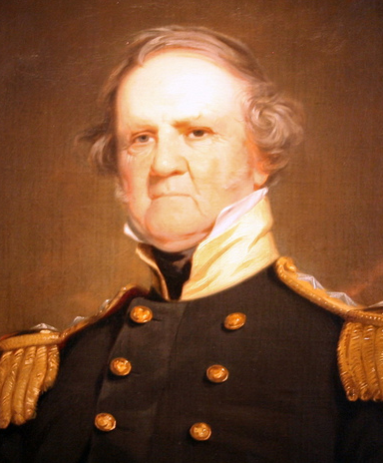
Zachary Taylor
Winfield Scott

Slide 8
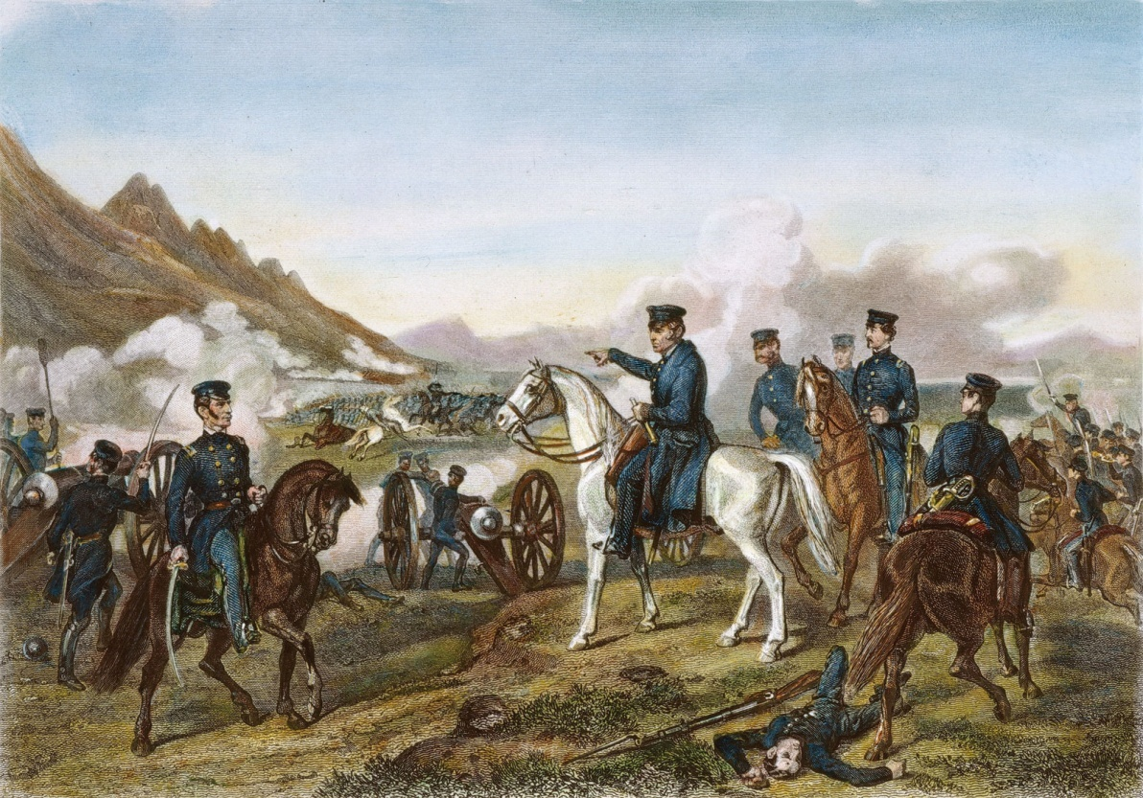
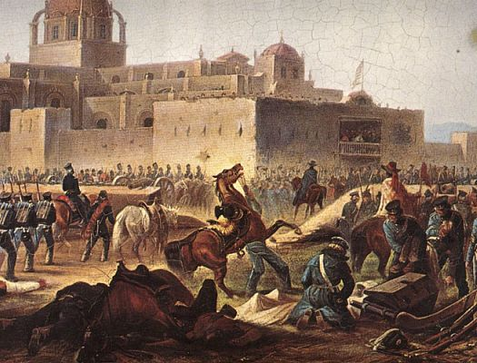
The Mexican-American War

Slide 9
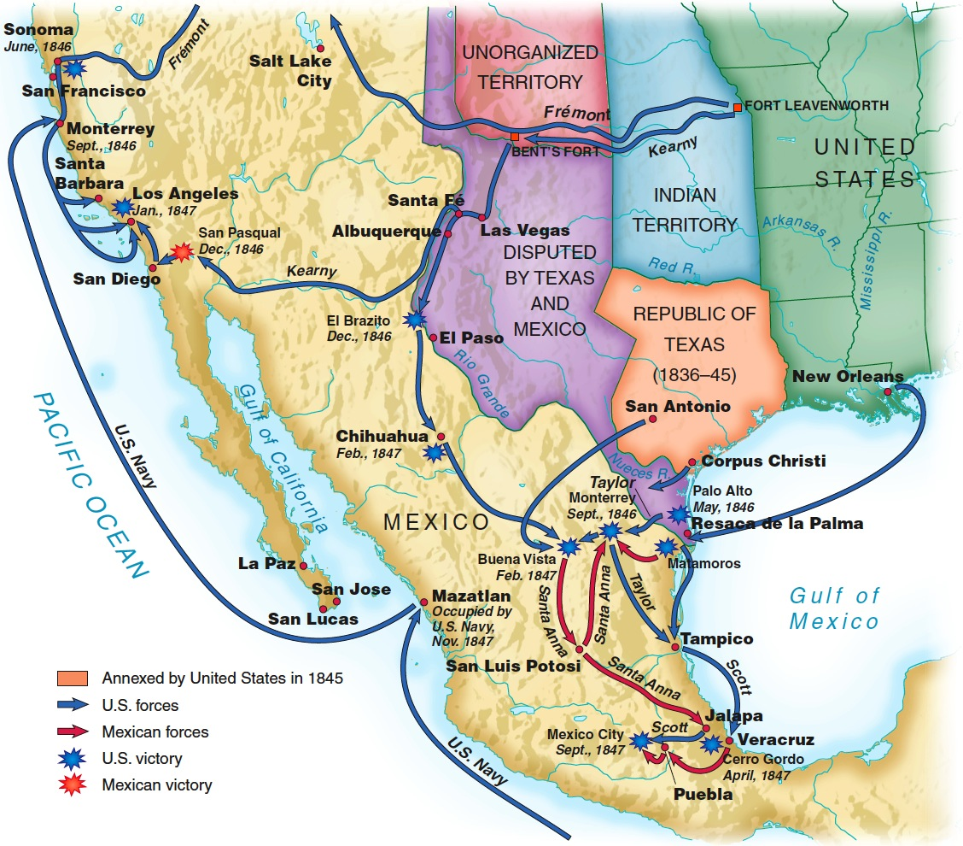
The Mexican War (1846-1848)

Slide 10
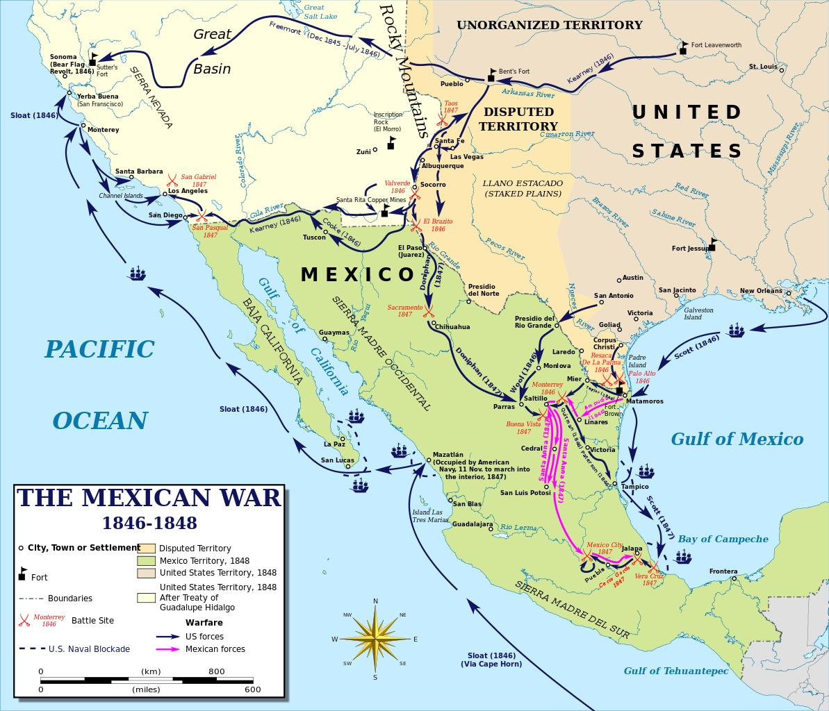
Steven Kearny
Wealthy family, he didn’t need to go into the military but he liked it
His goal: Secure Northern Mexico, Santé Fe and then to CA
Aug. 1846, Kearny was able to take over Santé Fe w/out a fight and was welcomed as a liberator in New Mexico
He hoped that the rest of his conquest would the same way, people would greet him as a liberator, he sent his men back to NM to protect it
However, in CA local land owners fought against Kearny, if it was not for the mobile artillery, he would have been overran and wiped out
After surrender by the locals, the US held Northern Mexico
Kearny captures CA after meeting up with a US naval expedition
This campaign is known as “The Long March”, Fort Leavenworth, KS to NM to CA

Slide 11
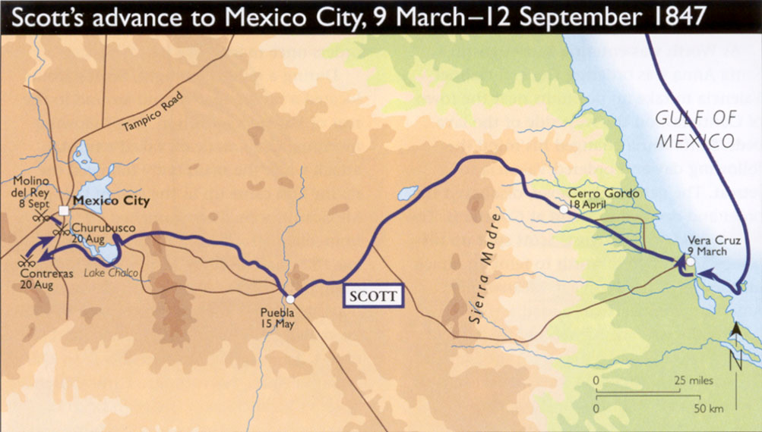
Amphibious landing at a fortified fort b/c of pirates, French invaders and the US; the defenders waited for Anna but he was busy with the Civil War
12,000 troops on row boats, and they had to drag the artillery through the sand
When Scott was prepared the attack the city he sent a message to let civilians leave but it was refused; many international innocents there
He shelled the fort for 3 days before the walls broke down and surrender of the fort
Scott’s next goal was Mexico City
Many people began to criticize the war, Congress felt like they were lied to, WHICH THEY WERE
Henry Clay lost a son at Bento Vista, he became a sharp critic of the war and gained support for his anti-war movement, Abe Lincoln was also an opponent of the war
Many felt that to continue the war would sacrifice our national identity; like freedom…
Taylor was woed by the Whigs, potential presidential candidate

Slide 12
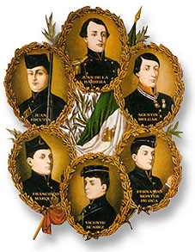
Capture of Mexico City September 13, 1847
Before getting to Mexico City, Robert E Lee helped Scott as an engineer, he found a way position canons to allow for an US victory
U. Grant was also at the same time
Mexico City was an island surrounded by marshes, very difficult to attack
Bridges built by the Aztecs
A few Irish deserted from the US army and helped defend the city for land, they were branded or executed depending
Gringos, Irish song about “green of the fields”
General Winfield Scott takes Mexico City and Mexico surrenders
Treaty of Guadalupe-Hidalgo= Rio Grande border and Northern Mexico become US territories
25% of the US continental (lower) US, includes Texas
Military experience, which later will impact the Civil War
Monumento a los Ninos Heroes

Slide 13
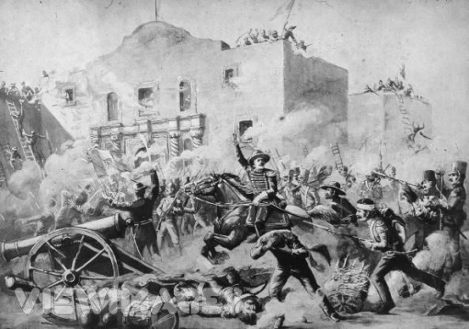
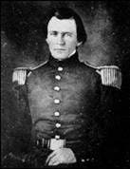
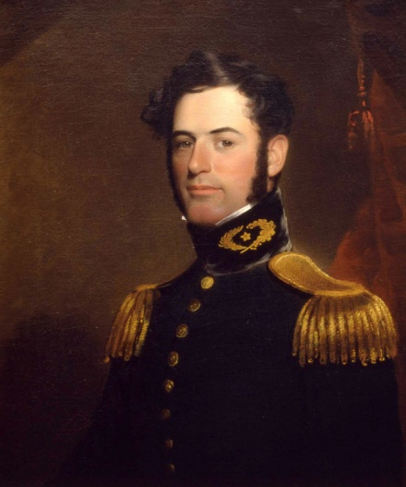
The Mexican American War
U. Grant
R. E. Lee

Slide 14
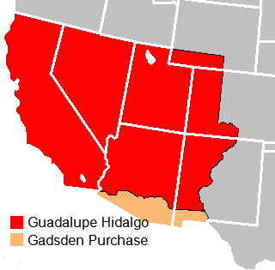
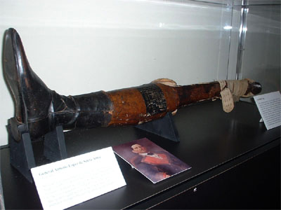
Impact Of The War

Slide 15
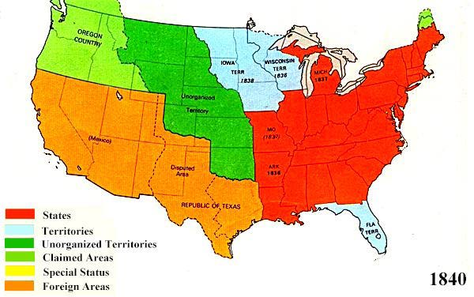
Impact of the War
Disease= Yellow fever
Disease claimed a toll seven times greater than that of Mexican weapons.
America secures land from coast to coast
Protection is provided because of these new borders

Slide 16
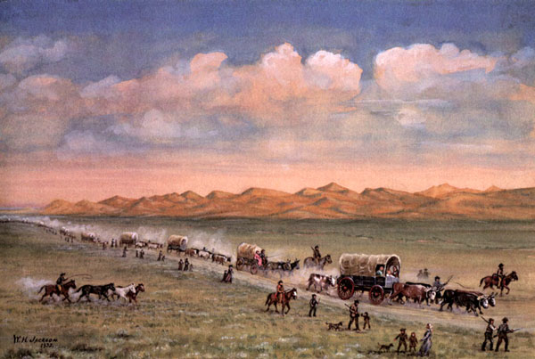
The Oregon Trail

Slide 17
Fight over Oregon Territory
4 Different nations claimed ownership of Oregon
  The US claims it because of fur trappers in the Rockies
  England explored up the Columbia River
  Spain controlled all areas south of OR
  Russia had settlements from Alaska down the west coast
  American Gray discovered the Columbia

Slide 18
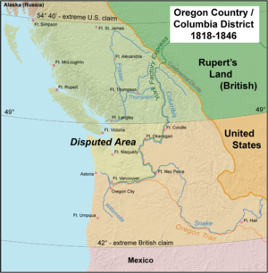
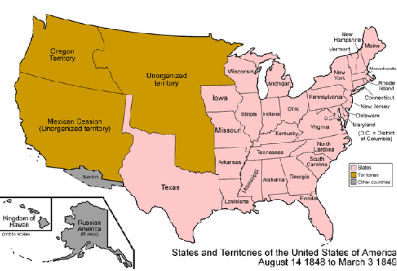
Joint Occupation

Slide 19
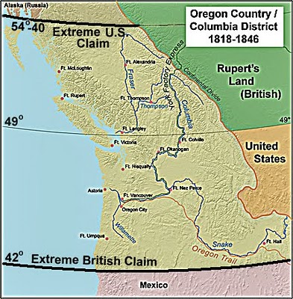
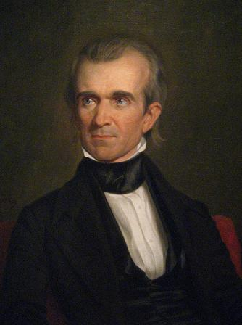
“54’40” or Fight!!”

Slide 20
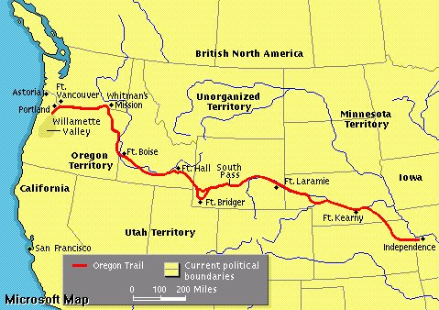
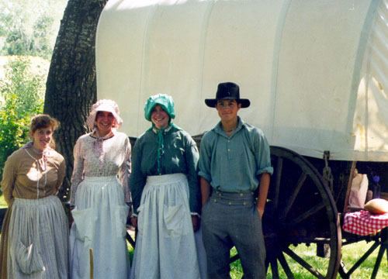
Life on The Trail

Slide 21
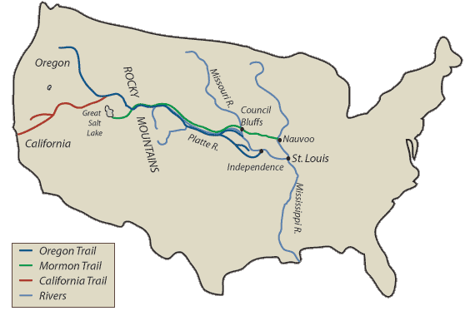
The California Trail

Slide 22
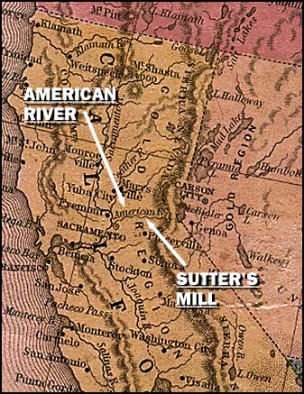
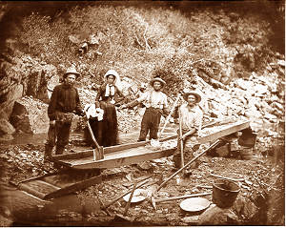
Get Rich or Die Trying

Slide 23
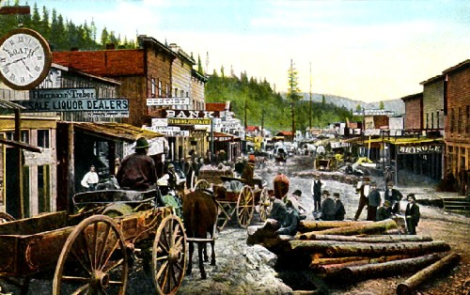
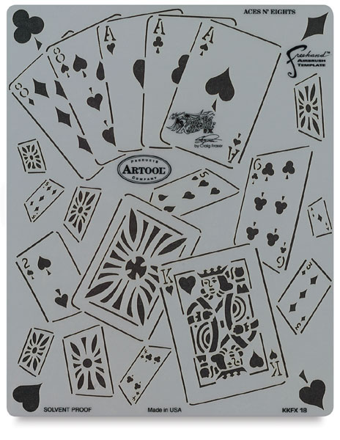
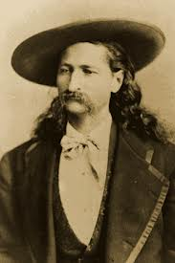
Boomtowns
Deadwood, South Dakota
Wild Bill Hickok

Slide 24
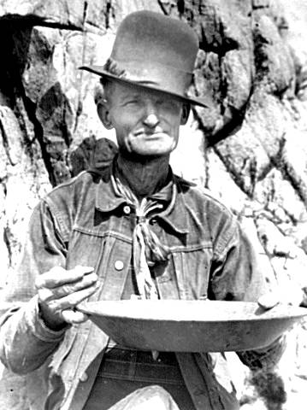
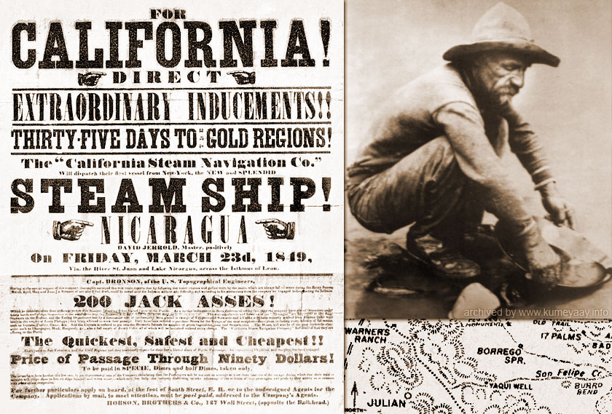
49ers

Slide 25
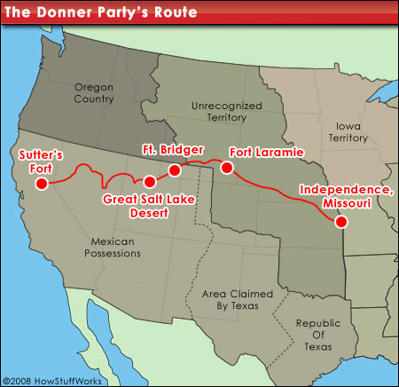
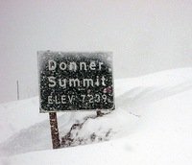
The Road To California

