Slide 1
Industrial Revolution/ Imperialism- Review

Slide 2
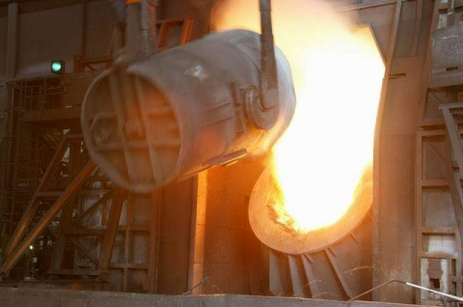
Growth Of Industries
Before the Civil War, manufacturing was tied to the farming economy
As a result of this, manufacturing branched out into heavy industry

Slide 3
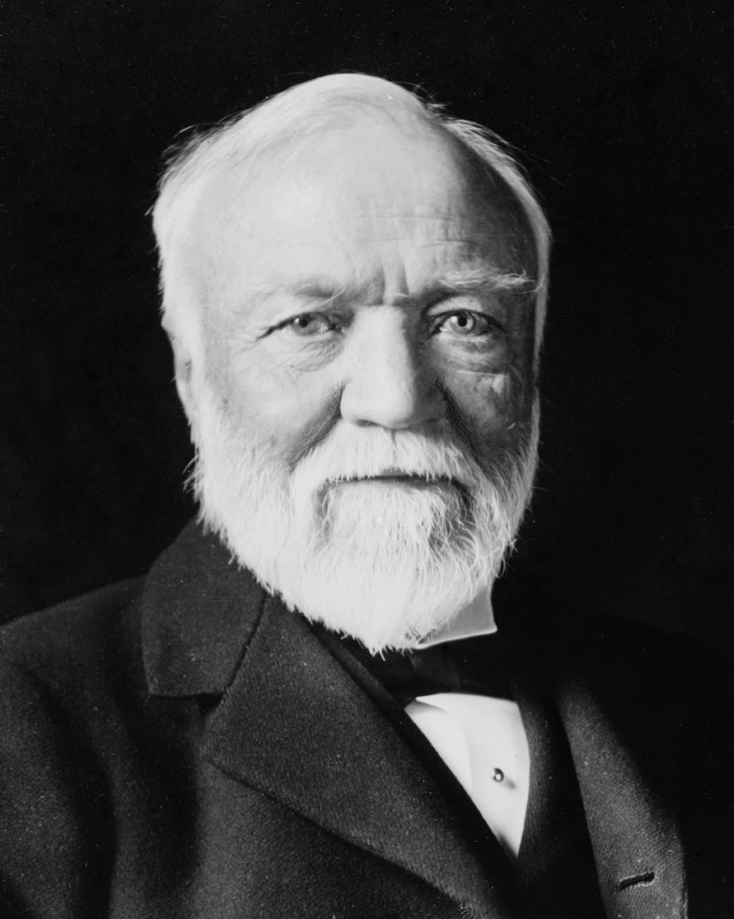
Andrew Carnegie
Moved to the US from Scotland in 1848, b/c of an economic depression in Europe
He realized that steel would replace iron as the metal of choice for building
In 1879, he created a blast furnace for making steel
His company US Steel was used to make skyscrapers, RR ties, and heavy manufacturing
His personal fortune was estimated at $225,000, or over 6 billion today

Slide 4
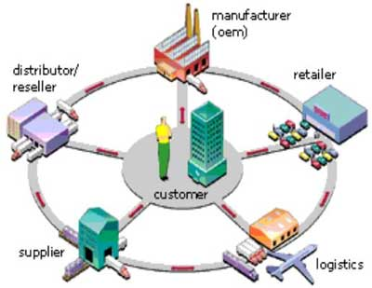
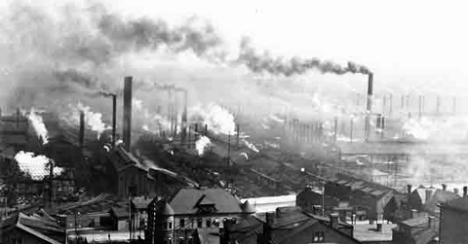
Vertical
Integration
Vertical integration- A company owns all of the different businesses in making a product
Carnegie’s Gospel of Wealth= Make $ and give it away later in life

Slide 5
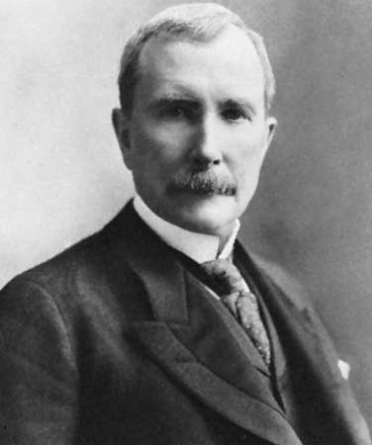
John D. Rockefeller
As kerosene and gasoline grew in importance, Rockefeller's wealth soared and he became the world's richest man and the first American worth more than a billion dollars.
Adjusting for inflation, he is often regarded as the richest person in history.
John D. Rockefeller’s standard oil owned 90% of oil refining in the US
S. Oil was one of the first mega- international companies, controlling the majority of the world’s refineries
Monopoly: A company that owns almost all or all of a product

Slide 6
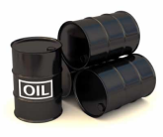
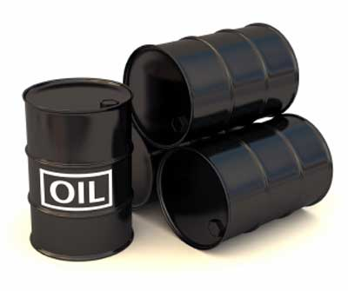


Horizontal Integration
HI= Purchase of competing companies in the same industry
Through HI, a company will lower prices and lowball competition
$
BP Oil
$
Texaco
$
Shell
Standard Oil

Slide 7
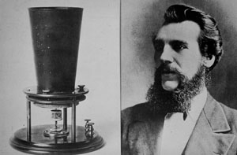
Creation of the Telephone
Bell's father, grandfather, and brother had all been associated with work on hearing and speech, and both his mother and wife were deaf
He also worked on the nature of heredity (mom and wife)
B/c of this, he often worked on sound- He tried to make his dog talk, used tuning forks
At 24, he founded the Boston School for the Deaf and Mute
In 1876, at the age of 29, Bell invented the telephone
Created AT & T based on his invention
Alexander Graham Bell

Slide 8
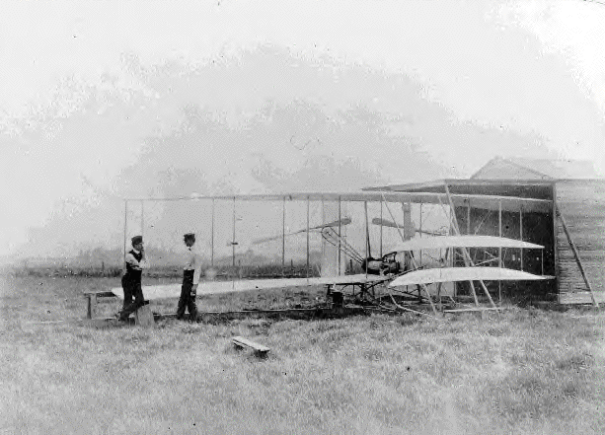
The Wright Brothers
Orville and Wilbur Wright flew the first self-propelled airplane
The flight lasted 12 seconds and went 120 feet
1903- 1969, in 66 years the US puts a man on the moon

Slide 9
Impact of the Industrial Revolution

Slide 10
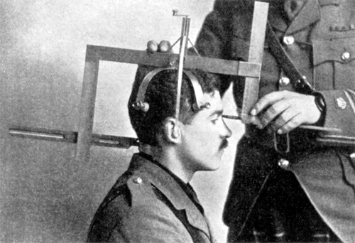
Social Darwinism
The wealthy were rich because they were more skilled/ smarter…
Workers needed to work harder to succeed
It’s Gods will

Slide 11
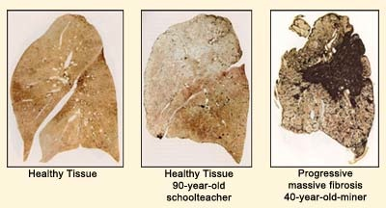
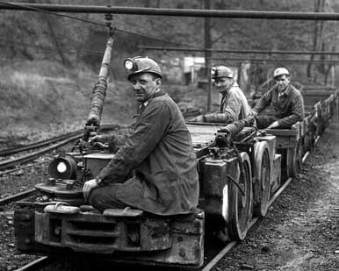
Coal Mines in America
The center of coal mining were located in West Virginia, Pennsylvania
This was one of the few jobs that always needed workers
Cave-ins, explosions and gas fumes were dangers of coal mining
Many people would die from “black lung”

Slide 12
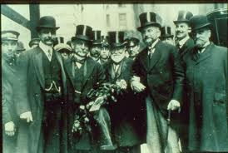
Robber Barons
Captains of industry, they made the US the #1 industry by 1900
Robber Baron= Owners of huge corporations
They held a lot of influence in congress and the White House

Slide 13
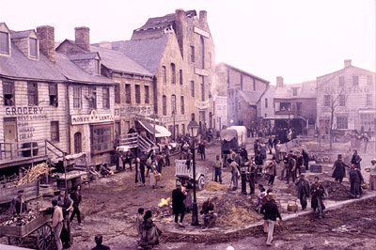
Tenements
Tenements are large structures with hundreds of people living in it
These were filthy, overpopulated and full of criminals
There would be one hose bid for 1,000 people
The room would be subdivided, forcing families into increasing smaller rooms

Slide 14
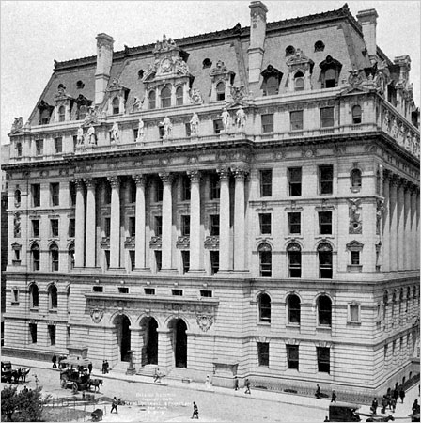
Tammany Hall
It started as a fraternal org. that operated social events
Political Machine- Government organization that kept itself in power illegally
Tammany Hall would provide jobs, a place to live and even citizenship, in return the immigrants would vote for the Tammany politicians
In NY and Chicago, mass corruption made the office about power, not the people
Tammany Hall Building

Slide 15
Ways Tammany Hall Stayed In Power
They bought votes in the following ways: Bribes, voting under dead peoples names, some people who vote several times
If people wanted to vote for the opponent: Violence, even death to candidates for office

Slide 16
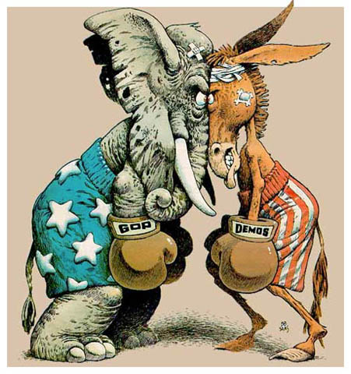
Thomas Nast
Moved to the US from Germany at 6
Political cartoonist during this period
Attacked the Tammany Hall political machine

Slide 17
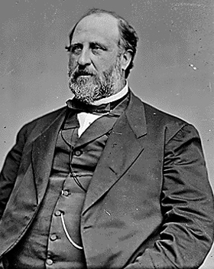
Boss Tweed
Corrupt leader of NY during the 1860’s and 70’s
At the height of his influence, he was the 3rd largest land owner in NYC, and owned several businesses
Boss would create government jobs on city-related projects for voters/ immigrants
Tweed and his employees would force vendors to pay 15% overcharge (beyond tax) to operate in NYC
He was thrown in jail for stealing around 25-40 million from public funds
"The way to have Power is to take it"
- William "Boss" Tweed

Slide 18
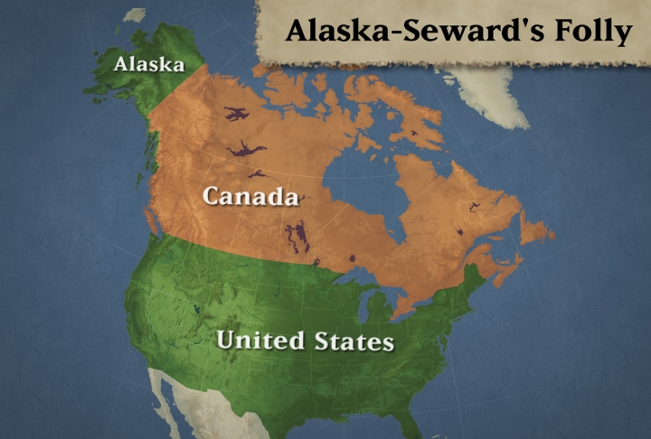
Homestead Act over 1 million claims
Refers to the US purchase of Alaska (1867)
Sec. of State William Seward purchased the land from Tzar Alexander II for $7.2 million
At the time, it was seen as a barren “Ice box” of nearly 600,000 sq. miles but the discovery of gold and oil was worth much more than the purchase

Slide 19
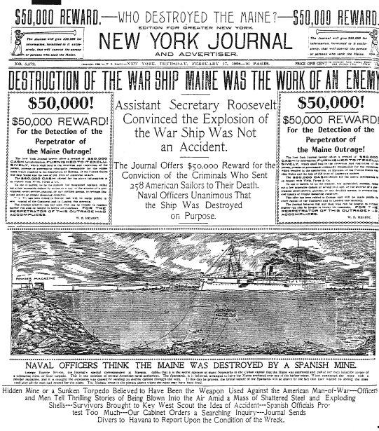
Yellow Journalism
Yellow Journalism- Writers who would exaggerate or make up stories to sell papers
Jingoism- Belief that the US should become an imperialism nation
US depression, 17% unemployment, looking for new markets
Hearst and Pulitzer controlled the press during this time period

Slide 20
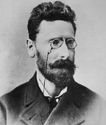
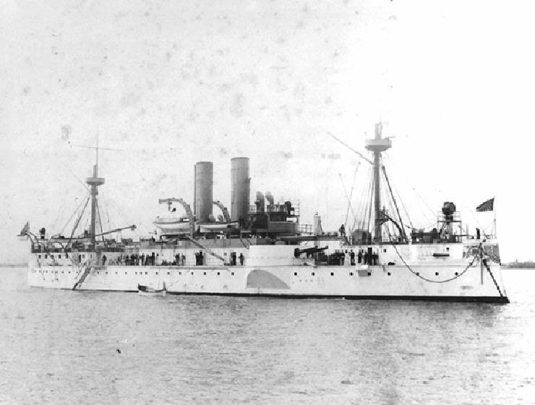
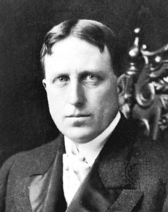
“Yellow Journalism” & Jingoism
Joseph Pulitzer
Hearst to Frederick Remington:
You furnish the pictures,
and I’ll furnish the war!
William Randolph Hearst

Slide 21
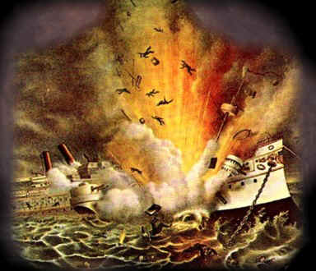
Cause of the Spanish- American War
The belief was that the US needed coal and gas stations throughout the world to effectively ship
Steam ships demanded constant resupply of coal
USS Maine was stationed in Cuba to protect US businesses there
March 28, 1898 USS Maine exploded in Cuba; killing 266 sailors
US investigation said that it was a Spanish mine
McKinley began to build up forces

Slide 22
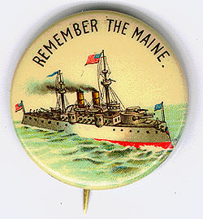
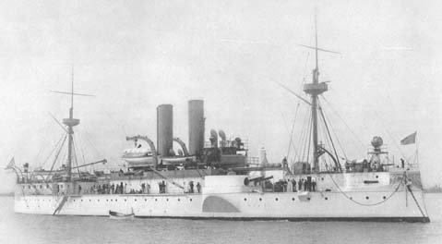
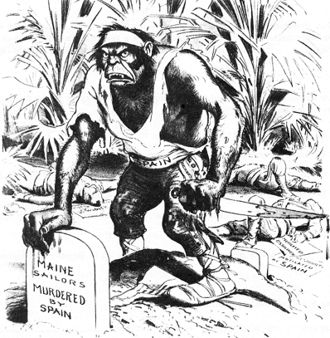
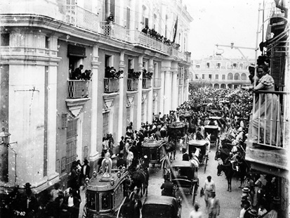
Remember the Maine
and to Hell with Spain!
Funeral for Maine victims in Havana

Slide 23
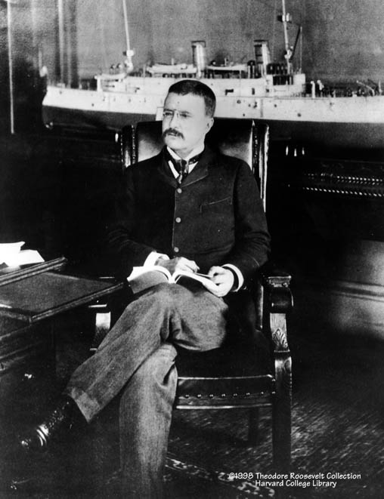
Theodore Roosevelt
Assistant Secretary of the Navy in the McKinley administration.
Imperialist and American nationalist
Quit his job to join the war effort
“The man has a backbone of a chocolate éclair!” TR talking about President McKinley

Slide 24
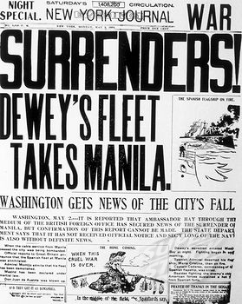
War in The Philippines
US Navy was ready for war in the Philippines
Commodore Dewey sunk the Spanish fleet in the Philippines, before the war had been declared
He destroyed the fleet so fast that he did not know what to do with the POWs

Slide 25
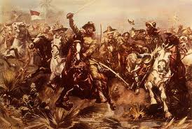
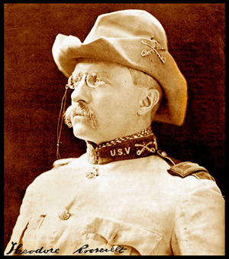
Rough Riders
Rough Riders- TR’s group of cowboys that fought in the war
They were like the Navy Seal’s of the Spanish-American war
The Rough Riders attacked San Juan/ Kettle Hill
They charged up hill on a fortified position
They took the hill from the Spanish, which later led to the victory of the war
The war lasted 4 months

Slide 26
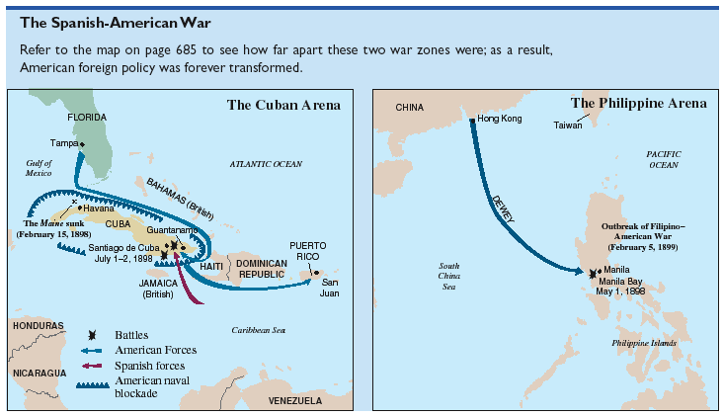
The Spanish-American War (1898):
“That Splendid Little War”

Slide 27
Impact Of The Spanish American War
There were 2,061 US deaths, only 385 died from battle casualties
Yellow fever, malaria and other diseases killed many of the US troops

Slide 28
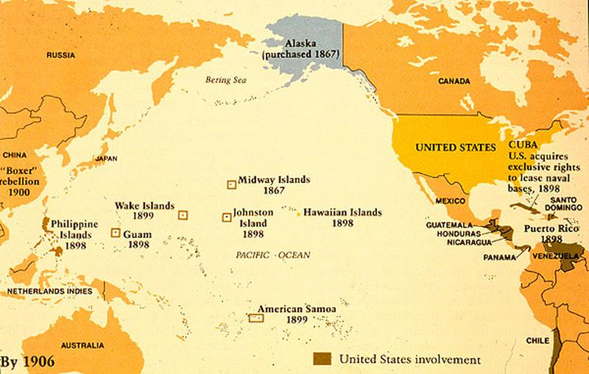
The American Empire
Gains Puerto Rico, Guam, Philippines…

