Slide 1
The Progressive Movement

Slide 2
Important Terms
Progressives- Political group that promised and fought for change in industrial America
Muckraker- Journalist that writes about social issues

Slide 3
Main Issues Of The Progressive Movement
Health issues
Poverty
Corporate corruption
Women’s vote

Slide 4

Muckrakers
Muckrakers were writers who investigated social and political corruption
They demanded that the politicians make changes in society

Slide 5
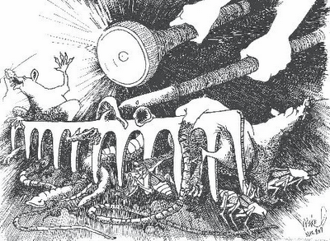

Slide 6

Progressive Authors
Upton Sinclair’s “The Jungle”
Wrote about meat packing plants
This book describes the filthy conditions of stored meat and danger to the workers

Slide 7
The Jungle by Upton Sinclair
“Workers would have to use there bare hands for everything. The workers had no gloves and no sinks. So if the workers really wanted to wash their hands they would have to use the water that was used for washing of the meat. ”
Quote describing parts of the Jungle

Slide 8

Jacob Riis
Author of “How the other half lives”
The book describes the poverty, disease and crime of NY
This was a book that led to public pressure on politicians to make changes

Slide 9
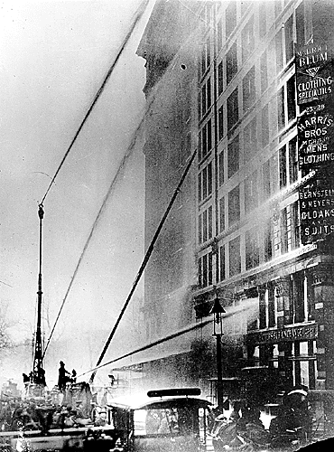
Triangle Shirtwaist Fire
fire engulfed top 3 floors—200 workers trapped on 8th floor
146 people died, mostly teenage girls—smoke inhalation, burned, jumped
3 days to identify bodies
Owners tried for manslaughter—not guilty; no laws to break
Factory opened within weeks

Slide 10
Changes From the Fire
Unions forced owners to take responsibility for workers
Doors opened out, indoor sprinklers and multiple exit became the law
laws established for safety, working conditions, hours, age
people use power of the state to change peoples’ lives

Slide 11
Impact of the Progressive Movement
Reforms in society began to take hold because of the progressives
3 influential presidents; Teddy Roosevelt, William Taft and Woodrow Wilson, pushed and created progressive laws during this time

Slide 12
Bibliography
Some slides provided by Ms. Susan M. Pojer, Horace Greeley HS, Chappaqua, NY
www.pptpalooza.com

