Slide 1
Road to Revolution/ Impact

Slide 2
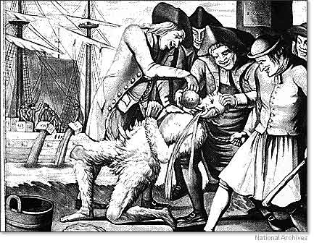
Sons of Liberty
Sons of Liberty: Group that formed to protest the taxes
Samuel Adams: Brother of John, fiery leader of the group
Destroyed British officials homes, tarred and feathered officials those who sold to the British
300 capital crimes: conspiracy to commit treason, robbing a rabbit warren, cutting down a tree, and counterfeiting tax stamps

Slide 3
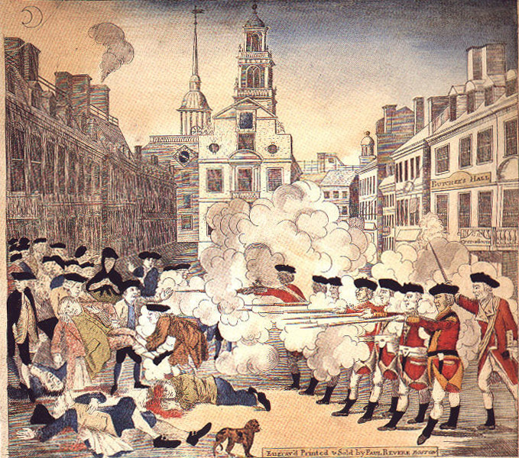
The Boston Massacre (March 5,1770)
Boston had 1 Red coat for every 4 citizens, occupied city; who found extra work
A mob was walking throughout the city angry about the lack of jobs
They ran into a group of British soldiers and began throwing sticks, rocks and snowballs
Crispus Attucks, half black dockworker, was the first shot and killed of the 5
Paul Revere’s engraving memorialized the event and was used as propaganda against the British in the colonies
John Adams represented the British soldiers in the trial b/c he felt all people deserved representation in law

Slide 4
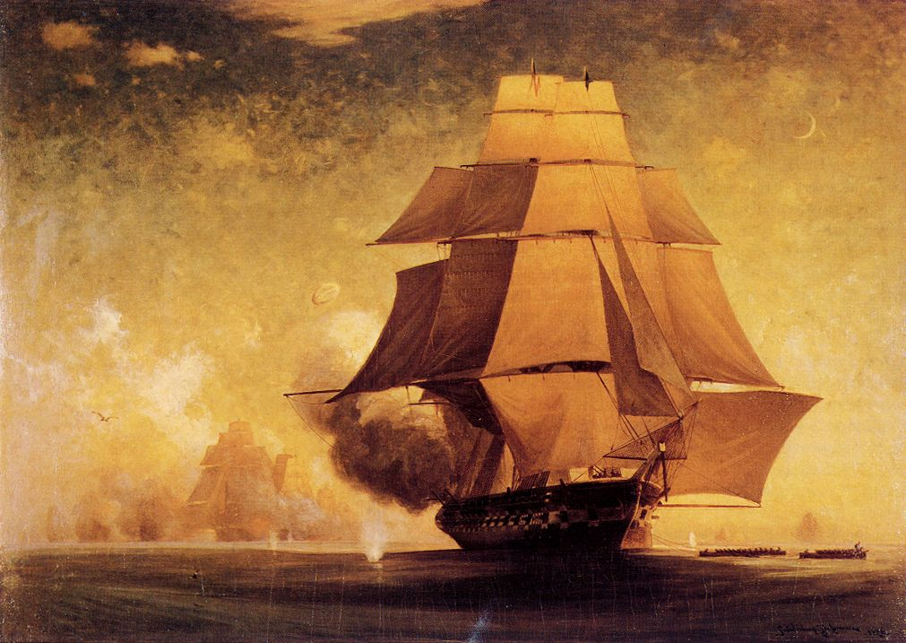
The Gaspee Incident (1772)
The British custom boat Gaspee, went to search a colonial ship for illegal goods
Members of the Sons of Liberty attacked the boat, looted and burned the ship
Providence, RI coast

Slide 5
Taxation Without Representation
“Taxation without representation is tyranny!!!” James Otis
“If these taxes are laid upon us, in any shape without representation where they are laid, are we not reduced to the miserable status of tributary slaves”

Slide 6
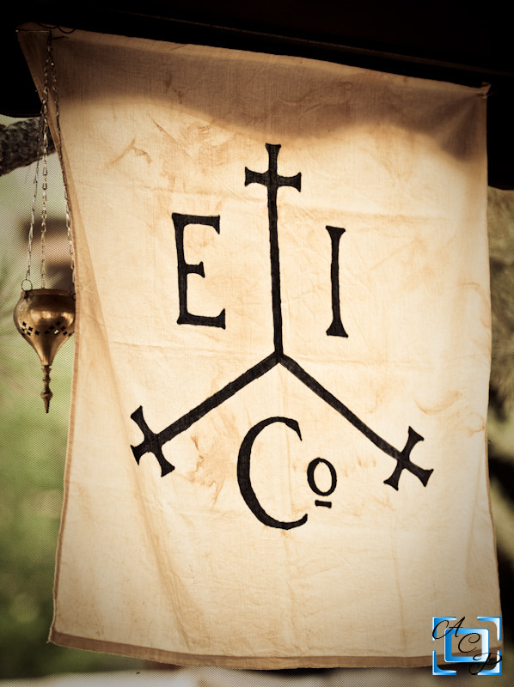
Tea Act (1773)
Tea Act= Said that only the East India Company could sell tea in America
British East India Co.: Largest most powerful company in the world
Monopoly on British tea imports.
Many members of Parl. held shares.
Permitted the Co. to sell tea directly to cols. without col. middlemen (cheaper tea!)

Slide 7
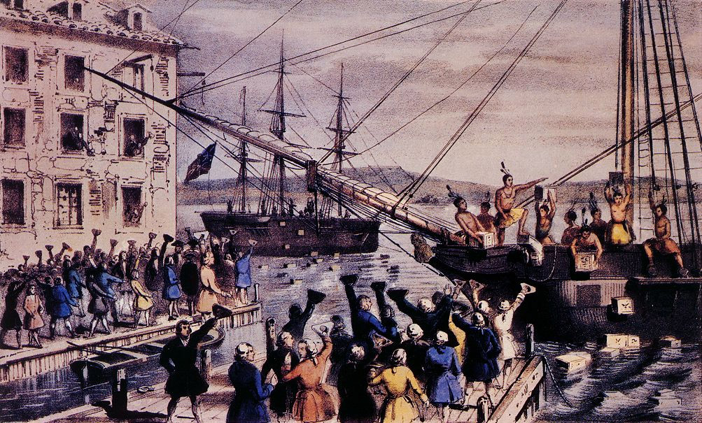
Boston Tea Party (1773)
Protest to the Tea Act
Members dressed as NA, maybe as a sign of respect, and began to through the tea into the harbor
Over $1 million was thrown into the sea

Slide 8
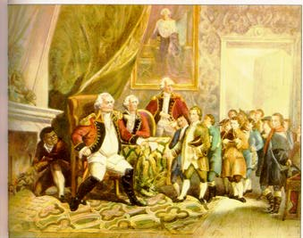
The Coercive or Intolerable Acts (1774)
These acts were passed as punishment for the Tea Party
The closing of Boston harbor, one of the largest/ wealthiest ports in the world
Martial law in the city
Quartering of British troops in Boston
British trials, even for colonists
Lord North

Slide 9
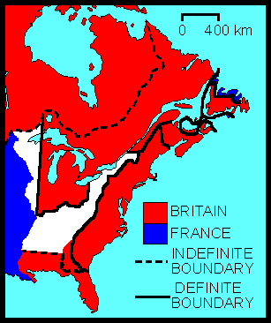
The Quebec Act (1774)
This gave much of the land in the Ohio River Valley to the colony of Quebec
Colonists felt like they were punished b/c it was the same time as Coercive

Slide 10
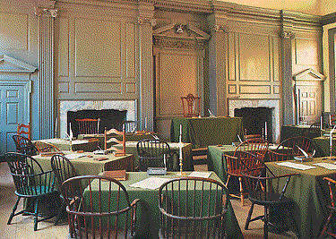
First Continental Congress (1774)
55 delegates from 12 colonies
Agenda → How to respond to the Coercive Acts & the Quebec Act?
1 vote per colony represented.

Slide 11
1st Continental Congress, 1774
  This was a meeting over the anger of the colonists b/c of the British’s Intolerable acts and the Boston Massacre
  Many viewed this as the Crown’s attempt to destroy the liberties of the colonists and limit expansion
  Results of the 1st Continental Congress
    Denounced the treatment of Massachusetts
    Declared the Intolerable Acts void
    Pushed the colonies to beginning raising a militia
    Organized a boycott of British goods and export trade to Britain
    The delegates agreed to meet in 1775- 2nd Con. Congress

Slide 12
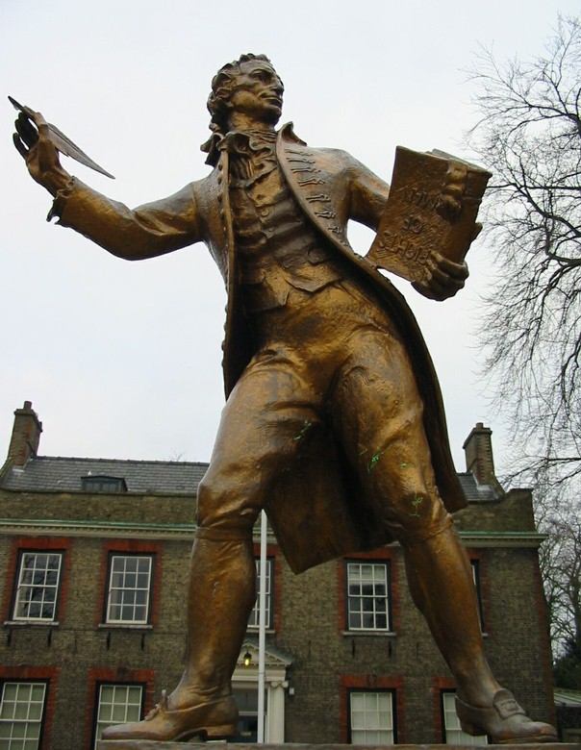
Thomas Paine: Common Sense
Writer of the essay Common Sense, that urged the independence of the colonies from Britain
  Island ruling a continent is un-natural
  The king is 3,000 miles away, how can he understand what we need
  We are them (British) and not even the beasts eat their young
He also wrote the American Crisis, which was read by even more people than Common sense

Slide 13
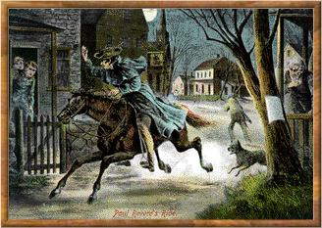
The Red Coats Are Coming!
(April 18, 1775)
Paul Revere & William Dawes make their midnight ride to warn the Minutemen of approaching British soldiers.

Slide 14
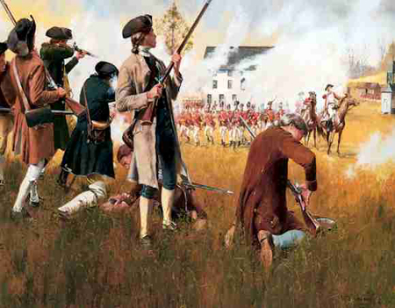
The Shot Heard ’Round the World!
UK sent troops to capture rebel munitions and leaders, like John Hancock and S. Adams
1/3rd of Mass. men between 16- 50 were ready to bear arms at a “minutes” notice
The townspeople had stored supplies/ weapons and were prepared to fight after Revere
Rebels opened fire as they marched to Lexington, and then retreated to Concord, hit and run again there
This was the first battle of the Revolutionary war
Lexington & Concord, Mass. – April 18,1775

Slide 15
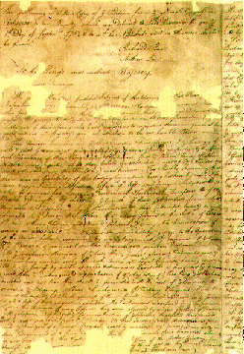
The Second Continental Congress
(May, 1775)
After Lex/Con, the colonists were trying to decide what to do next
The possible war was the main issue, as many of the loyalists fought to stay with the Brits
OBP= Last attempt at a peaceful solution, but neither side really wanted this
Demanded the repeal of the acts/ taxes by the King
When the king refused the colonists felt that the only choice was war
They also made Washington the commander of the army
Olive Branch Petition

Slide 16
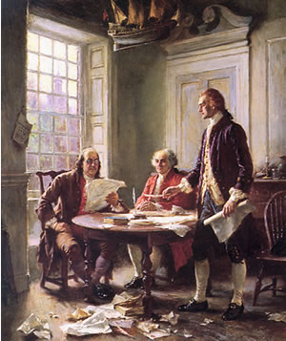
Declaration of Independence (1776)

Slide 17
List of grievances/ complaints
The Declaration said that all people have equal rights given by God and protected by the government
The government should be servants of the people
Finally when the government becomes unjust the people can revolt

Slide 18
Complaints against England!
1) Taken away our Representative Government
2) Made it difficult to become a citizen and purchase land
3) Kept a standing army in the colonies
4) Quartered troops
5) Changed our laws
6) Cut off our trade
7) Taxation without Representation
8) Took away our Trial by Jury
9) Started rebellions
10) Refused to discuss these complaints with us

Slide 19
Advantages Comparison
British
American
Better industry/ manufacturing
Experienced, organized military
NA alliances from the French and Indian war
Large treasury
Vastly superior navy
They were fighting for their homes
Much shorter supply lines
Superior rifles (more accurate)
Familiar with the territory
The British did not use the Tories effectively
Ability to gain foreign support

Slide 20
Issues w/ Colonial Government
Government could not levy taxes (state taxes), no central army until 1780
Forced to ask the states for money, soldiers (state militias)
Soldiers would only fight for their state and many left to farm, fighting in the winter
They would fight for 90 days, then go home
Desertion was high b/c they could walk home and be with family
1777 US offered land (NW territory) to those who fight
Con. Congress took away land from the loyalists and gave it to some soldiers
The states would not work with each other
No navy against the world’s best
US needed foreign aid, France and Spain wanted to help to weaken the UK
SP/FR smuggled $ and soldiers to avoid getting dragged into the war

Slide 21
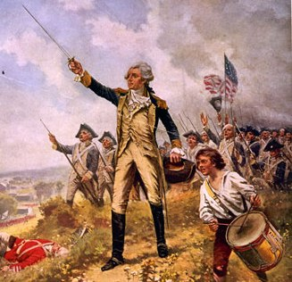
Saratoga
French- His descendants fought in the Crusades, w/ Joan of Arc
Born into a wealthy family, his father died in the 7 years war, died fighting the British
No military command, never fired upon, and didn’t speak English
Good friends with Washington, Father/son attitude toward each other
Following Valley Forge- Washington sent Lafayette to France for aid, which he got
Saratoga- The battle was the turning point of the war, US began to win, instead of lose
Also, the open support of the French for the US
Marquis de Lafayette

Slide 22
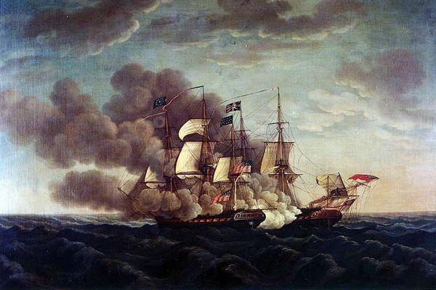
Yorktown
The last major battle of the Revolution
Cornwallis, new British general, needed more troops after costly victories in the south
British strategy of capturing cities (Europe) but only 10% of US lived in the city
He tried to get the reinforcements from Yorktown port
French navy blocked the British navy from helping Cornwallis
Washington and the French navy sieged, or shelled, Cornwallis into submission
After the defeat at Yorktown, the British felt that the war was too costly
The British government surrendered after the defeat at Yorktown, ending the 6 year war

Slide 23
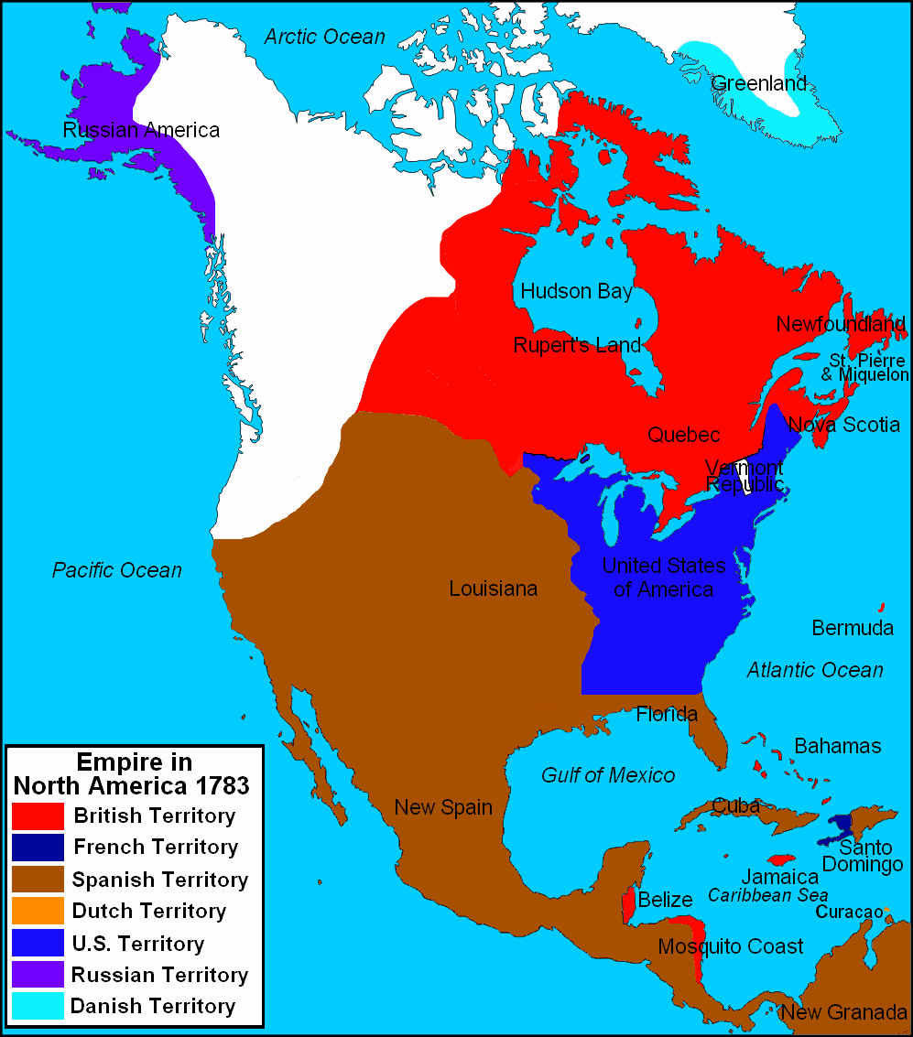
Treaty of Paris, 1783
Peace terms took 2 years to complete, J. Adams, J. Jay and B. Franklin- Key US figures
The US was recognized as an independent nation by the world, set boundaries
US must pay $100,000 to the UK for 7 years war debt
All British troops were withdrawn from American soil but many stay in Ohio terr. (NW territory)
Many loyalists (Tories) fled to Canada or British held Caribbean islands

