Slide 1
Richard M. Nixon

Slide 2
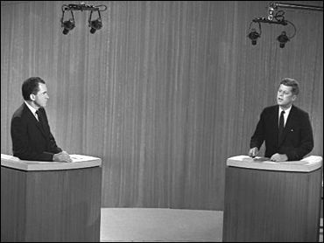
Background
He grew up in a lower class family
He was picked on in school and never really got over it
Nixon became a politician after serving in WWII
Presidential election between JFK and Nixon in 1960

Slide 3
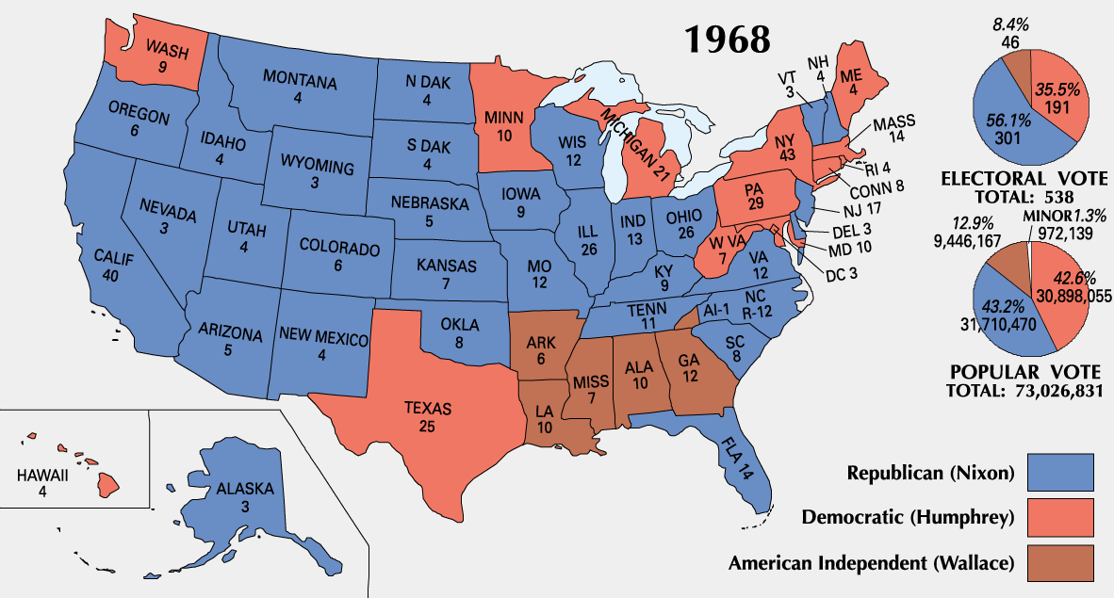
Election of 1968
It was a wrenching national experience, conducted against a backdrop that included the assassination of civil rights leader Martin Luther King, Jr. and subsequent race riots across the nation, the assassination of presidential candidate Robert F. Kennedy, widespread demonstrations against the Vietnam War across American university and college campuses, and violent confrontations between police and anti-war protesters at the 1968 Democratic National Convention.

Slide 4
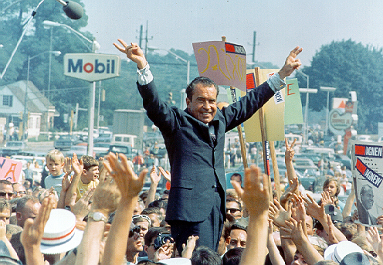
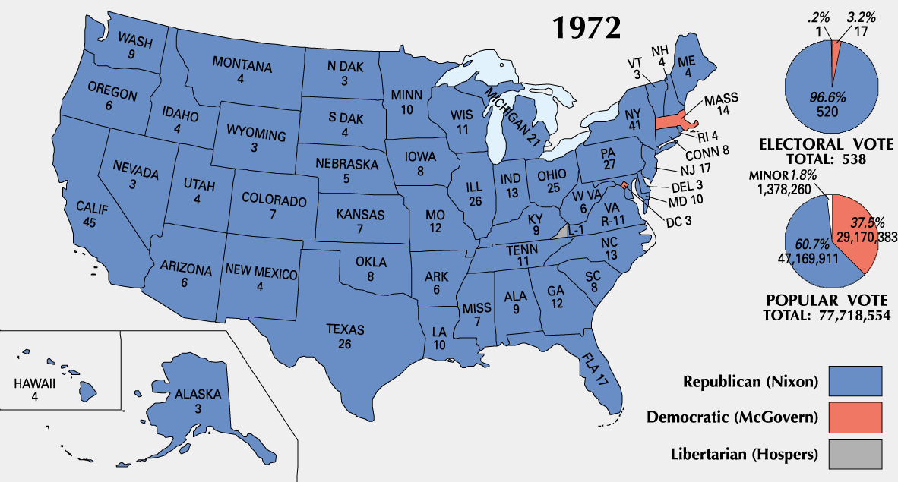
Silent Majority

Slide 5
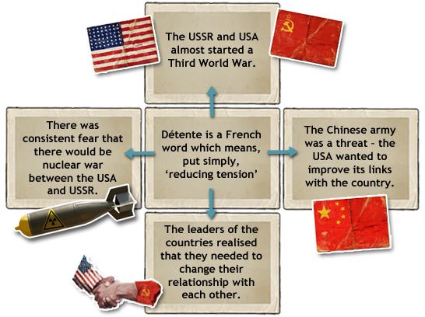
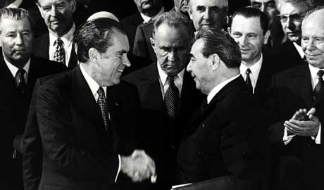
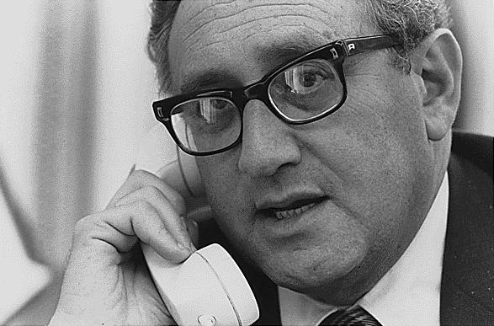
Détente
Nixon and USSR’s Brezhnev
Henry Kissinger

Slide 6
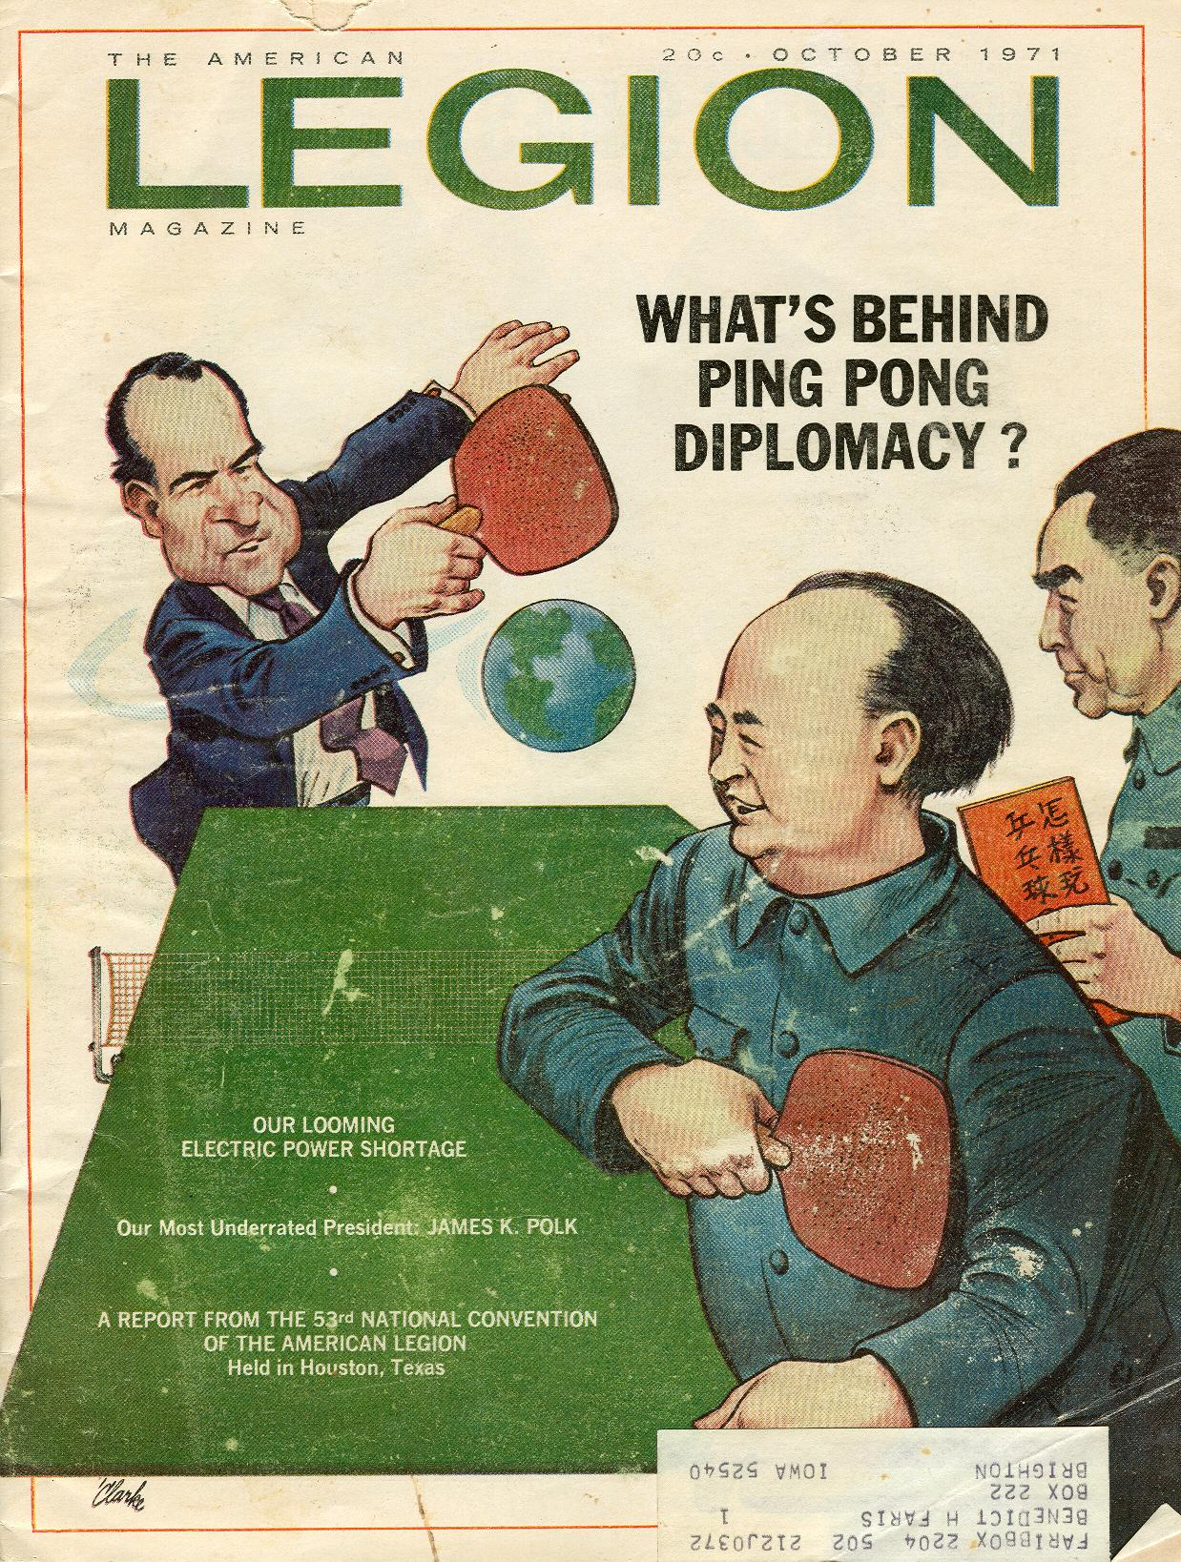
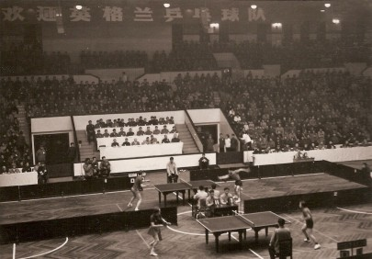
Ping Pong Diplomacy

Slide 7
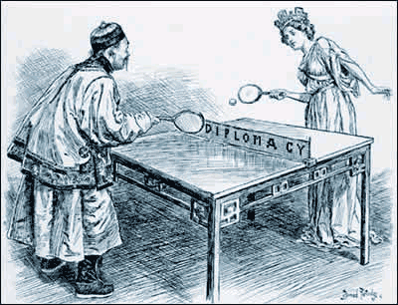
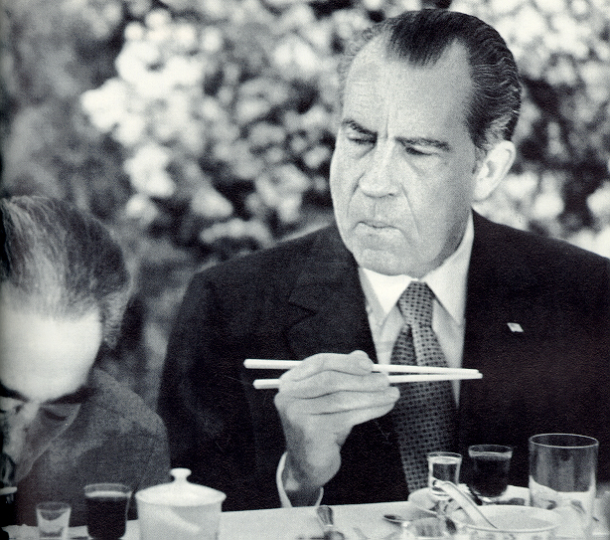
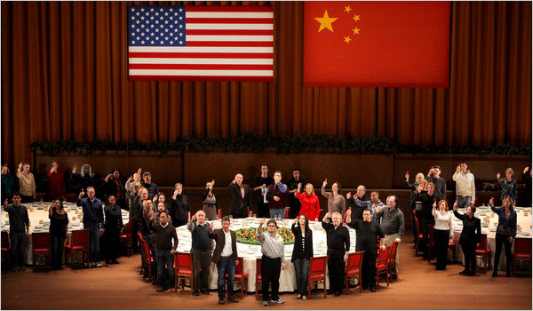
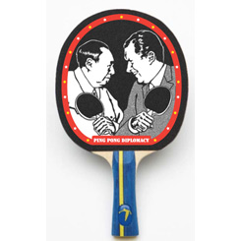

Slide 8
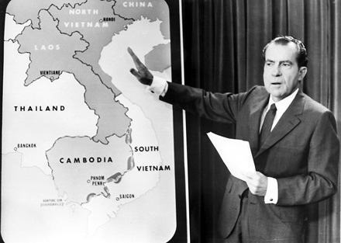
Vietnamization
Vietnamization= Process of gradual withdrawal of US troops from S. Vietnam
However, he extended the bombings to Cambodia

Slide 9
The Pentagon Papers
The Pentagon Papers was the name given to a secret Department of Defense study of U.S. political and military involvement in Vietnam from 1945 to 1967
As the Vietnam War dragged on and the U.S. military presence in South Vietnam increased to more than 500,000 troops by 1968, the military analyst Daniel Ellsberg (who had worked on the study) came to oppose the war, and decided that the information contained in the Pentagon Papers should be more widely available to the American public.
He secretly photocopied the report and in March 1971 gave the copy to The New York Times, which subsequently published a series of articles based on the report’s findings.
The Nixon administration tried to block the publication but it was too late.

Slide 10
The Pentagon Papers
In addition to publication in the newspapers, portions of the Pentagon Papers entered the public record when Senator Mike Gravel of Alaska, an outspoken critic of the Vietnam War, read them aloud in a Senate subcommittee hearing.
These portions revealed that the presidential administrations of Harry S. Truman, Dwight D. Eisenhower, John F. Kennedy and Lyndon B. Johnson had all misled the public about the degree of U.S. involvement in Vietnam, from Truman’s decision to give military aid to France during its struggle against the communist-led Viet Minh to Johnson’s development of plans to escalate the war in Vietnam as early as 1964, even as he claimed the opposite during that year’s presidential election.

Slide 11
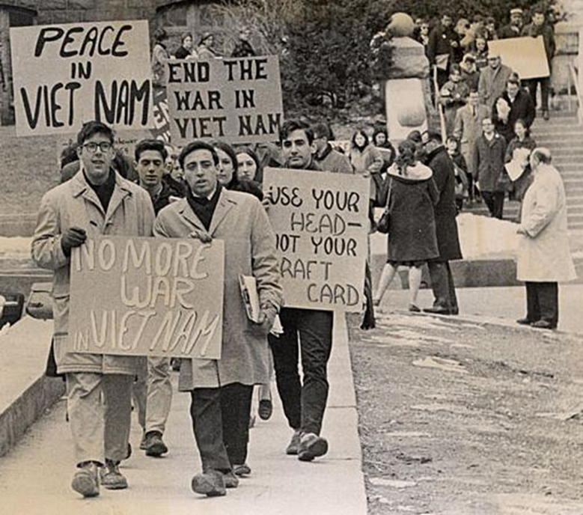
The “New Left”- Protest Movement
  Baby boom= Almost 59% of the US was 34 years old or younger
  Huge increase in college students 3.1- 5 million between 1960- 66, mostly white, middle-upper class students

Slide 12
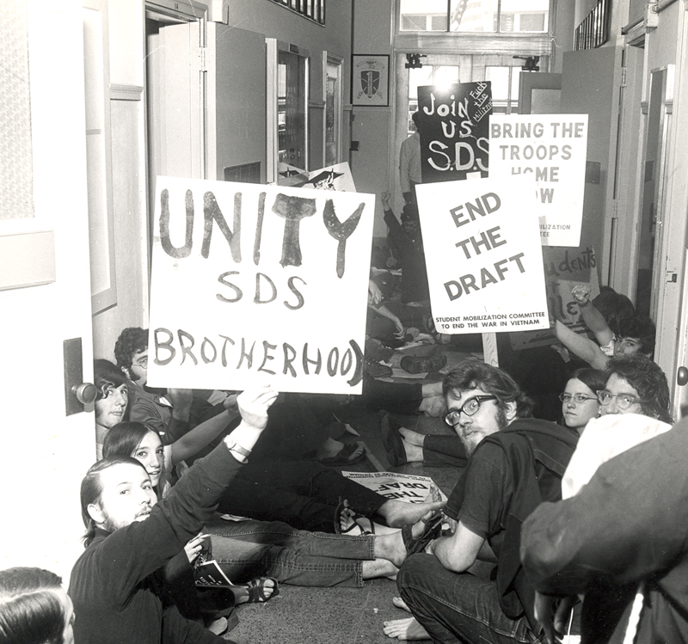
The “New Left”- Protest Movement
New left= Social issues, not communism. Protests for better America, freedom of speech…
SDS, or Students for a Democratic Society
Protested for the end of wars, freedom of speech, poverty, reduction of nuclear weapons…

Slide 13
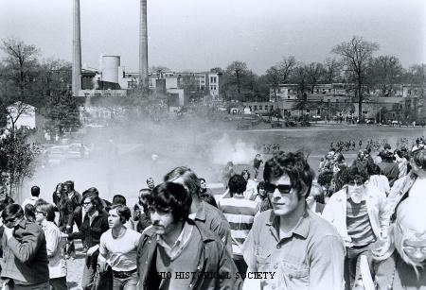

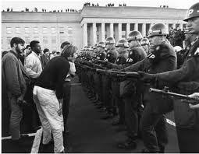
Student protest against invasion of Cambodia and that troops were sent in to destroy VC base in Cambodia
The students broke into and took over one of the administration buildings, so the Ohio National Guard was called to end the protest

Slide 14
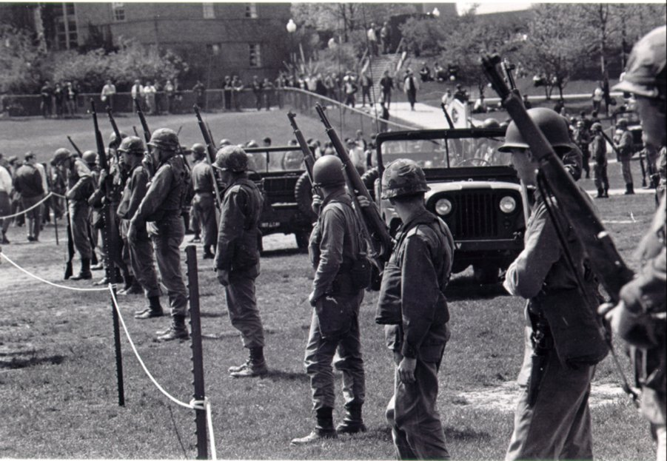

Slide 15
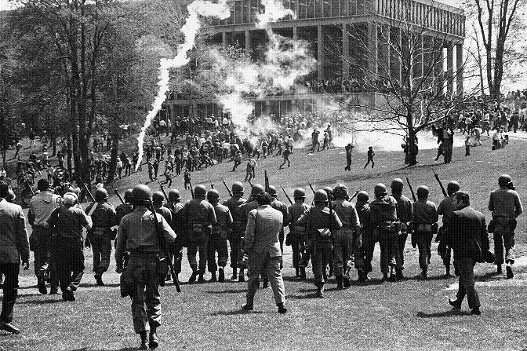
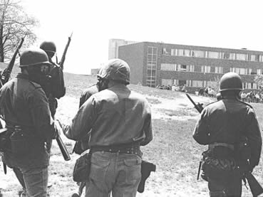

Slide 16
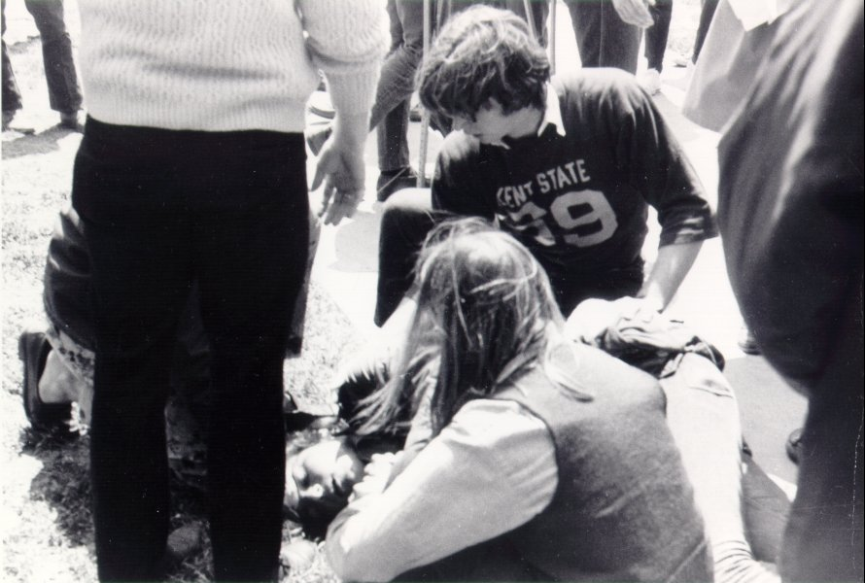
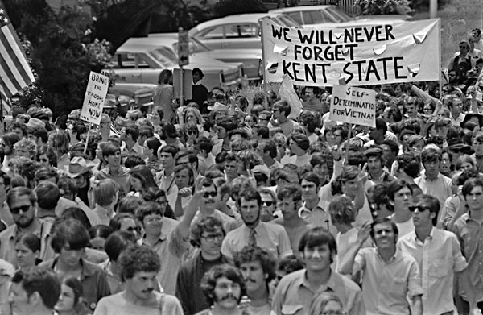
During an altercation on May 4, twenty-eight guardsmen opened fire on a crowd, killing four students and wounding nine.
Following the killings, the unrest across the country escalated even further.
Almost five hundred colleges were shut down or disrupted by protests.

Slide 17
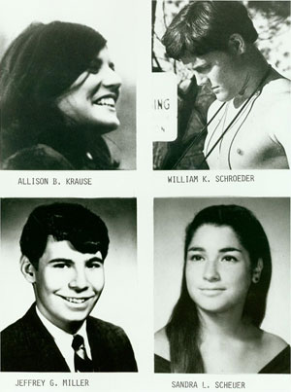
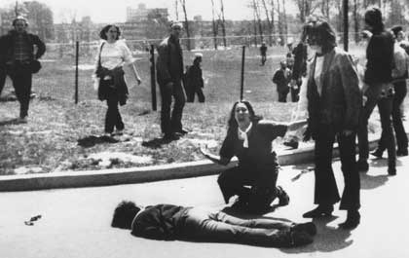
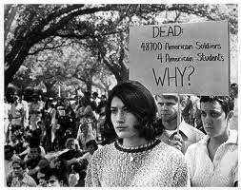

Slide 18
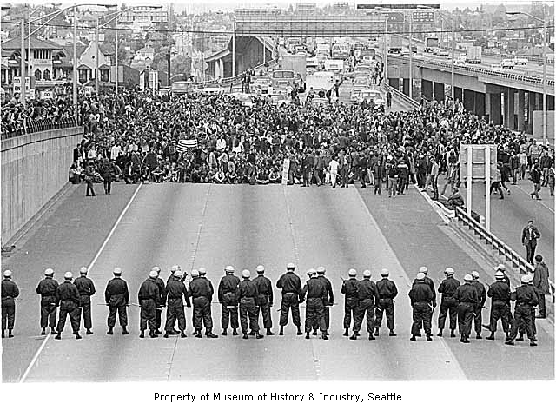
Protests following the Kent State shooting

Slide 19
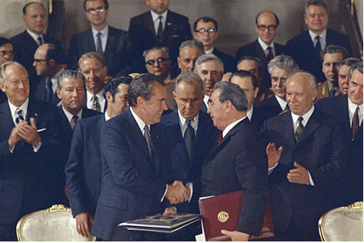
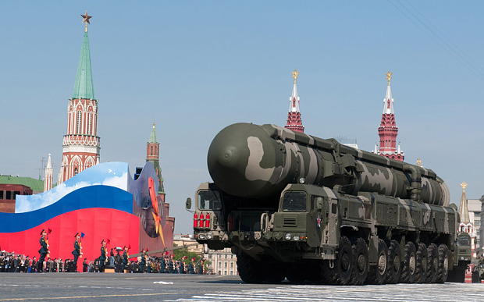
SALT
(Strategic Arms Limitation Treaty)
The US and USSR pledge to not test nuclear in the atmosphere
Reduction of nuclear arms production
Today, the US and Russia have 90% of the nuclear arms in the world

Slide 20
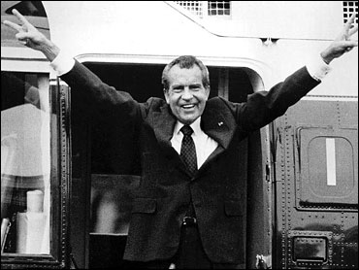
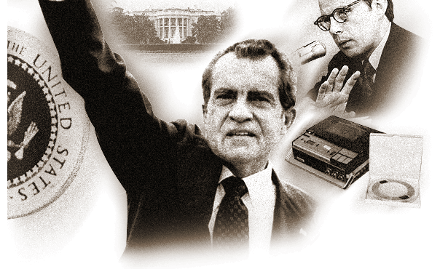
Watergate
Nixon sent 5 men to break into the Democratic National Committee (DNC)
They were caught trying to steal and spy on the DNC
He wins re-election (1972) by over 60%

Slide 21
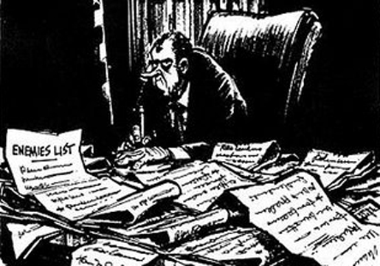
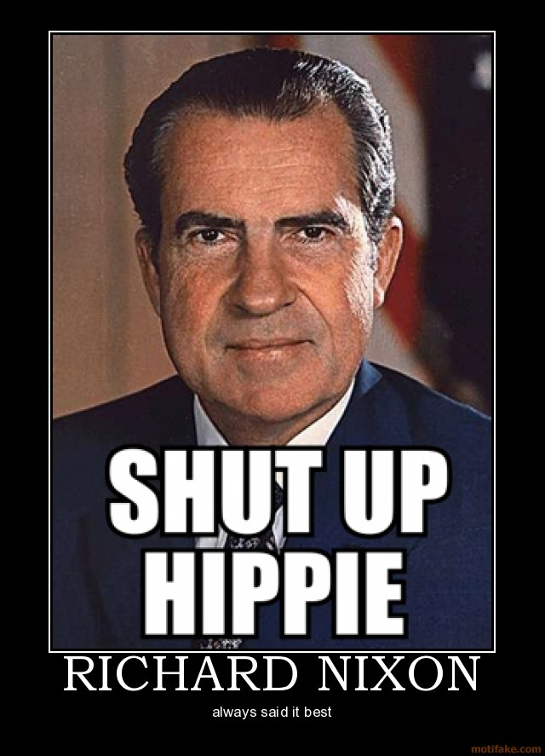
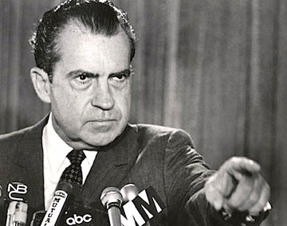

Slide 22
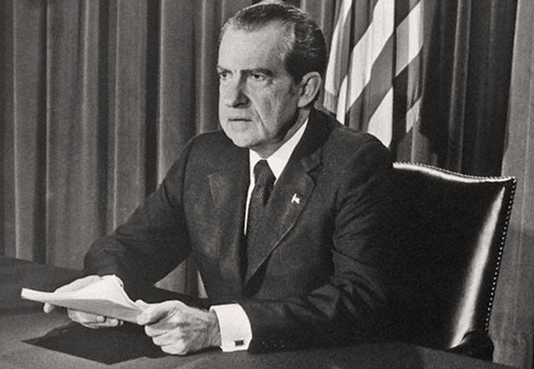
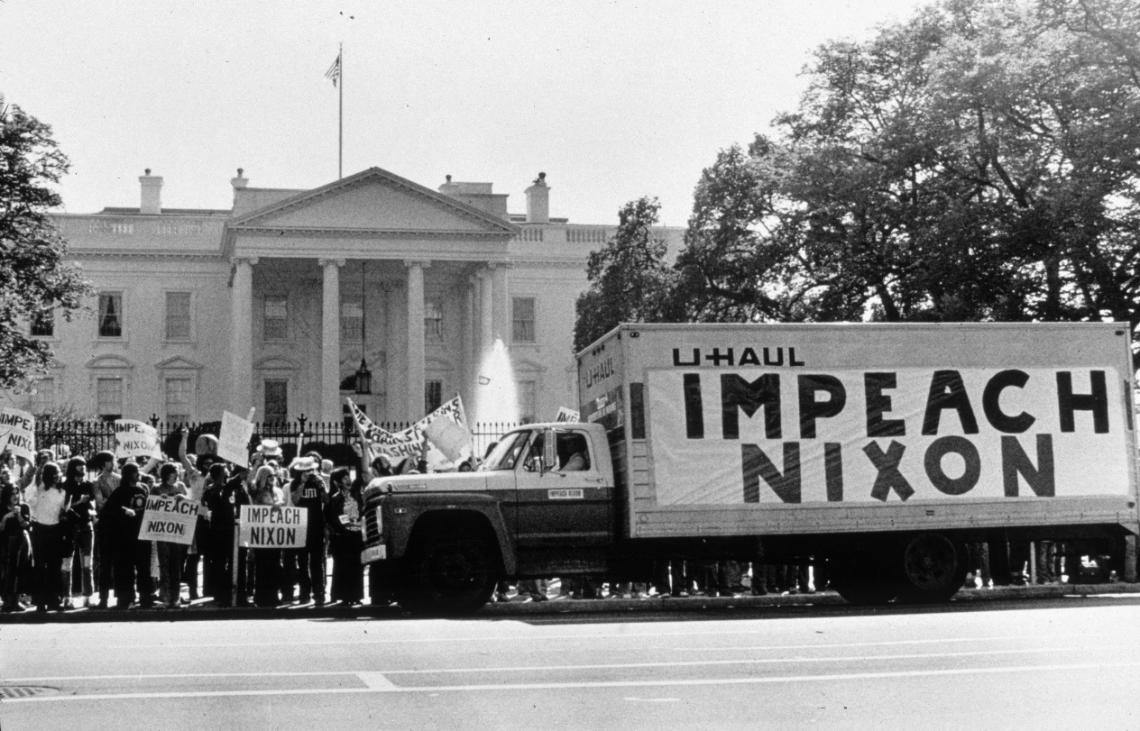
The Watergate Fallout
The media began to attack Nixon for his involvement
It was revealed that Nixon had been taping people in the White House
The Supreme Court rules that Nixon must turn over the tapes

Slide 23
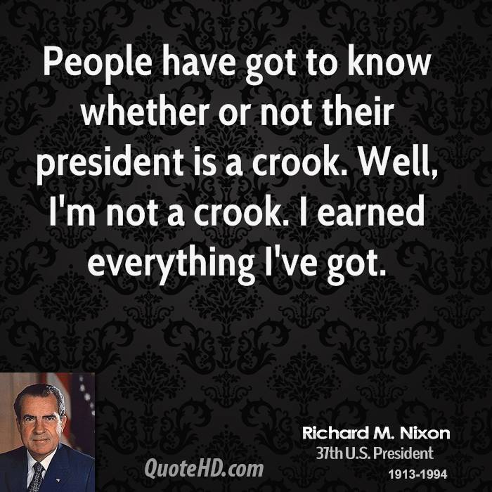
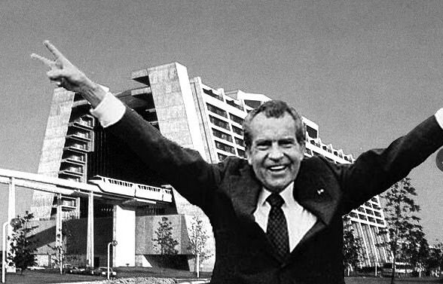

Slide 24
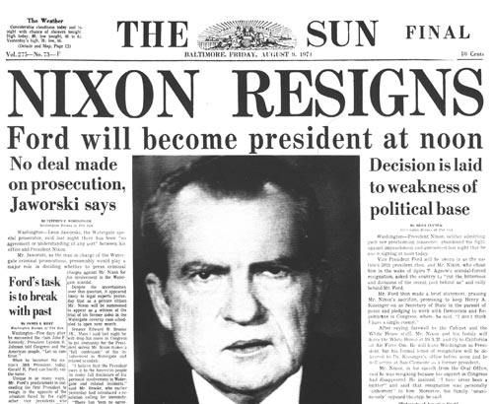
Nixon Resigns
Nixon attempts to destroy the tapes
The Senate passes articles of impeachment
Nixon resigns from office before the impeachment and the probable conviction

Slide 25
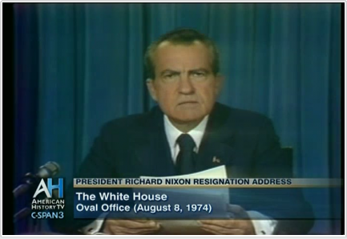
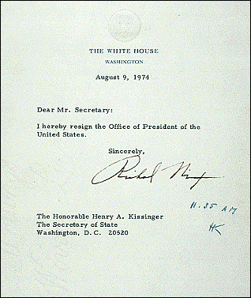
You won't have Nixon to kick around anymore, because, gentlemen, this is my last press conference.
  Richard Nixon after his resignation

Slide 26
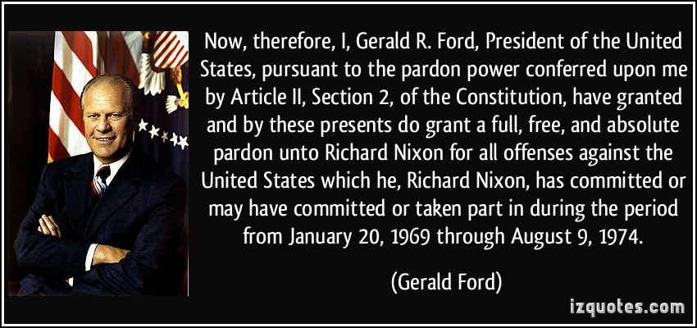
“I know I will go to Hell because I pardoned Richard Nixon.”
- Gerald Ford

