Slide 1
Causes of the Civil War- Review

Slide 2
The Factory System
Movement from man/ animal power to machine power, led to the beginning of real cities in the US; Example= Cotton Gin
Power Loom= Northern profits from the Southern cotton- raw cotton in, finished cloth out
Allowed for spinning and weaving under one roof
Factory owners would put work clocks in the building- change from the sun to clock
Francis Lowell; Lowell, Mass. large industrial city, population go up 20,000 in 15 years
1/3rd of the town worked in the factory, 85% single women 15-25 yrs. Old
For many this was their 1st time out of the house, $2 a day
Increase in factories= increased demand for immigrant labor
Factory conditions began during this period led to the Progressive movement 60 years later in an effort to change the worst of the conditions

Slide 3
Sectionalism
Definition- Devotion to the interests of the state and needs of a state or region, rather than the nation
This created a strong division, both economically and politically, between the North and the South

Slide 4
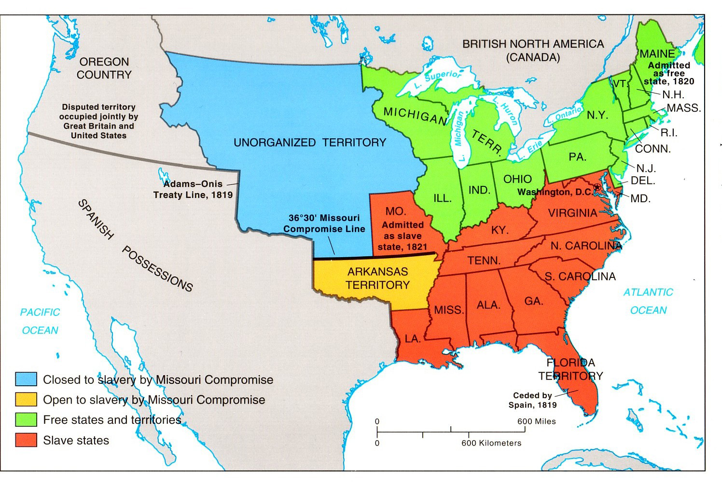
The Missouri Compromise,
1820

Slide 5
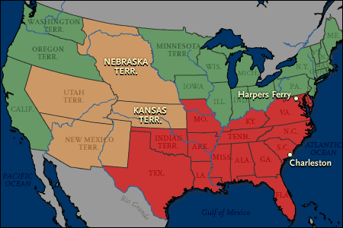
Sectionalism Maps
Wilmot Proviso, 1846- Barring slavery from all new territories

Slide 6
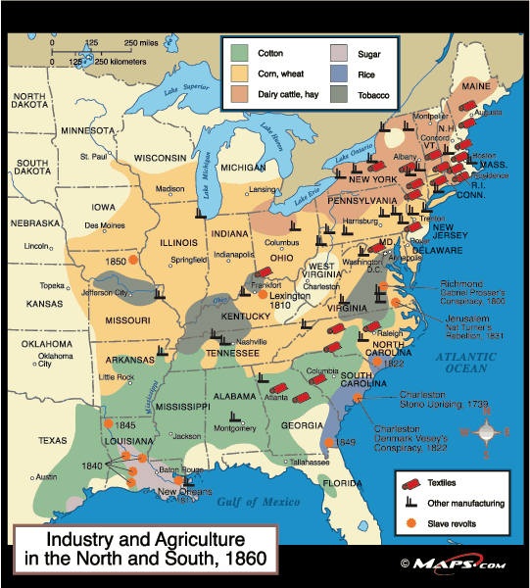
Sectionalism Maps
Sectionalism
Wilmot Proviso- David Wilmot wrote an law prohibiting slavery in all new states
Passed the House but was defeated by the Southern votes of the Senate
Calhoun led the group that argued that the Congress had no right to prohibit slavery, and the Missouri Compromise was wrong
By 1835, cotton had replaced rice and tobacco as #1 crop in Southern agriculture
Between 1820- 1860, the # of slaves grew from 1.5 to 4 million
Higher demand= more cost, $500 to $1500 for a skilled slave hand

Slide 7
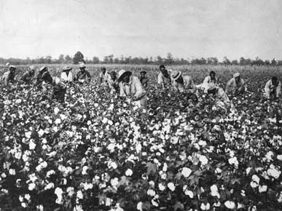
The Plantation System
In 1860, ½ of the population of 9 million people living in the South was a slave or a family member of a slave holding family
But less than 1/3rd owned slaves, however many Southerners believed that they had the potential of getting slaves/ becoming rich
Yomen farmers= Self-sustaining farmers, sometimes rent slaves
Plantations varied in size of several hundred to several thousand acres and were very profitable
These plantation could own 100s of slaves, with a large variety of crops
Jackson had over 100 and Washington had 300+
One major negative about the production of cotton is that the crop will destroy the land
The destruction of the land fueled the demand for more lands out west

Slide 8
Southern Defense of Slavery
  Most of the founding Fathers saw slavery as a necessary evil that would naturally fade away based on economics
  However, there was a shift before the Civil War from that to the Benevolent Master
  Many Southerners saw the system as beneficial to the slaves, b/c they get clothes, food…
  Known as the Positive Good theory, they need us b/c they are weaker

Slide 9
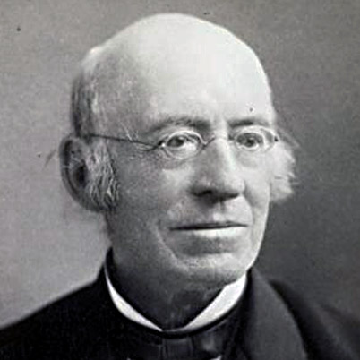
Anti-Slavery Movement
During and after the Revolutionary War, several groups formed
Most argued on the moral grounds b/c the southern economy was not as strong as it was in the 1850-60s
1816, American Colonization Society was to purchase the freedom of more than 1400 slaves and ship the freed slaves to Liberia- Monroevia named after James Monroe, b/c he was president at the time
Most abolitionists did not believe in equality but separate communities, Lincoln
Abolitionist movement leaders- White: William Lloyd Garrison, Black: David Walker, Henry Garnet
William Lloyd Garrison

Slide 10
Compromise of 1850
In 1850, there was a debate over the application of California as a free state.
The Compromise of 1850:
  California is admitted as a free state
  Mexican Cession was split into 2 territories: Utah and New Mexico
  A stricter Fugitive Slave Law was passed compelling states to cooperate with federal officials in the capturing and returning of runaway slaves

Slide 11
Impact of the Compromise of 1850
  The status of slavery was clearly established by law
  State officials cannot help federal officials- Northern nullification of Southern law
  The nation avoided war for a time and both sides were OK w/ the deal
  Debate was put aside; future issues still there, Utah and New Mexico?

Slide 12
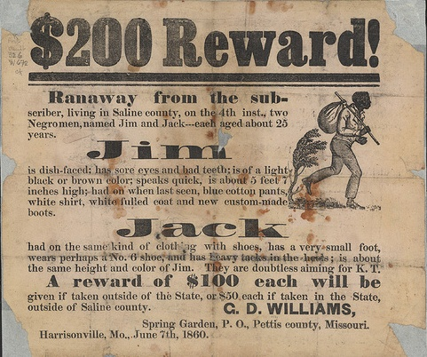
Fugitive Slave Law, 1850
1,000 slaves a year successfully run away
This law eliminated all rights freed blacks had; most that were taken were never slaves
Judges were paid $10 for sending slaves “back” to the South, $5 to release them
Those who refused to assist slave-catchers, or aided fugitives, could be fined up to $1,000 and jailed for six months.
Relations between North and South were strained by the underground RR and the Southern practice of taking Freed blacks to make up for escaped slaves

Slide 13
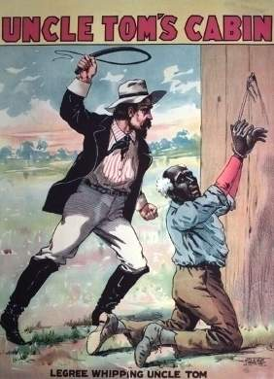
Uncle Tom’s Cabin- 1852, Harriet Beecher Stowe
This book was written in a response to the Fugitive Slave Act
Uncle Tom's Cabin was a runaway best-seller, selling 10,000 copies in the United States in its first week; 300,000 in the first year; and in Great Britain, 1.5 million copies in one year.
Only the Bible sold more copies that year
The main character, a slave named Tom, helps several groups of slaves runaway/ hide but in the end is whipped to death by his owner
"I would write something that would make this whole nation feel what an accursed thing slavery is.“
- Harriett Beecher Stowe

Slide 14
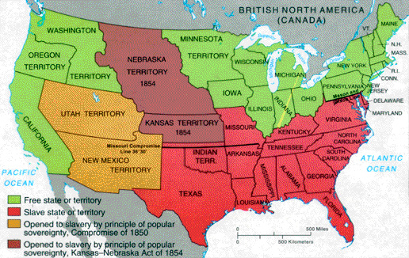
Kansas Nebraska Act, 1854

Slide 15
Kansas- Nebraska Act
Both groups were unhappy with the Compromise of 1850; South- CA as free state, North- Harsh Fugitive Slave laws
This act reopened the slavery debate- introduced by Sen. Steven Douglas and narrowly passed the Congress
Douglas threatened Pierce to back the bill or he would make his presidency a hell
He wanted popular sovereignty in the West, but he thought the N states would not allow slaves anyway, people in Neb. Won’t support slavery
He gives the South something (pop. sov.) in return for RR hub through Chicago
The Act abolished the Missouri Compromise, divided Kansas and Nebraska into 2 terr. and allowed those states to decide on slavery
Both Kansas and Nebraska were above the 36’30”
Northerners felt betrayed and angry b/c the issue was reopened, and Douglas is trying to move slavery into the territories

Slide 16
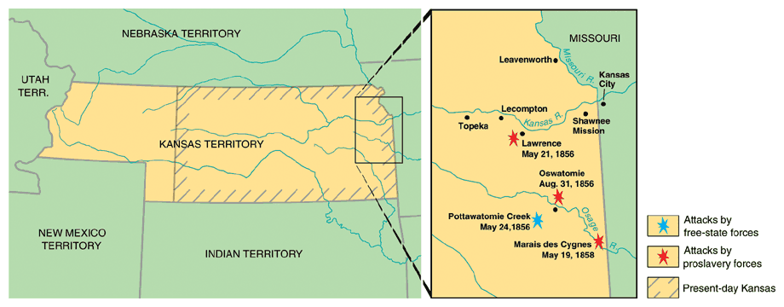
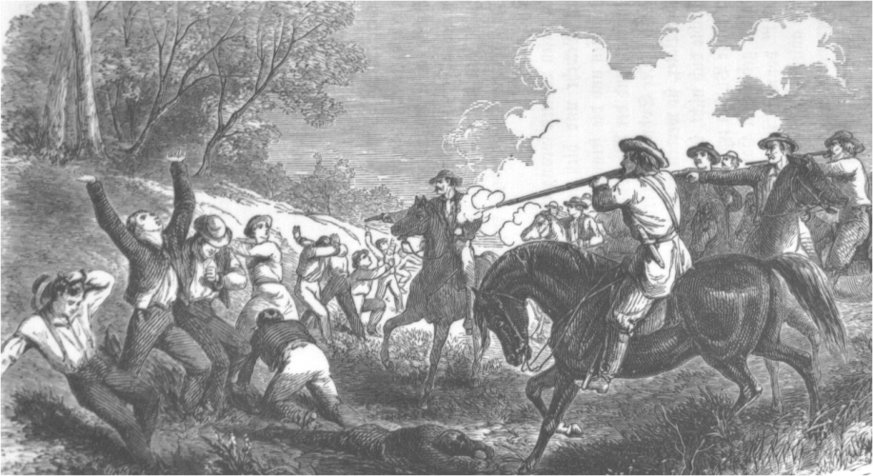
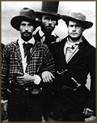
“Bleeding Kansas”
Border “Ruffians”
(pro-slavery Missourians)

Slide 17
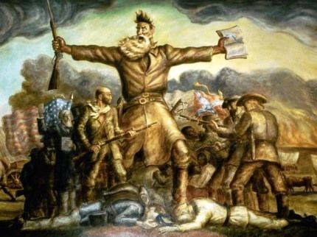
Bleeding Kansas
Direct result of the Kan/ Neb act, it put the states at war with itself
Abolitionists building were burned
Over 200 were killed in the conflict, John Brown killed 5 random people in a slave town, with a sword

Slide 18
John Brown
Pottawatomie Creek
Hours before heading out on a raid against pro-slavery men, Se. Charles Sumner was brutally attacked on the US Senate floor by a southern Congressman
He almost died, “The Crime against Kansas” speech provoked it
On the night of May 24, 1856, Brown and his sons raided cabins in Franklin County, Kansas; Pottawatomie Creek had several pro-slavery sympathizers
James Doyle and his family (3) were home
J. Brown and his group hacked them to death with swords; split heads, cut off arms
Brown went to 2 more houses and dragged out their homes and killed them (5 total)
Oct. 16, 1859 John Brown and 3 of his sons and 15 followers (white/ black) attacked the federal arsenal at Harper’s Ferry, Virginia
The goal was to get weapons for a slave revolt
The group took several hostages, including a relative of Washington
No slaves rose up to join the rebellion and the group was stuck after the locals attacked them
Robert E. Lee led the Marines to capture Brown and 8 men who survived the assault
Within 36 hours of the attack, most of Brown's men had been killed or captured

